Slide 1
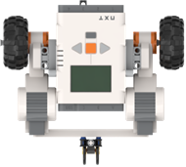
Notional Robot Relay Finals Arena
Robot 4 (LF)
Robot 3 (OA)
Robot 1 (LF)
Extinguish Flame
Robot 2 (WF)

