Slide 1
Embedded Control
Week 4 (7/20/11)

Slide 2
Week 4
15:00 – Lecture
  Inductors
  Brushed DC motors
  H-bridges
16:00 – Lab
  Brushed DC motor control

Slide 3
Inductance
Voltage generated through a wire as a function of the change in current
  Magnetic field generated perpendicular to the wire
  Coiled wire (wrapped around a magnetic core) concentrates the magnetic field
N
N
N
S
N
S
N
N
S
S
S
S

Slide 4
Inductors
Create voltage proportional to the change in current
  Copper wire wrapped around an iron core
  Produce a magnetic field as a function of the change in current
  Measured in Henries (H)
  Inductance is directly proportional to voltage and inversely proportional to the change in current

Slide 5
Networks of Inductors
Series configuration
  Total inductance is the sum of each individual inductance
  Total inductance is always greater than that of any individual inductor
Parallel configuration
  Total inductance is the inverse of the sum of the inverse-inductance of each individual inductor
  Total inductance is always less than that of any individual inductor

Slide 6
Coupled Inductors
Changes in current produce magnetic fields and vice versa
  Coupled inductors share a looped magnetic core
  Used in voltage transformer circuits
    Voltage is directly proportional to the number of turns of the wire

Slide 7
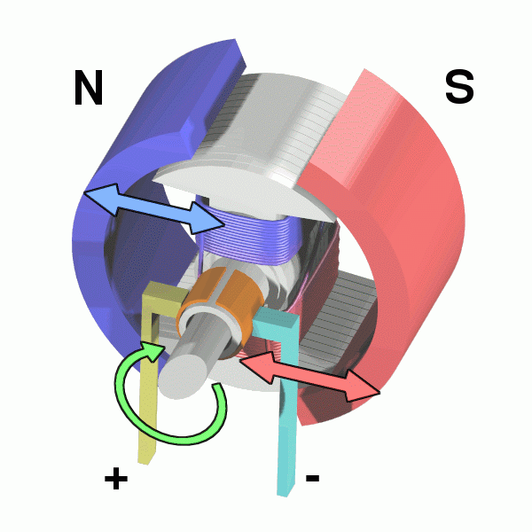
Brushed DC Motors
Converts electrical energy to rotational mechanical energy
Components
  Concave magnets
    North and south polarity
  Armature
    Copper wire wound around an iron core connected to the output shaft which spins freely
  Commutator
    Contact brushes that reverse the direction of current for every half-turn of the armature
http://en.wikipedia.org/wiki/File:Electric_motor.gif

Slide 8
H-Bridges
Circuits that uses switches to reverse the direction of the current
Vcc
Vcc
Vcc
Vcc
M
+
M
+
M
+
M
+
Circuit is open; motor is free to rotate in either direction
Diagonal switches (top right, bottom left) are closed; motor spins in positive (CCW) direction
Diagonal switches (top left, bottom right) are closed; motor spins in negative (CW) direction
Bottom switches are closed; motor terminals are grounded, which stops motor

Slide 9
Direction Control (Transistor H-Bridges)
Vcc
Action | B3 | B2 | B1 | B0
Free rotation | 1 | 0 | 1 | 0
Forward | 1 | 1 | 0 | 0
Backward | 0 | 0 | 1 | 1
Brake | 1 | 1 | 1 | 1
1kΩ
1kΩ
B3
B
B
B1
C
E
C
E
M
+
1kΩ
1kΩ
B2
B
B
B0
E
C
E
C
Vcc
Transistors act as electronic switches which can be controlled by the digital output of a microcontroller and can direct the flow of current in the circuit with little current applied to the base of each transistor
1kΩ
1kΩ
B3
B
B
B1
C
E
C
E
M
+
1kΩ
1kΩ
B2
B
B
B0
E
C
E
C
http://www.robotroom.com/BipolarHBridge.html

Slide 10
Lab
Brushed DC Motor Control
  Building and controlling a brushed DC motor using an H-bridge circuit and the NXT Sensor Expansion Kit

Slide 11
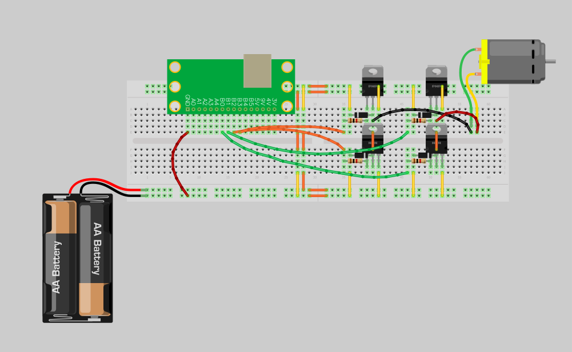
Transistor H-Bridge
Part | Name | Value
Resistor | R1 | 1kΩ
 | R2 | 1kΩ
 | R3 | 1kΩ
 | R4 | 1kΩ
Transistor | T1 | PNP
 | T2 | PNP
 | T3 | NPN
 | T4 | NPN
Diode | D1 | Power
 | D2 | Power
 | D3 | Power
 | D4 | Power
Motor | M1 | Brushed
Battery | P1 | 9V
T1
P1
T2
R1
R2
B3
B
D1
D2
B
B1
C
E
M1
C
E
M
+
T3
T4
R3
R4
B2
B
B
B0
E
C
D3
D4
E
C

Slide 12
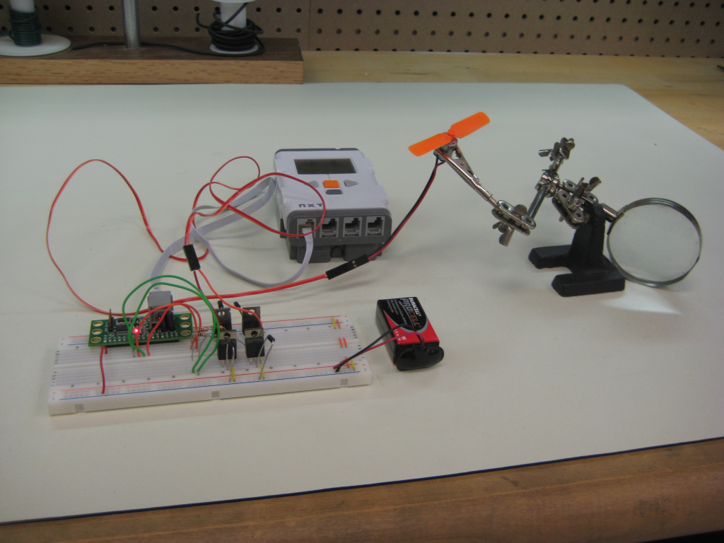
Lab Setup
Brushed DC motor
NXT
Wire holder
Proto-board
9V Battery and plug
H-Bridge

Slide 13
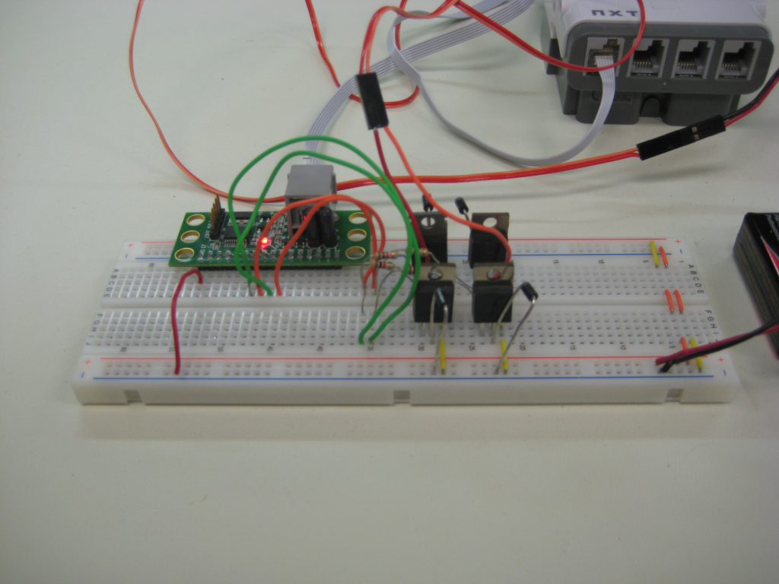
Circuit
PNP
Bridge both power and ground rails
Connect the proto-board GND pin to common ground
NPN
9V Battery and plug

Slide 14
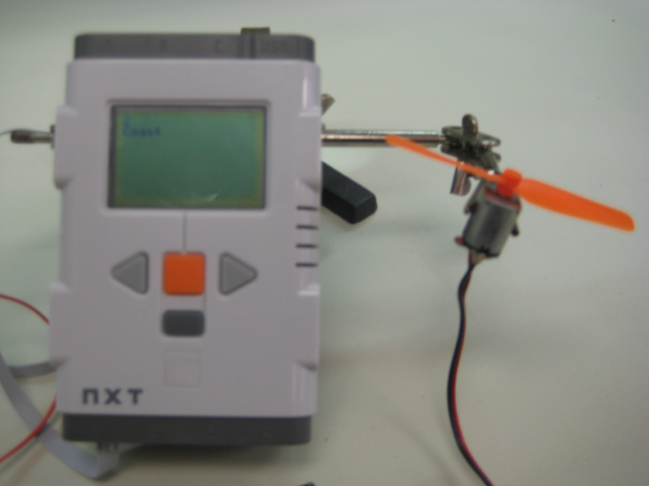
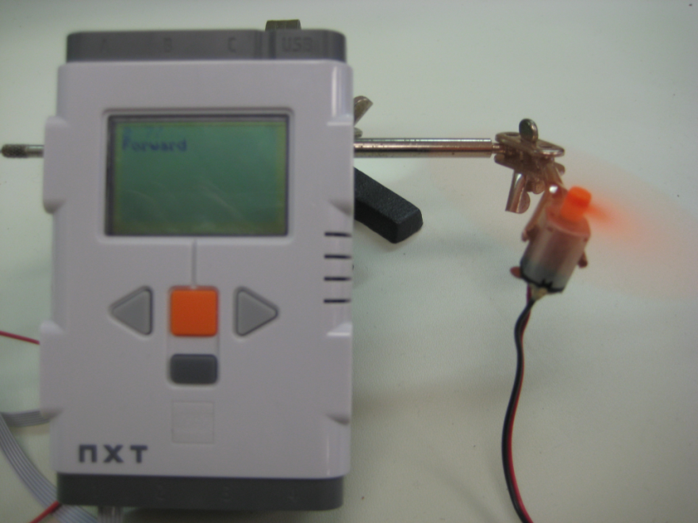
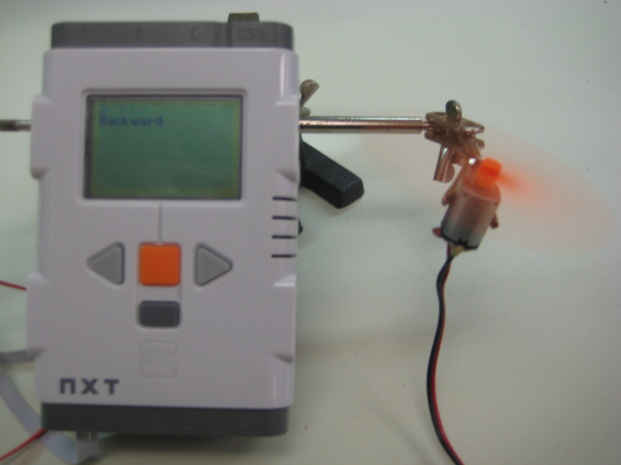
Output
Press the center button □ to let the motor spin freely
Press the left button < to drive the motor forward
Press the right button > to drive the motor backward

