Slide 1
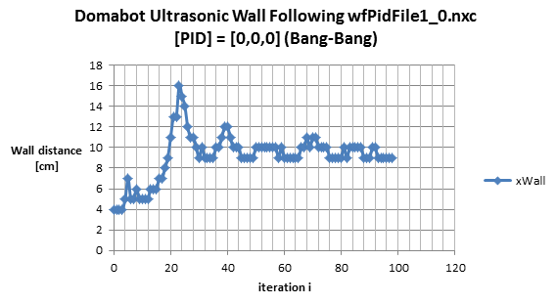
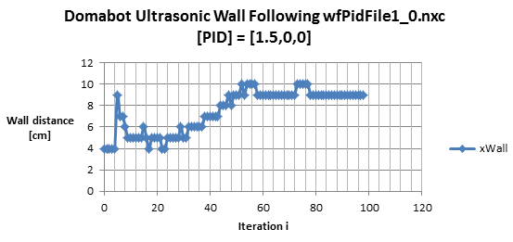

Slide 2
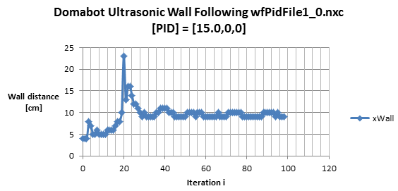
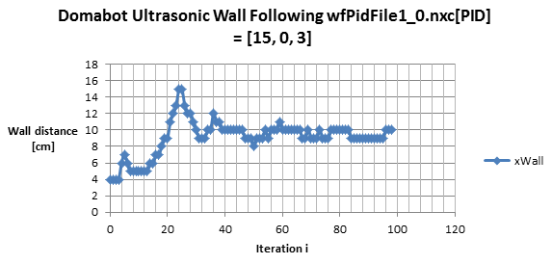

Slide 3
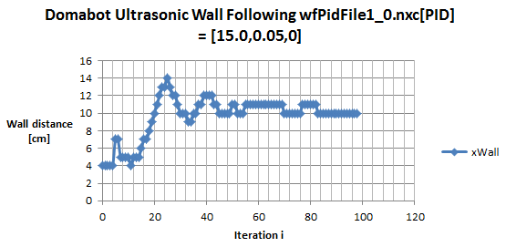

Slide 4
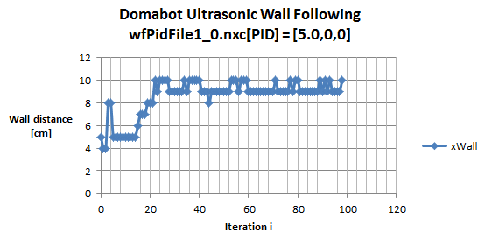
Plots of P-only control performance and steady-state error
P gain | Rise time
1.5 | ~52
5 | ~24
15 | ~20
Reduced rise time with P-only control suggest that Domabot is not a 1st order system. If it was 1st order, the I don’t think the rise time would reduce as P-gain increases. Also, I don’t think we’d see overshoot (kP = 15).
Perhaps Domabot already has an integrator in it.
kP = 5 has better rise time than kP = 1.5 and benefit of not overshooting. But there’s oscillations in the steady-state error

Slide 5
