Slide 1
lectureWallFollowingDomabotBangBangAndProportionalControl-102722a.pptx
Lego NXT Domabot Wall-Following
Bang-Bang and Proportional Control
Copyright Paul Oh, 2022 ©

Slide 2
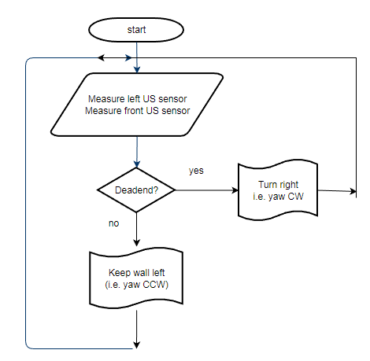
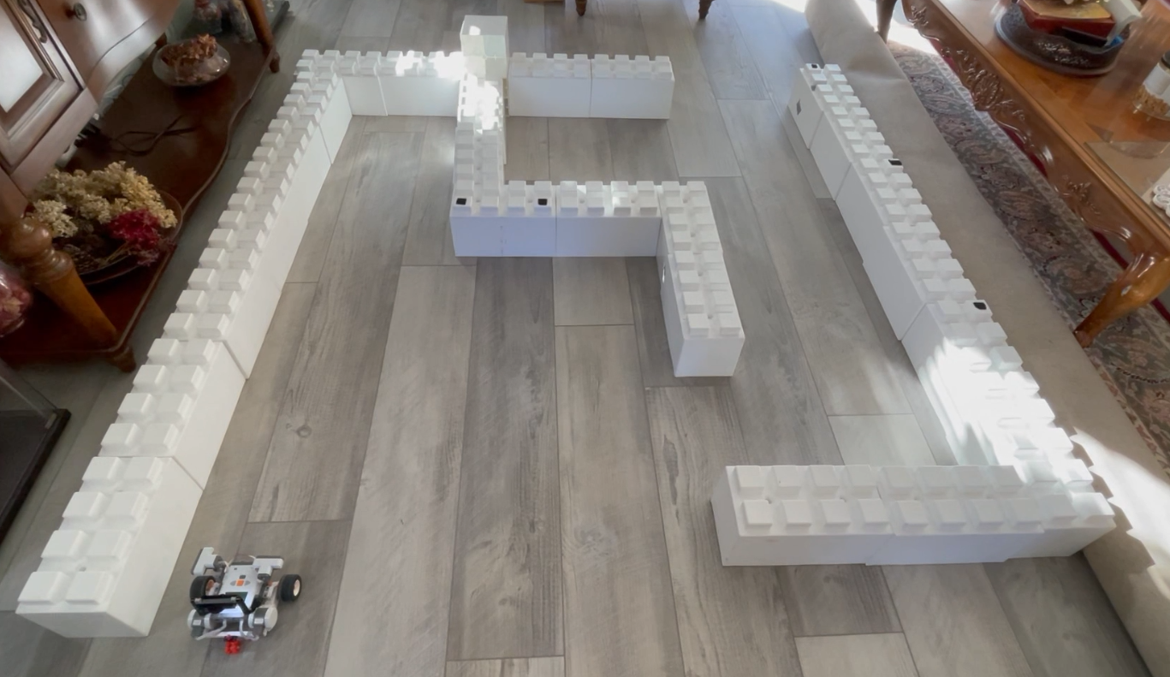
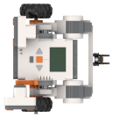
Motivation:
Finding paths to complete a maze. Google Maps begins this way
Solution:
(1) Always hug the wall left of the robot; (2) Turn right if there’s an obstacle

Slide 3
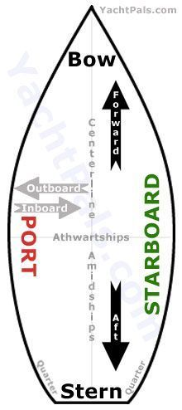
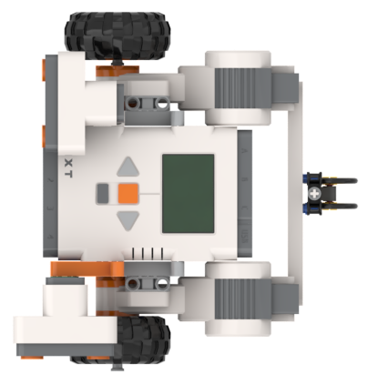
Implementation: Part 1 (wall-following)
First, we need an algorithm to keep the robot’s portside a fixed distance from the wall. Like line-following, one uses closed-loop feedback e.g. bang-bang, Proportional, or PID
Q1: What portside-to-wall distance to use?
Turn radius = 160/2 = 80 mm
Tight CCW yaw:
  Rotate around body center (black circle)
  Motor A = speed and Motor C = -speed
Wide CCW yaw:
Rotate about wheel
Motor A = speed and Motor C = 0
Motor C
Motor A
20 studs = 20*8 = 160 mm
Thus, a 10 cm portside-to-wall distance is possible with tight yaws

Slide 4
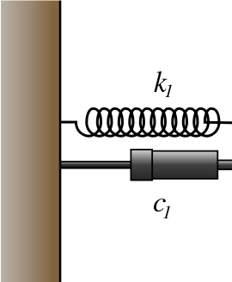
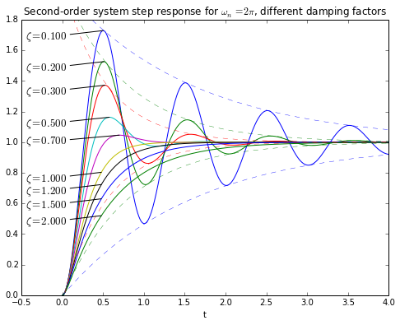
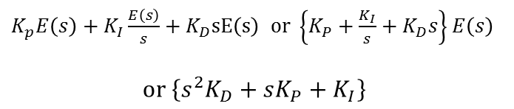
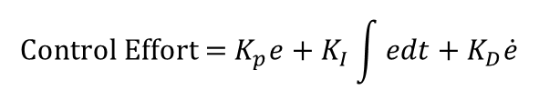
Q2. Which closed-loop control to use?
Line-following experience contrasts bang-bang and proportional control. Both oscillate but the latter does so less. Why?
Conceptually, PID acts like a mass-spring-damper on the error
$$\text{Control} \text{Effort}\text{ = }K_{p}e+K_{I}\int{edt}+K_{D}\dot{e}$$
$K_{p}E\left(s\right)+K_{I}\frac{E\left(s\right)}{s}+K_{D}sE\left(s\right)$ $\text{or} \left\{K_{P}+\frac{K_{I}}{s}+K_{D}s\right\}E\left(s\right)$
$$\text{or} \left\{s^{2}K_{D}+sK_{P}+K_{I}\right\}$$
In other words, the form is a 2nd order system
Selection of PID gains can increase performance (i.e. reduce rise time) and/or stability (i.e. steady-state error, undershoot, overshoot)

