Slide 1
lectureLineFollowingDomabotBangBangAndProportionalControl-093022a.pptx
Lego NXT Domabot Line-Following
Bang-Bang and Proportional Control
Copyright Paul Oh, 2022 ©

Slide 2
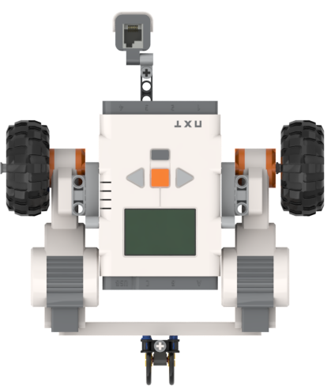
What’s Really Happening
Black line’s right-edge
Whiter part of mat
Zoom In
Left
Port C
Right
Port A
Light sensor reports intensity (not color)
Sensor traces outer edge of black line
Thus, reported values will change as sensor traces line

Slide 3
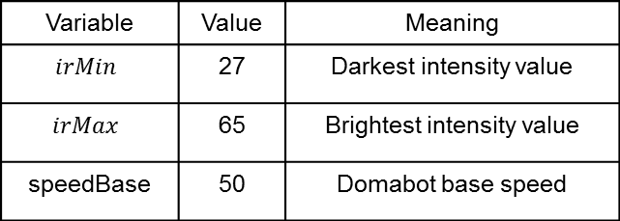

Bang-Bang Control
Approach: Find a threshold value. When irValue > irThresh then yaw CCW (towards black)
Yaw CW (thus towards whiter part) by moving Left Motor (C) and Stopping Right Motor (A)
Yaw CCW (thus towards darker part) by moving Right Motor (A) and Stopping Left Motor (C)
Suppose
29 | 30 | 31 | 32 | 33 | 34 | 35 | 36 | 37 | 38 | 39 | 40 | 41 | 42 | 43 | 44 | 45 | 46 | 47 | 48 | 49 | 50 | 51 | 52 | 53 | 54 | 55 | 56 | 57 | 58 | 59 | 60 | 61 | 62 | 63 | 64 | 65
Variable | Value | Meaning
$$irMin$$ | 27 | Darkest intensity value
$$irMax$$ | 65 | Brightest intensity value
speedBase | 50 | Domabot base speed
$$\text{irThresh} ≜\frac{\text{irMax}\text{−}\text{irMin}}{2}= \frac{65+29}{2}=47$$

Slide 4
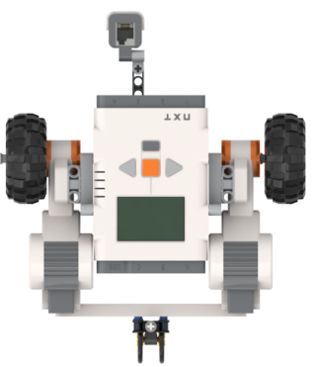
Pseudocode for calibrating and computing irThresh
Set timer for 2 seconds;
// Step 1 - Yaw CCW slowly
Forward Right Motor slowly;
Reverse Left Motor slowly;
While (current time < 2 seconds){
Read irValue; // read light sensor value
if irValue > irMax
irMax = irValue;
if irValue < irMin
irMin = irValue;
} // end while
Set timer for 3 seconds;
// Step 2 - Yaw CW slowly
Forward Left Motor slowly;
Reverse Right Motor slowly;
While (current time < 3 seconds){
Read irValue; // read light sensor value
if irValue > irMax
irMax = irValue;
if irValue < irMin
irMin = irValue;
} // end while
// Yawing CW and CCW results in min and max values
// Step 3 – Display values and calculations
irThresh = (irMin + irMax) / 2; // i.e. mid-point
Display min, max, and threshold values
Hit Right Arrow to continue
Step 1:
Sensor on outermost part of black line i.e. (A)
Start yawing CCW
Right
Port A
Left
Port C
Right
Port A
Left
Port C
(A) Initial position
(B) CCW Yaw finished
Step 2:
Now sensor somewhere on black line i.e. (B)
Start yawing CW i.e. (C)
Right
Port A
Left
Port C
Left
Port C
Right
Port A
(B) CCW Yaw finished
(C) CW Yaw finished

Slide 5
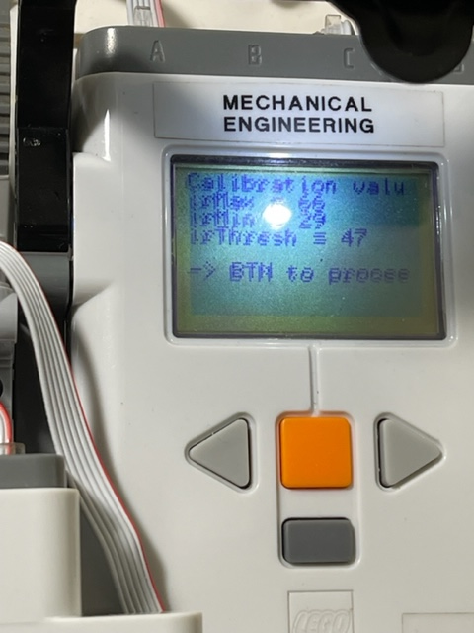
Pseudocode for bang-bang line following
Step 3:
Display results
Set timer for 2 seconds;
// Step 4 – Domabot may have yawed onto white
// Yaw CCW again, towards outermost black edge
Forward Right Motor slowly;
Reverse Left Motor slowly;
Read irValue;
While (irValue > irThresh){ // still in whitish area
Read irValue; // read light sensor value
} // end while
// Step 5 – Domabot back on outermost edge of black line
// Start Bang-Bang line following
do {
Check if user hit left arrow button to quit;
Read irValue;
if irValue > irThresh { // then sensor on whitish part
speed = speedBase; // so right motor forward
Forward Right Motor at speed;
Stop Left Motor;
};
if irValue <= irThresh { // then sensor on blackish part
speed = speedBase; // so left motor forward
Forward Left Motor at speed;
Stop Right Motor;
};
} while (left arrow button not pushed)
// Step 6 – User hit Left Arrow Button
Turn off Left and Right motors;
Play Sound
Stop all tasks
Step 4:
Sensor might have yawed onto white area i.e. (D)
Start yawing CCW until at outermost black edge i.e. (E)
Left
Port C
Left
Port C
Right
Port A
Right
Port A
(D) Start yawing CCW
(E) Domabot at edge
Begin Domabot bang-bang

Slide 6



Proportional Control
Yaw CW (thus towards whiter part) by moving Left Motor (C) and Stopping Right Motor (A)
Yaw CCW (thus towards darker part) by moving Right Motor (A) and Stopping Left Motor (C)
29 | 30 | 31 | 32 | 33 | 34 | 35 | 36 | 37 | 38 | 39 | 40 | 41 | 42 | 43 | 44 | 45 | 46 | 47 | 48 | 49 | 50 | 51 | 52 | 53 | 54 | 55 | 56 | 57 | 58 | 59 | 60 | 61 | 62 | 63 | 64 | 65
$$\text{irThresh}\text{ =}\frac{\text{irMax}\text{−}\text{irMin}}{2}= \frac{65+29}{2}=47$$
Yaw CW (rightward)
Turn
Yaw CW (rightward)
Turn
Turn
Turn right
$$47+\frac{65−47}{2}=47+9=56$$
Go Straight
Go Straight
irValue
56
irValue
irValue
29
47
65
29
38
47
65
29
47
65
$47−\frac{65−47}{2}=47−9=$38
Yaw CCW (leftward)
Yaw CCW (leftward)
Turn left
Bang-Bang: 2 regions
(Yaw CW or CCW)
3 regions
(Yaw CW, Go Straight, Yaw CCW)
Proportional: Infinite Regions

Slide 7
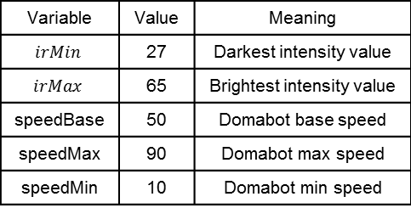
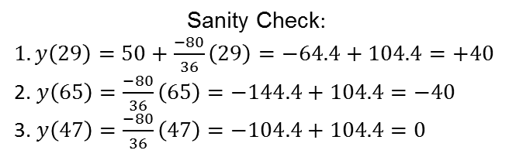


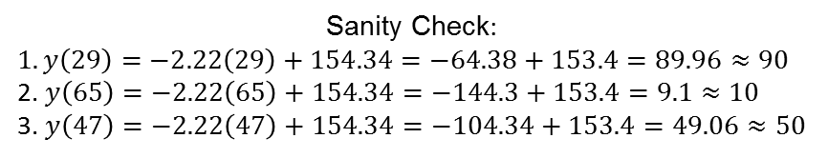
Normalize the graph
y = Speed
Variable | Value | Meaning
$$irMin$$ | 27 | Darkest intensity value
$$irMax$$ | 65 | Brightest intensity value
speedBase | 50 | Domabot base speed
speedMax | 90 | Domabot max speed
speedMin | 10 | Domabot min speed
Turn right
+90
(Max speed to add is 40)
Go Straight
speedBase = 50
(Max speed to subtract is 40)
10
Turn left
0
Blackest
29
47
65
100
Whitest
x = irValue
Sanity Check:
$1. y\left(29\right)=50+\frac{−80}{36}\left(29\right)=−64.4+104.4=+40$
2. $y\left(65\right)=\frac{−80}{36}\left(65\right)=−144.4+104.4=−40$
3. $y\left(47\right)=\frac{−80}{36}\left(47\right)=−104.4+104.4=0$
$$\text{Slope} m=\frac{10−(90)}{65−29}=\frac{−80}{36}=−2.22$$
Equation of a Line is $y\left(x\right)=mx+b \text{thus} b=y\left(x\right)−mx$
Hence $b=50−\left(−2.22∙47\right)=50+104.34=154.34$
Sanity Check:
$1. y\left(29\right)=−2.22\left(29\right)+154.34=−64.38+153.4=89.96≈90$
2. $y\left(65\right)=−2.22\left(65\right)+154.34=−144.3+153.4=9.1≈10$
3. $y\left(47\right)=−2.22\left(47\right)+154.34=−104.34+153.4=49.06≈50$
So $y\left(x\right)=−2.22x+\text{154.34}$

Slide 8
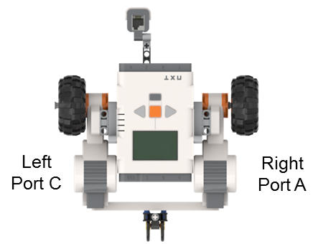


Formulate P-control law
y = Speed
Turn right
+90
(Max speed to add is 40)
Go Straight
speedBase = 50
(Max speed to subtract is 40)
10
Turn left
0
Blackest
29
65
100
Whitest
x = irValue
47
Call this irError
(1-1). $\text{s}\text{peed} \text{for} \text{Motor} \text{C}\text{ (}\text{left}\text{)= }\text{speedBase}\text{ + }\text{gain}(\text{irValue}\text{ − }\text{irThresh}\text{)=50+2.2(}\text{irValue}\text{ − }\text{irThresh}\text{)}$
(1-2). $\text{s}\text{peed} \text{for} \text{Motor} \text{A}\text{ (}\text{right}\text{)= }\text{speedBase}\text{ − }\text{gain}(\text{irValue}\text{ − }\text{irThresh}\text{)=50−2.2(}\text{irValue}\text{ − }\text{irThresh}\text{)}$
Blue area: yaw CW (away from black): Increase Motor C speed and Decrease Motor A speed
$$\text{Sanity} \text{Check}\text{: }\text{let} \text{irValue}\text{=40 }\text{then}$$
$$\text{speed} \text{C}\text{=50+(−2.22)(40−47)=50 + (−2.22)(−7) = 50 + 15.54 = 65.54}$$
$$\text{speed} \text{A}\text{=50−(−2.22)(40−47)=50 + (2.22)(−7) = 50 − 15.54 = 34.46}$$
Results in yawing CW (QED)
Green area: yaw CCW (toward black): Decrease Motor C speed and Increase Motor A speed
$$\text{Sanity} \text{Check}\text{: }\text{let} \text{irValue}\text{=55 }\text{then}$$
$$\text{speed} \text{A}\text{=50−(−2.22)(55−47)=50 + (2.22)(8) = 50 + 17.76 = 67.76}$$
$$\text{speed} \text{C}\text{=50+(−2.22)(55−47)=50 + (−2.22)(8) = 50 − 17.76 = 32.24}$$
Results in yawing CCW (QED)

Slide 9
Pseudocode for Proportional Control Line Following
// Calculate proportional gain from
// calibrated values irMax and irMin
// and defined speedMin and speedMax values
kP = (speedMin - speedMax) / (irMax - irMin);
Do {
Check if Left Arrow Button pushed;
Read irValue;
irError = irValue – irThresh;
// On whiter part if irError > 0
// So increase Motor C to yaw towards black
speed = speedBase + kP * irError;
// NB: speed now > speedBase
if speed > speedMax
speed = speedMax;
if speed < speedMin
speed = speedMin;
Forward Motor C at speed;
// And decrease Motor A to yaw towards black
speed = speedBase – kP * irError;
// NB: speed now < speedBase
if speed > speedMax
speed = speedMax;
if speed < speedMin
speed = speedMin;
Forward Motor A at speed;
} while Left Arrow Button not pushed
// Left Arrow Button was pushed
// Exit gracefully
Turn off both motors;
Play Exit sound
Stop All Tasks
Recall Equations (1.1) and (1.2) from before
Also kP is the slope calculated from calibration

