Slide 1
Slides: NXC Programming 1
Best Practices, Data Types, TextOut and FormatNum

Slide 2
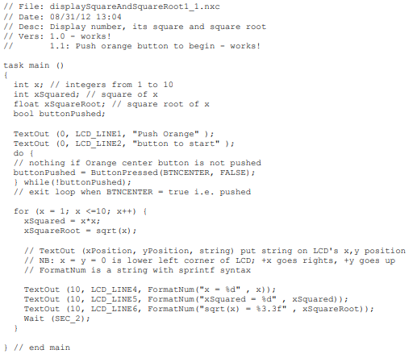
Best Practices
ME 425: Always start all your NXC programs with these intro comments
Filename is descriptive
Filename is multiword
  Leading word is not capitalized
  Subsequent words capitalize 1st letter
Filename has version e.g. 1_0a, 1_1b, etc
Refs: could be an additional comment to recall related code
(1)
ME 425: Variable Declarations
(2)
Opening brace wastes line space
Filename descriptive and multiword
Comment describes variable
2-space indent within braces
Add comment to closing brace
Comment settings e.g. why SEC_2
ME 425: Body
(3)
ME 425: Ending
(4)
Display closing message e.g. “Bye!”
Close any motors, sensors, etc with StopAllTasks

Slide 3
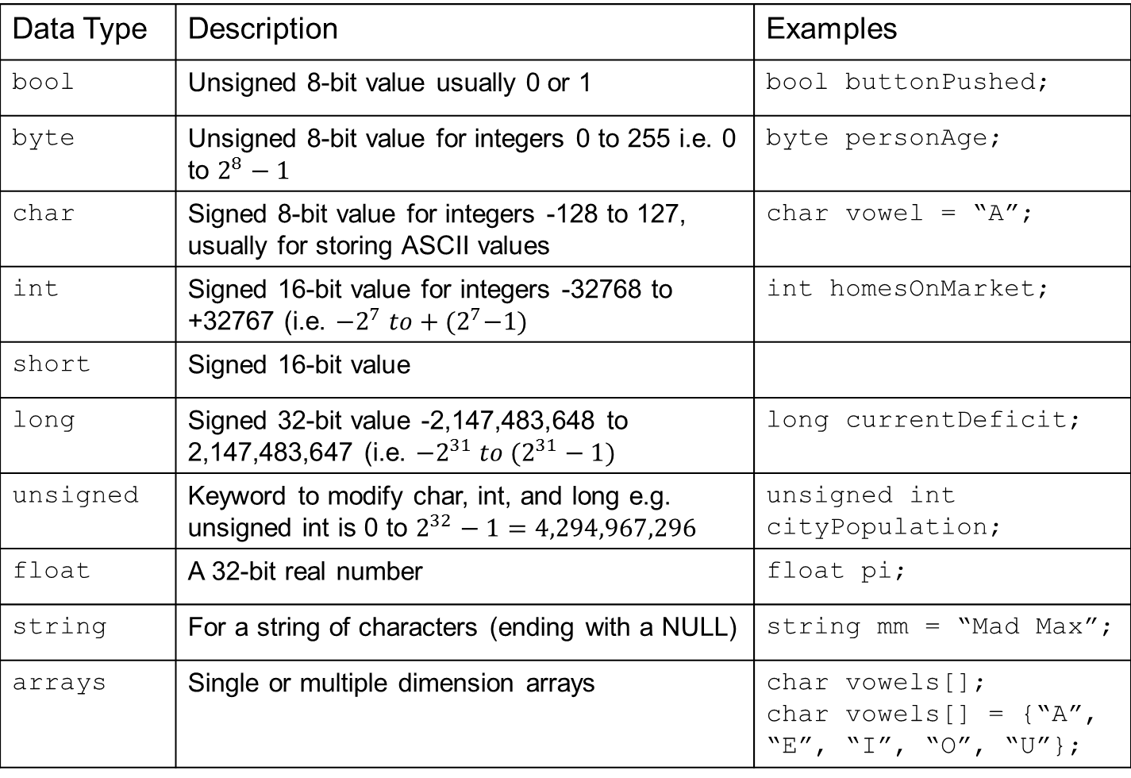
Data Types
http://bricxcc.sourceforge.net/nbc/nxcdoc/nxcapi/vars.html
Data Type | Description | Examples
bool | Unsigned 8-bit value usually 0 or 1 | bool buttonPushed;
byte | Unsigned 8-bit value for integers 0 to 255 i.e. 0 to $2^{8}−1$ | byte personAge;
char | Signed 8-bit value for integers -128 to 127, usually for storing ASCII values | char vowel = “A”;
int | Signed 16-bit value for integers -32768 to +32767 (i.e. ${−2}^{7} to+{(2}^{7}−1)$ | int homesOnMarket;
short | Signed 16-bit value
long | Signed 32-bit value -2,147,483,648 to 2,147,483,647 (i.e. $−2^{31} to (2^{31}−1)$ | long currentDeficit;
unsigned | Keyword to modify char, int, and long e.g. unsigned int is 0 to $2^{32}−1=4,294,967,296$ | unsigned int cityPopulation;
float | A 32-bit real number | float pi;
string | For a string of characters (ending with a NULL) | string mm = “Mad Max”;
arrays | Single or multiple dimension arrays | char vowels[]; char vowels[] = {“A”, “E”, “I”, “O”, “U”};

Slide 4
TextOut
http://bricxcc.sourceforge.net/nbc/nxcdoc/nxcapi/group___display_module_functions_ga9a070f70dbe14ebfb0b6b0c0abbef64c.html#ga9a070f70dbe14ebfb0b6b0c0abbef64c
char TextOut(int x, int y, string str, unsigned long options)
Usually use
LCD_LINE1
LCD_LINE2
:
LCD_LINE8
String must be a string variable or text within quotes
E.G. mm or “Mad Max” where mm was declared as string
I never used.

Slide 5
FormatNum
http://bricxcc.sourceforge.net/nbc/nxcdoc/nxcapi/group__cstring_a_p_i_gae1e152293a956a9911b3940664b7b9f4.html#gae1e152293a956a9911b3940664b7b9f4
Follows sprintf format specifier
string FormatNum(string fmt, variant num)
Often combine TextOut and FormatNum e.g.
TextOut(0, LCD_LINE1, FormatNum(“Age = %d”, myAge));
TextOut(0, LCD_LINE2, FormatNum(“Pi = %f”, piValue));
Specifier | Used for
%d | Display an int
%f | Display a float
%x | Display int in Hex
Often control the width e.g. minimum number of spaces (right justified)
TextOut(0, LCD_LINE1, FormatNum(“Age = %3d”, myAge));
TextOut(0, LCD_LINE2, FormatNum(“Pi = %10.4f”, piValue));
 |  |  |  | 3 | . | 1 | 4 | 1 | 5
Just white space
4 positions after decimal point

Slide 6
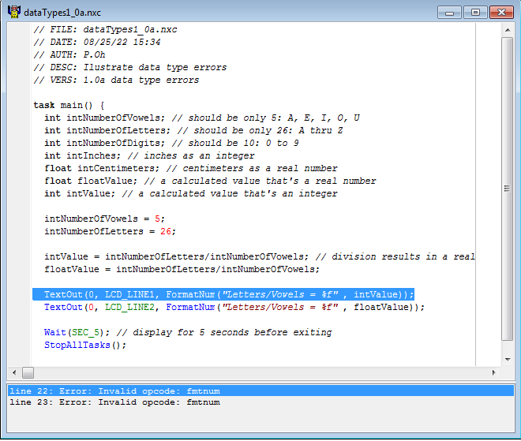
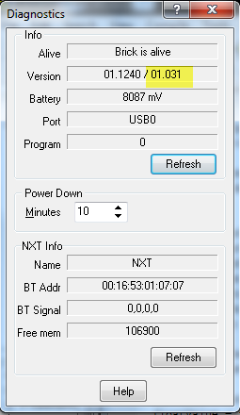
Issues to Watch Out For
Culprit: Usually means needs firmware update
Error: “Invalid opcode: fmtnum”
Solution: Tools – Download Firmware and then use file from course site i.e. lms_arm_nbcnxc_131.rfw

Slide 7
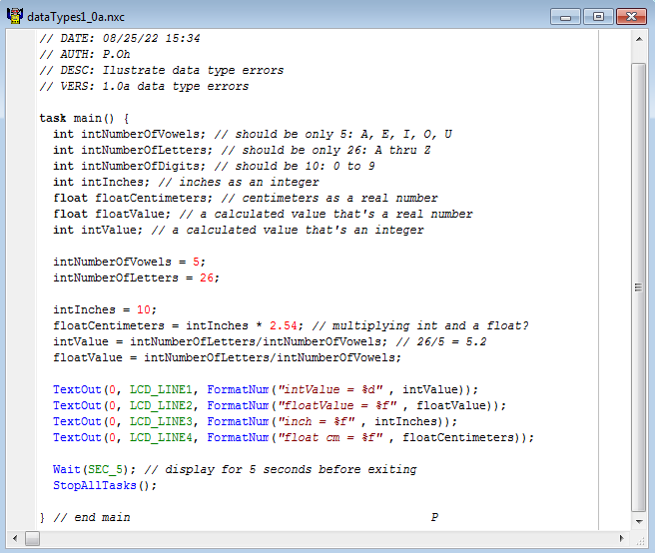
Bad Practice: Mismatching data types
Equations involving any variable that’s a float, then declare results as float
If calculation will result in real number, then declare as float
Match specifier with data type

