Slide 1
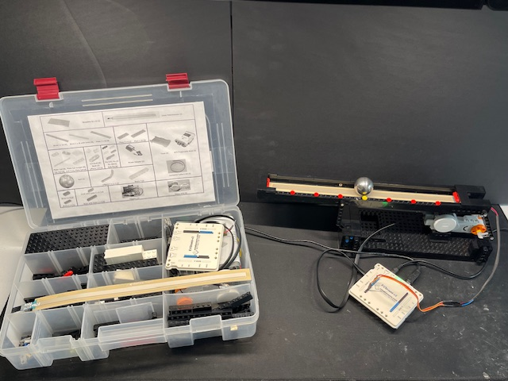
Lego Ball-and-Beam (BNB) Kit
In Tackle Box
Lego Ball-and-Beam (BNB)
Spectra Symbol SoftPot Linear Sensor 300 mm
1-1/4” Alloy Steel Ball
NXT Motor
Arduino UNO with EVShield

Slide 2
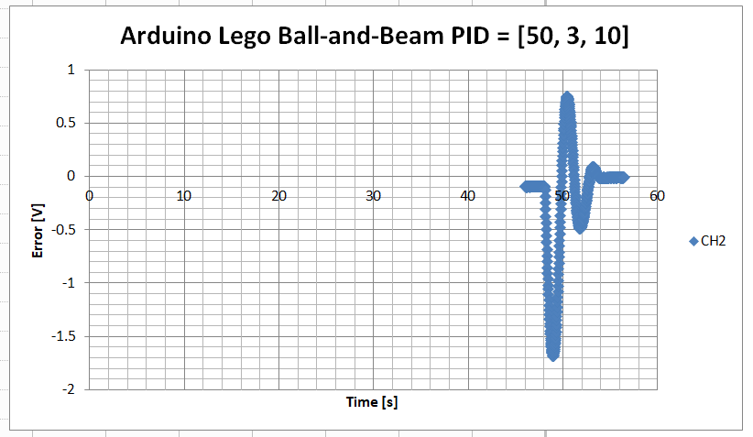
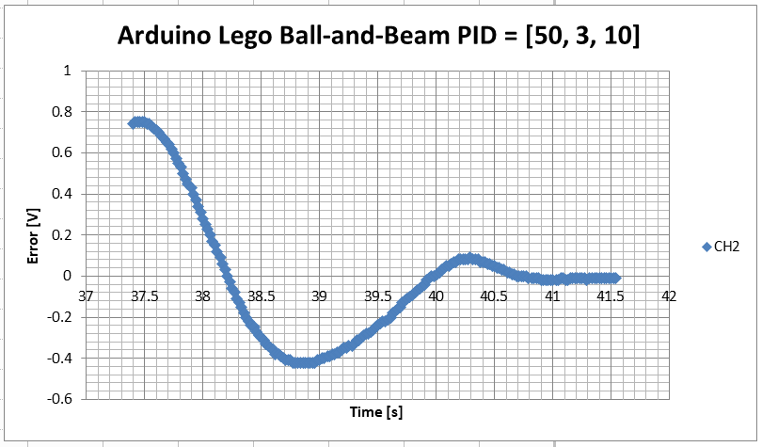
Real-time Plots of BNB Step Response using Excel Data Streaming

Slide 3
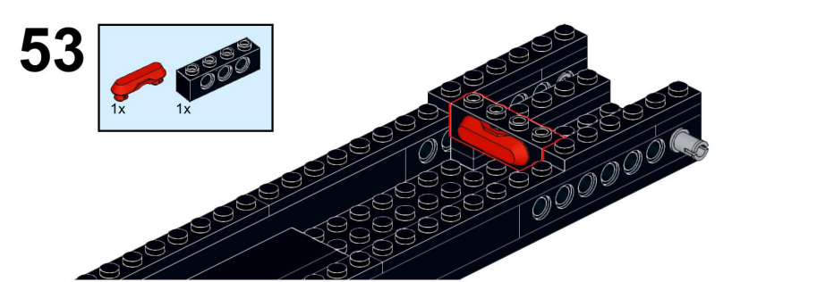
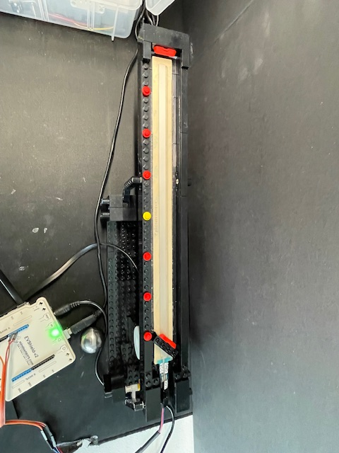
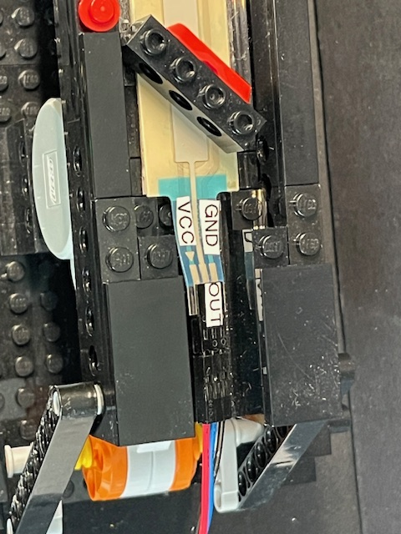
Spectra Symbol Sensor attached to beam with double-sided tape

Slide 4
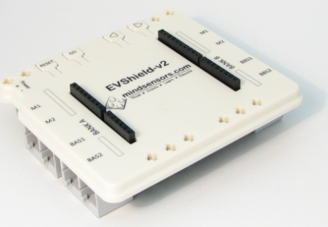
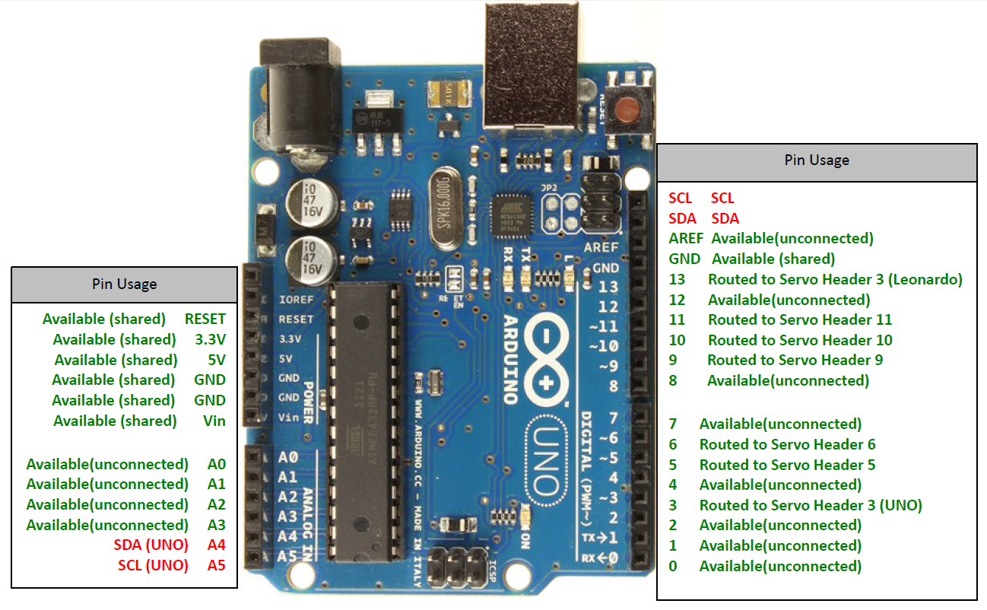
9V power supply
Mindsensors EVShield
M1 connects to NXT Motor
Spectral Symbol Sensor Pins:
+5V
GND
VOUT

