Slide 1
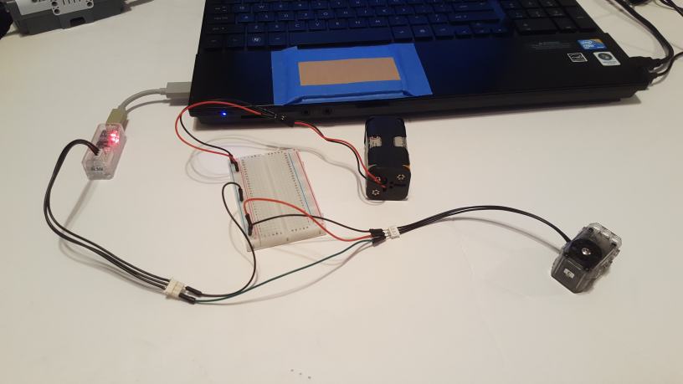
Dynamixel XL-320: Changing ID Number
Last updated 06/12/19
Preamble: Multiple XL-320 motors can be physically connected with 3P-XL cables. This is called daisy chaining. Each XL-320 can be assigned a unique ID number. Daisy chaining allows a microcontroller to command a specific XL-320 by it’s ID number. The factory default ID number is 0x01 (or 1 decimal). The Robotis Dynamixel Wizard allows one to change the ID number.
Further complications is that the XL-320 uses a 3P-XL cable. The XL-320 datasheet http://emanual.robotis.com/docs/en/dxl/x/xl320/#control-table-of-eeprom-area provides details. Namely, this cable employs a Molex 51065-0300 female connector. This connector does not fit the Dynamixel programmer (U2D2). Hence, one has to employ jumper wires.
U2D2 Programmer
Four AA Battery pack
Dynamixel XL-320
Overall Wiring Diagram

Slide 2
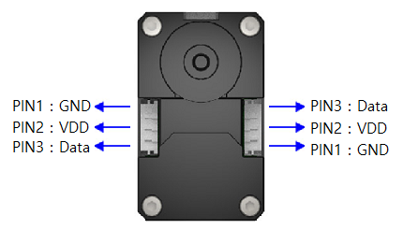
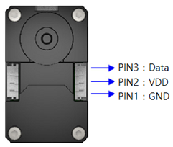
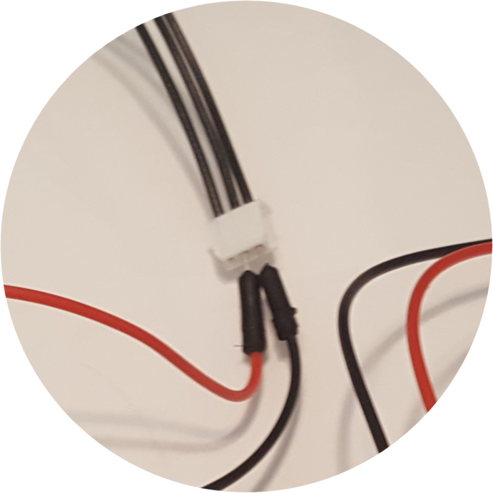
Last updated 06/12/19
Step 1: 6 Volt Motor (Dynamixel XL-32) Voltage wiring
Datasheet of XL-320 shows pins connections.
http://emanual.robotis.com/docs/en/dxl/x/xl320/#control-table-of-eeprom-area
NB: left figure is from Top i.e. looking into the servo horn
Servo
Horn
Insert male black and red jumper wires into the XL-320’s Molex connector. Attach other ends into breadboard. Insert Battery pack’s +6V and GND lines into breadboard as well
Note: Work with XL-320 Right side connector.
Servo
Horn
Not connected
RED Jumper
BLK Jumper
Close-up
Four AA Battery pack

Slide 3
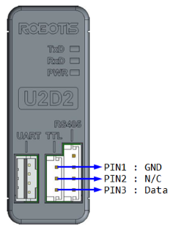
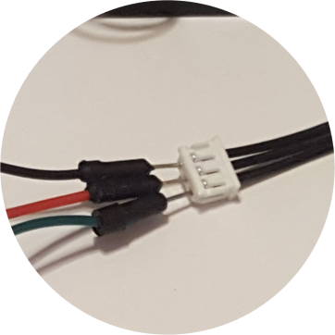
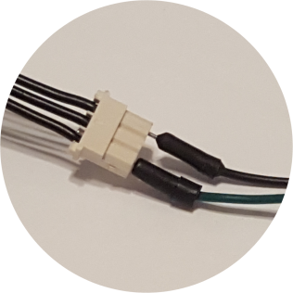
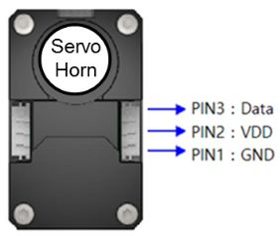
Last updated 06/12/19
Step 2: U2D2 Programmer wiring
U2D2 Manual http://support.robotis.com/en/product/auxdevice/interface/u2d2.htm shows the pinout diagram below
Servo
Horn
U2D2 Programmer
Close-up
BLK Jumper
Close-up
GRN Jumper
GRN Jumper
Insert GRN male jumper wire into U2D2 cable connector’s Pin 3 (Data).
Insert other end of GRN male jumper into Pin 3 (Data) of XL-320’s connector

Slide 4
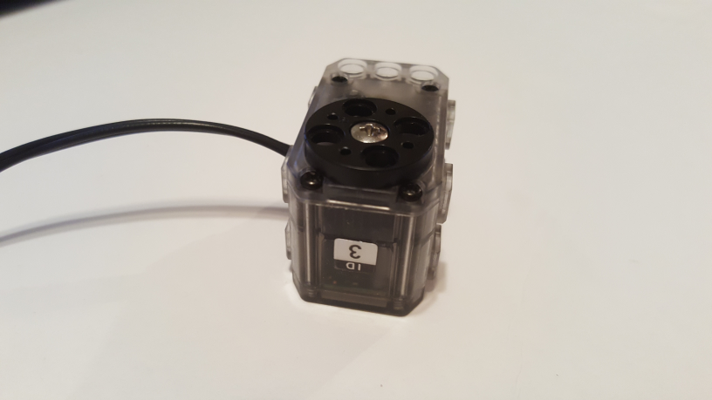
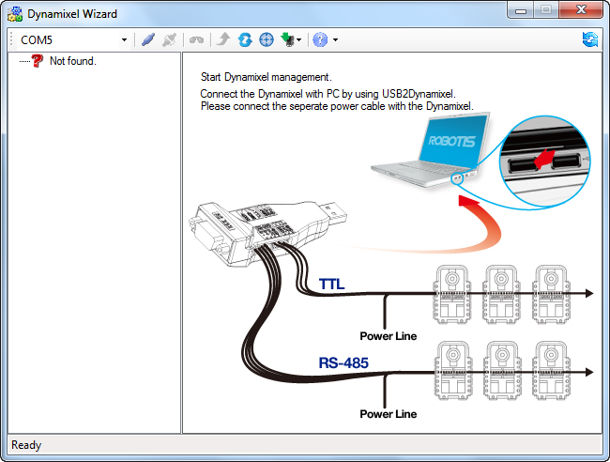
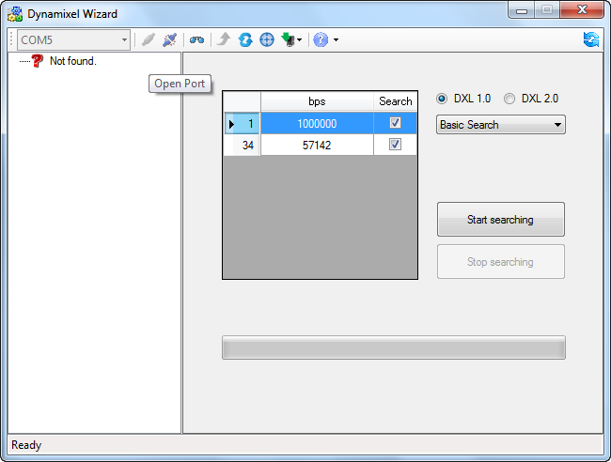
Last updated 06/12/19
The photo shows the sticker on this Dynamixel XL-320 is labeled “ID 3”. But the factory default for XL-320 motors is 0x01. Subsequent steps show how to change the ID via the Dynamixel Wizard program
Step 3: Execute Dynamixel Wizard program from PC
1. Opening screen; this particular setup uses serial COM port 5
2. Click Open Port icon and then “Start Searching” button

Slide 5
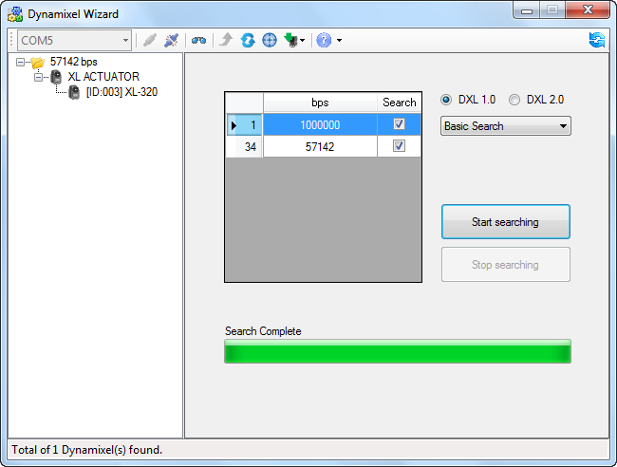
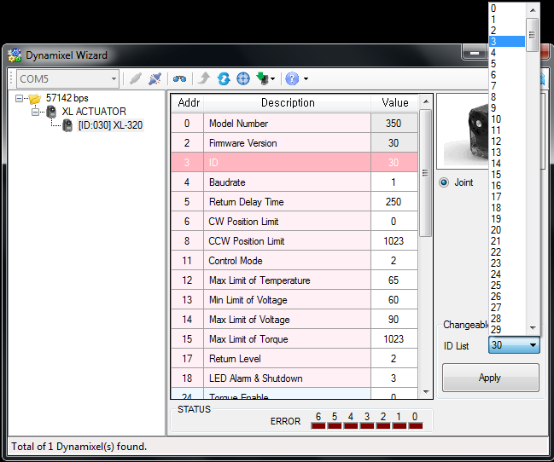
Last updated 06/12/19
Step 4: Continued
3. Successful search discovers Dynamixel XL-320. Click on [ID:003] XL-320
4. XL-320 description results. Scroll and click on ID. Use pull-down menu to select 3 (57600 bps). Click Apply button.

Slide 6
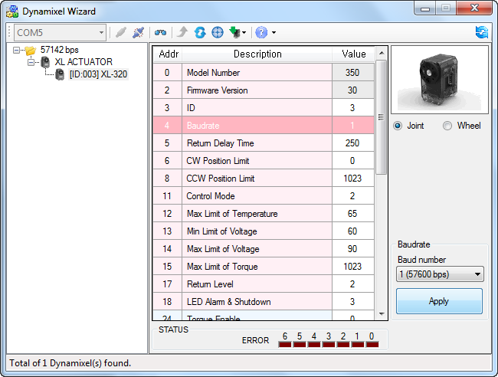
Last updated 06/12/19
Step 4: Continued
While in this menu, check that the baud rate is set for 1 (57600 bps). Click Apply button.
Click the Close Port icon on top ribbon bar and exit program.
Congratulations! The ID for this Dynamixel XL-320 is now set 0x03 (or 3 decimal)

Slide 7
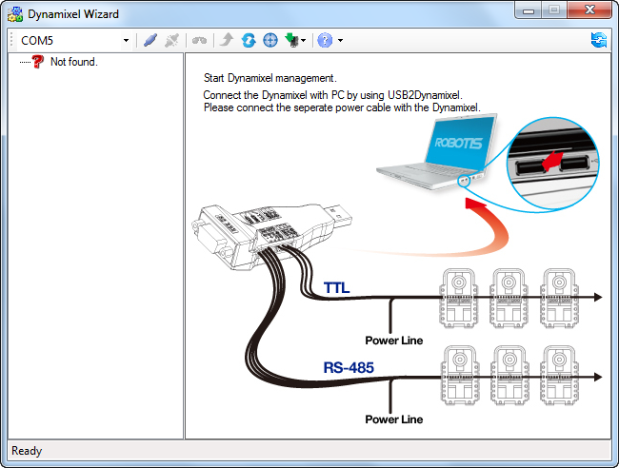
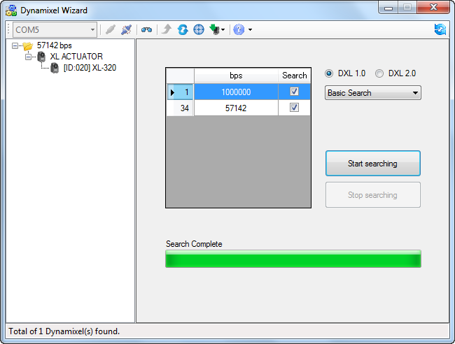
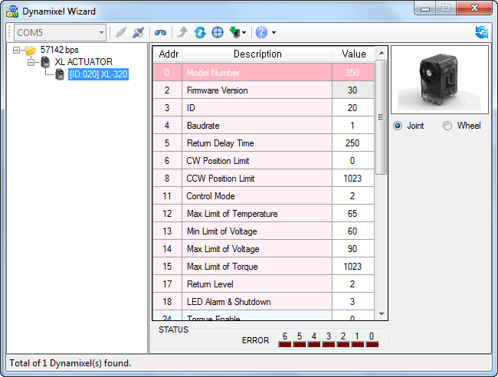
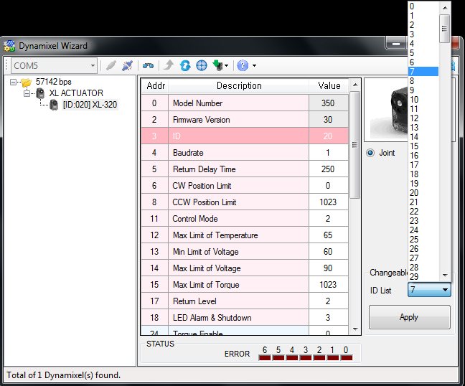
Last updated 06/12/19

Slide 8
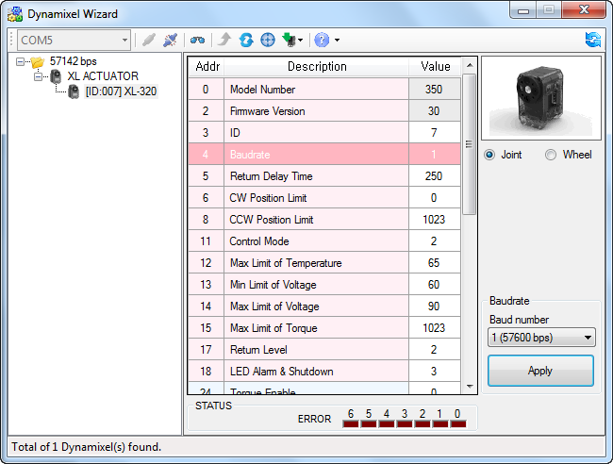
Last updated 06/12/19

Slide 9
Last updated 06/12/19

Slide 10
Last updated 06/12/19

Slide 11
Last updated 06/12/19

Slide 12
Last updated 06/12/19

