Slide 1
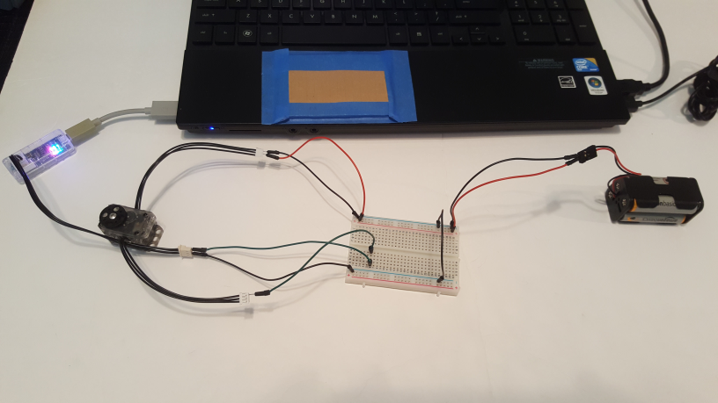
Dynamixel XL-320: Changing Baud Rate
Last updated 06/11/19
Preamble: By default, the Dynamixel XL-320 is configured for 1 MBPS (baud) rate. The LEGO NXT Brick however, uses a 57600 Baud rate. Thus, to connect an NXT to this Dynamixel, one needs to change the XL-320 baud rate to 57600.
Further complications is that the XL-320 uses a 3P-XL cable. The XL-320 datasheet http://emanual.robotis.com/docs/en/dxl/x/xl320/#control-table-of-eeprom-area provides details. Namely, this cable employs a Molex 51065-0300 female connector. This connector does not fit the Dynamixel programmer (U2D2). Hence, one has to employ jumper wires.
U2D2 Programmer
Four AA Battery pack
Dynamixel XL-320
Overall Wiring Diagram

Slide 2
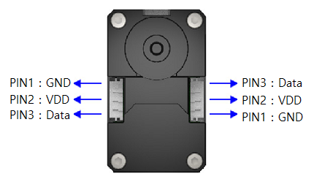
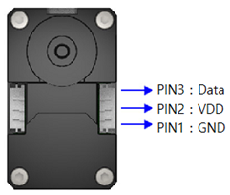
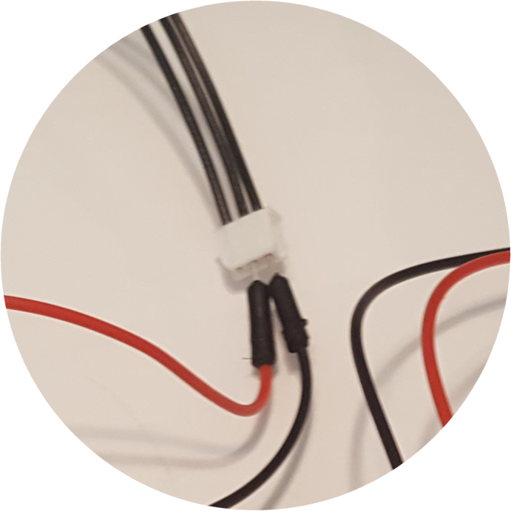
Last updated 06/11/19
Step 1: 6 Volt Motor (Dynamixel XL-32) Voltage wiring
Datasheet of XL-320 shows pins connections.
http://emanual.robotis.com/docs/en/dxl/x/xl320/#control-table-of-eeprom-area
NB: left figure is from Top i.e. looking into the servo horn
Servo
Horn
Insert male black and red jumper wires into the XL-320’s Molex connector. Attach other ends into breadboard. Insert Battery pack’s +6V and GND lines into breadboard as well
Note: Work with XL-320 Right side connector.
Servo
Horn
Not connected
RED Jumper
BLK Jumper
Close-up
Four AA Battery pack

Slide 3
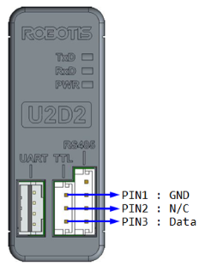
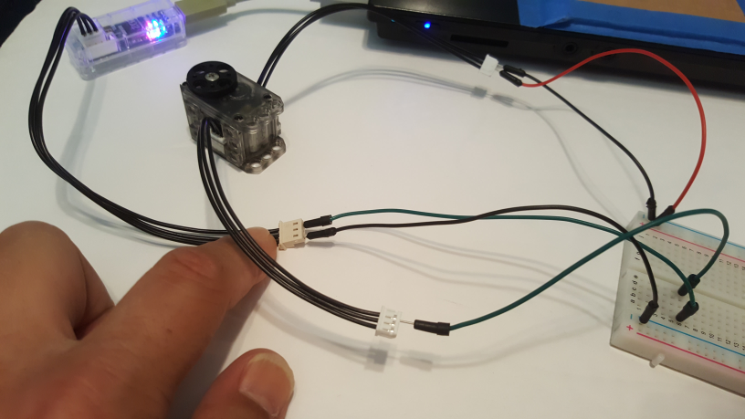
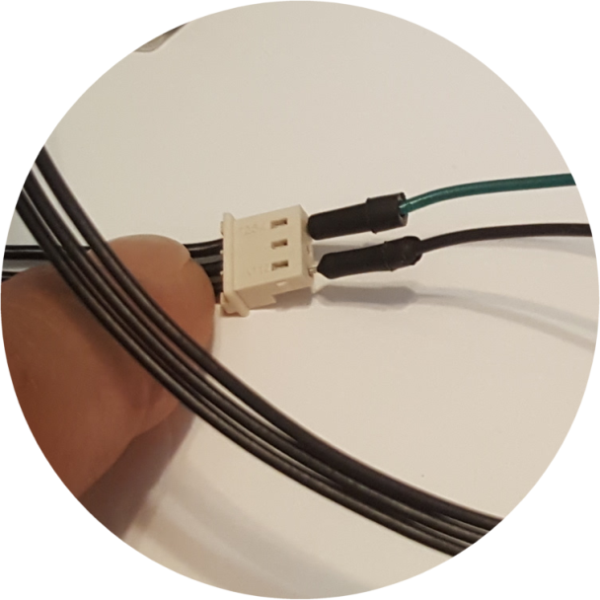
Last updated 06/11/19
Step 2: U2D2 Programmer wiring
U2D2 Manual http://support.robotis.com/en/product/auxdevice/interface/u2d2.htm shows the pinout diagram below
U2D2 Programmer
Breadboard data line
BLK Jumper
Breadboard GND bus
GRN Jumper
Insert BLK male jumper wire into U2D2 cable connector’s Pin 1 (GND). Insert other end into breadboard GND line
Insert GRN male jumper wire into U2D2 cable connector’s Pin 3 (Data). Insert other end into breadboard data line (for Step 3)
Close-up

Slide 4
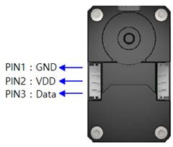
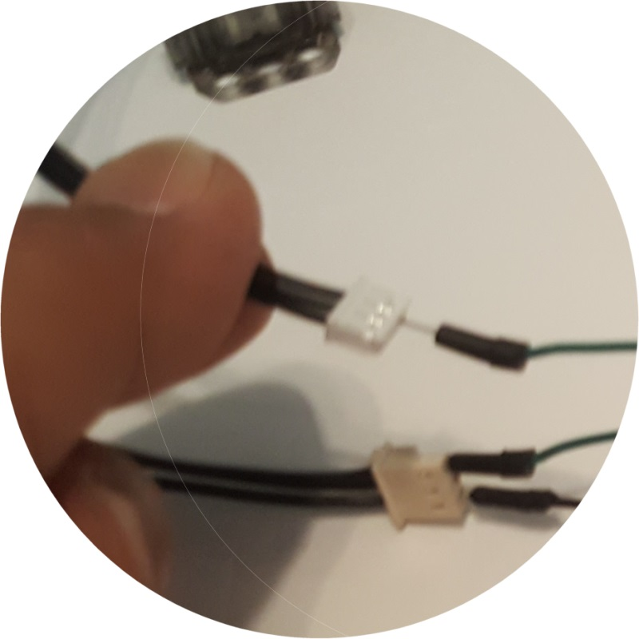
Last updated 06/11/19
Step 3: Dynamixel XL-320 Data line Wiring (and tying Grounds)
Note: Work with XL-320 Left side connector.
Servo
Horn
Not connected
Breadboard data line
Not connected
GRN Jumper
GND Bus
GND Bus
Insert GRN male jumper wire in XL-320 Molex connector. Attach other end into Breadboard Data line (so that connection in made from Step 2-2
Tie GND lines; connect BLK jumper wire between the two GND Busses on Breadboard

Slide 5
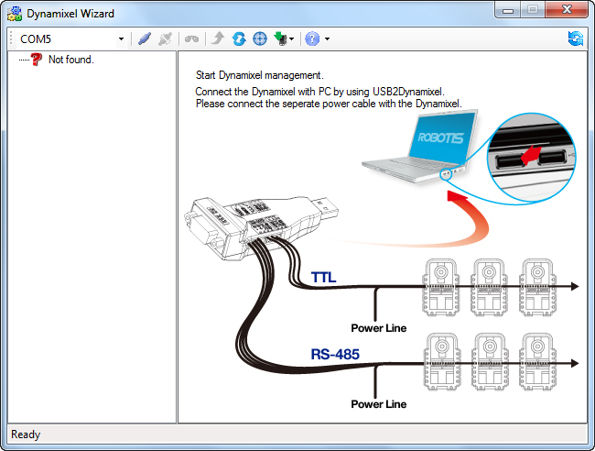
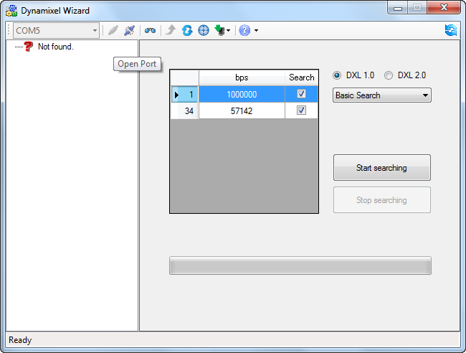
Last updated 06/11/19
Step 4: Execute Dynamixel Wizard program from PC
1. Opening screen; this particular setup uses serial COM port 5
2. Click Open Port icon and then “Start Searching” button

Slide 6
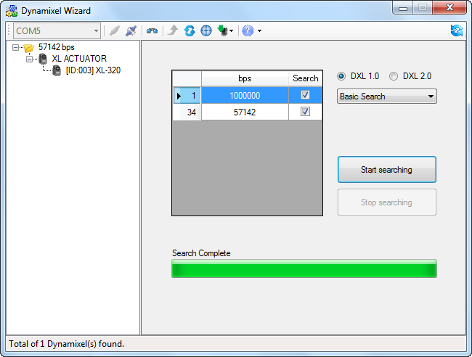
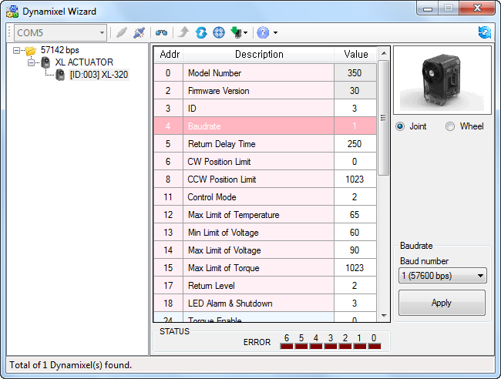
Last updated 06/11/19
Step 4: Continued
3. Successful search discovers Dynamixel XL-320. Click on [ID:003] XL-320
4. XL-320 description results. Scroll and click on Baudrate. Use pull-down menu to select 1 (57600 bps). Click Apply button.
Congratulations! The Dynamixel XL-320 is now set for 57600 BPS and ready for future LEGO NXT communications

