Slide 1
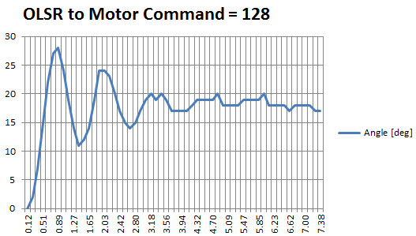
28-18 = 10 deg
24-18 = 6 deg
18 deg
T=0.89
T=1.9

Slide 2

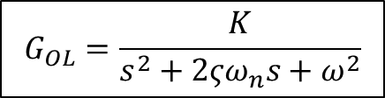

$$G_{OL}=\frac{K}{s^{2}+2ςω_{n}s+ω^{2}}$$
$$Θ(s)$$
$$M(s)$$

