Slide 1
Angle Sensor
Motorized propeller
NXT Port 1

Slide 2
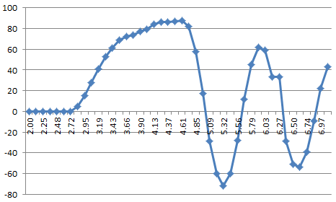
(87, 4.49)
(62, 5.91)
T=5.91-4.49=1.42 sec

Slide 3
NXT Port 1
MTRMX-NX Port
Header Pin: Motor 1
Cable to motor
Pigtail to Power Supply

Slide 4
Pigtail to Power Supply
Cable to motor
Power Supply Cable

