Slide 1
Open-Loop Step Response
© Copyright Paul Oh

Slide 2




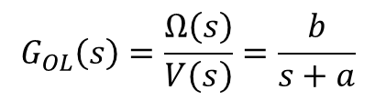



Recall that the dynamic equations of motion for a DC motor (for low inductances)
can be modeled as a 1st order system.
Modeling can be also be represented by Block Diagrams and Laplace Transforms
$$V\left(s\right)$$
$$\frac{b}{s+a}$$
$$\left(s\right)$$
motor command
motor velocity
$$G_{OL}\left(s\right)$$
: called Open Loop Transfer Function
Mathematically, this becomes:
$$G_{OL}\left(s\right)=\frac{Ω\left(s\right)}{V\left(s\right)}=\frac{b}{s+a}$$
(1)
or
$$\left(s+a\right)Ω\left(s\right)=bV\left(s\right)$$
Method 1: Solve for $ω\left(t\right)$with Ordinary Differential Equations:
(1) becomes:
$$\dot{ω}\left(t\right)+aω\left(t\right)=bv(t)$$
(2)
Suppose one gives the motor a step input i.e. applies a velocity command
In time domain, step input is:
$$v\left(t\right)=\left\{\begin{aligned}0:t≤0 \\ M:t>0\end{aligned} \right.$$
(3)
© Copyright Paul Oh

Slide 3

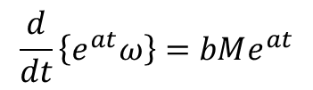
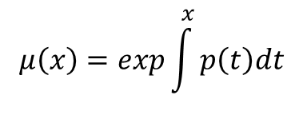



Subbing (3) into (2) yields
$$\dot{ω}\left(t\right)+aω\left(t\right)=bM$$
(4)
This first-order differential equation is solved using an integrating factor
$$μ\left(x\right)=exp\int^{x}{p\left(t\right)dt}$$
when one has equations of the form:
$$\dot{ω}+p\left(t\right)ω=g\left(t\right)$$
(5)
Thus comparing (4) and (5), say:
$$p\left(t\right)≜a$$
and using integrating factor, one creates the equation:
$$e^{at}\left\{\dot{ω}+aω\right\}=e^{at}bM$$
or
$$\frac{d}{dt}\left\{e^{at}ω\right\}=bMe^{at}$$
(6)
© Copyright Paul Oh

Slide 4
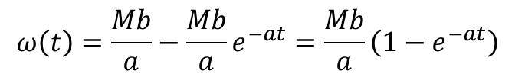
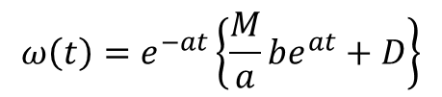
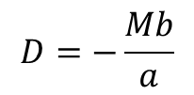
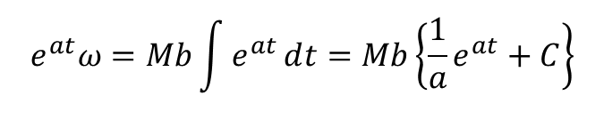
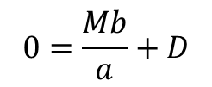
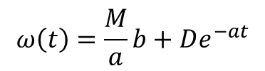
Integrating (6) yields
$$e^{at}ω=Mb\int{e^{at}ⅆt=Mb\left\{\frac{1}{a}e^{at}+C\right\}}$$
where C is unknown constant
(7)
Multiplying (7) with the exponent yields:
$$ω\left(t\right)=e^{−at}\left\{\frac{M}{a}be^{at}+D\right\}$$
or
$$ω\left(t\right)=\frac{M}{a}b+De^{−at}$$
where D is unknown constant
(8)
With initial conditions (IC), say that $ω\left(0\right)=0$ then (8) becomes
$$0=\frac{Mb}{a}+D$$
or
$$D=−\frac{Mb}{a}$$
(9)
Subbing (9) into (8), one gets general solution form
$$ω\left(t\right)=\frac{Mb}{a}−\frac{Mb}{a}e^{−at}=\frac{Mb}{a}\left(1−e^{−at}\right)$$
(10)
© Copyright Paul Oh

Slide 5
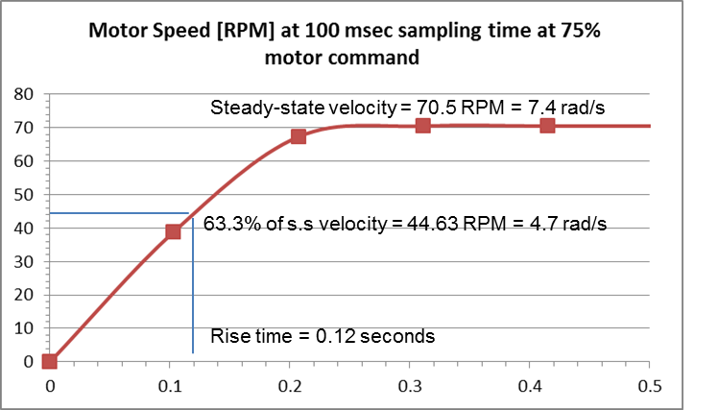





From M=75 step response lab of NXT DC motor, we saw a graph like:
$$ω\left(t\right)=ω_{ss}\left(1−e^{−at}\right)$$
(11)
If we say that $a≜\frac{1}{τ}$ then one has
$$ω\left(t\right)=ω_{ss}\left(1−e^{−\frac{t}{τ}}\right)$$
From graph, see $ω_{ss}=70.5$ RPM
Brackets
$$ω$$
Error [V]
44.4
70.5 – 44.4 = 26.1 or 37% (i.e. 63% of steady-state)
60.6
70.5 – 60.6 = 9.9 or 14.0% (i.e. 86% of steady-state)
67.0
70.5 – 67.0 = 3.5 or 5% (i.e. 95% of steady-state)
69.1
70.5 – 69.1 = 1.4 or 2% (i.e. 98% of steady-state)
69.8
70.5 – 69.8 = 0.7 or 1% (i.e. 99% of steady-state)
© Copyright Paul Oh

Slide 6

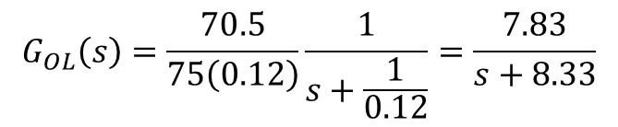
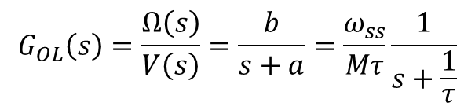
Comparing (10) and (11) we see that:
$$b=\frac{ω_{ss}}{Mτ}$$
(12)
Subbing (11) and (12) into (1) yields:
$$G_{OL}\left(s\right)=\frac{Ω\left(s\right)}{V\left(s\right)}=\frac{b}{s+a}=\frac{ω_{ss}}{Mτ}\frac{1}{s+\frac{1}{τ}}$$
(13)
For $τ=0.12$ and $ω_{ss}=70.5$ RPM, and step input $M=75$ (13) becomes:
$$G_{OL}\left(s\right)=\frac{70.5}{75\left(0.12\right)}\frac{1}{s+\frac{1}{0.12}}=\frac{7.83}{s+8.33}$$
(14)
© Copyright Paul Oh

Slide 7
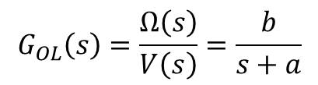
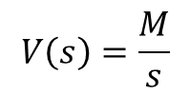



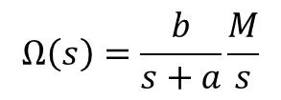

Method 2: Solve for $ω\left(t\right)$with Laplace Transforms:
Like before, and referring to (1), have
$$\frac{b}{s+a}$$
$$G_{OL}\left(s\right)=\frac{Ω\left(s\right)}{V\left(s\right)}=\frac{b}{s+a}$$
$$V\left(s\right)$$
$$\left(s\right)$$
from (1)
Like before, one has a step input i.e. velocity command, referring to (3)
$$v\left(t\right)=\left\{\begin{aligned}0:t≤0 \\ M:t>0\end{aligned} \right.$$
from (3)
The Laplace Transform for a step input signal is given by:
$$V\left(s\right)=\frac{M}{s}$$
(15)
Substituting (15) into (1) yields:
$$Ω\left(s\right)=\frac{b}{s+a}\frac{M}{s}$$
(16)
© Copyright Paul Oh

Slide 8
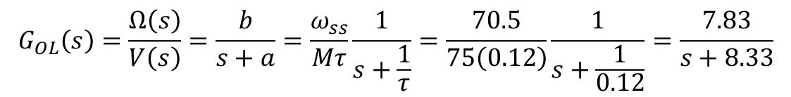
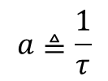
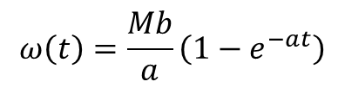



The inverse Laplace of (16) yields response in time-domain:
$$ω\left(t\right)=\frac{Mb}{a}\left(1−e^{−at}\right)$$
(17)
If we define:
$$a≜\frac{1}{τ}$$
(18)
and from NXT motor plot that steady-state, have
$$\lim_{t→∞}{ω\left(t\right)=ω_{ss}}$$
(19)
Then with (18) and (19), (17) yields:
$$ω_{ss}=Mbτ$$
or
$$b=\frac{ω_{ss}}{Mτ}$$
(17)
Hence, subbing values of $a$ and $b$ in (1), yields:
$$G_{OL}\left(s\right)=\frac{Ω\left(s\right)}{V\left(s\right)}=\frac{b}{s+a}=\frac{ω_{ss}}{Mτ}\frac{1}{s+\frac{1}{τ}}=\frac{70.5}{75\left(0.12\right)}\frac{1}{s+\frac{1}{0.12}}=\frac{7.83}{s+8.33}$$
(18)
Same as (14); Laplace gives same
Solution as ODE method
© Copyright Paul Oh

Slide 9

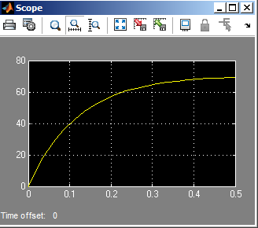
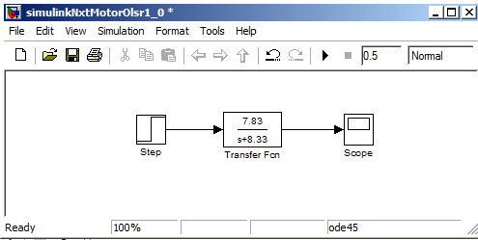
Simulink simulation of OLTF yields a plot similar to experimentally acquired one:
In Lab, will compare experimental and
(Simulink) simulated OLTF step response
© Copyright Paul Oh

