Slide 1
Mechanisms and Algorithms
Lab: Lego Levers, Shafts and Cranks

Slide 2
Lab Philosophy
 | Electronics | Mechanisms
Plans | Schematic Drawings | Assemblies
Items | Resistors, etc | Beams, etc
Acquisition | Radio Shack | McMaster-Carr
Drawing | Orcad | Pro/E
Simulating | Spice | Pro/E
Test/Evaluate | Breadboarding | Quick-connect
Lego
Assemblies
Beams, etc
Lego Store
MLCAD
Pro/E
Quick-connect
80/20
Assemblies
Beams, etc
80/20 Store
CAD Plug-ins
Pro/E
Quick-connect
Plans: read drawings, understand part roles and part connections
Items: Learn proper name of parts and what parts exist
Acquisition: Learn vendors for Bill of Materials (BOM)
Drawing: Communicating and Archiving your designs
Simulation: Rapid prototyping
T&E: Learn to physically construct, identify challenges and learn troubleshooting

Slide 3
Lab Experiments
Introduction to Lego Fundamentals
Reciprocating Motion: Simple Crank
Reciprocating Motion: 3-Bar Crank (Isogawa Pg. 61)
Reciprocating Motion: Crankshaft (Isogawa Pg. 63)
Homework: Reciprocating Motion: Slider-Crank (Isogawa Pg. 62)

Slide 4
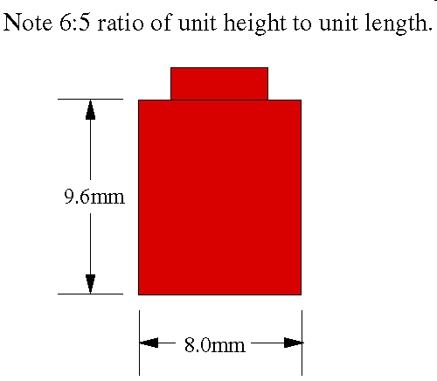
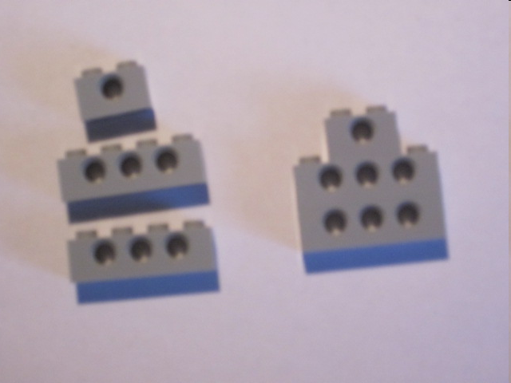
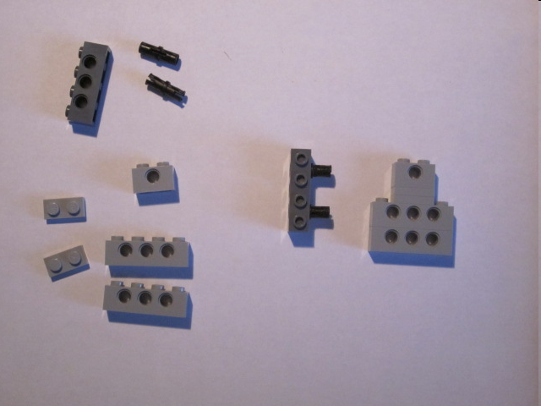
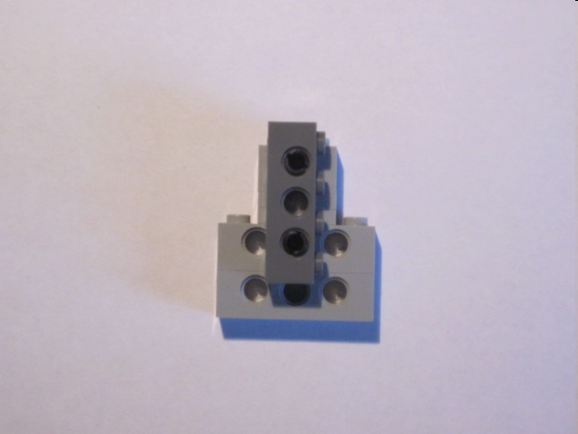
Exercise 1: Introduction to Lego Fundamentals
In Lego: Vertical > Horizontal. We have a 6:5 ratio
6:5 ratio important: Naïve approaches yield weak and unsound connections:
Stacking (naïve approach)
Bracing (best practice)
versus
Structural weak (try it)
5:6 ratio demands 2 plates for aligning holes

Slide 5
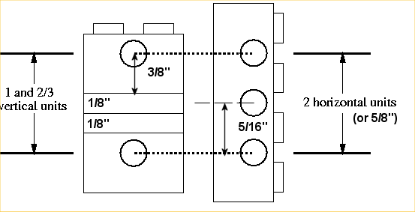
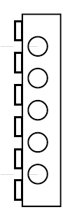
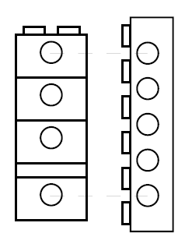
Motivation for Plates
From example: the 5:6 rule demands 2 plates
Two stacked bricks = 1 vertical unit
1 plate = 1/3 vertical unit
1 vertical unit + 2*1/3 vertical units = 5/3 vertical units
5:6 ratio states 6 vertical units = 5 horizontal units
Hence:
Exercise 1-1: What do you need to stack to align holes with a 5-hole beam
Note: space between aligning holes = 4 horizontal units
Aligning holes
4 vertically stacked bricks = 3 vertical units. Hence need plate

Slide 6
Plate Equation
: Number of full-height vertical units (i.e. N bricks - 1)
: Number of 1/3-height vertical units (i.e. plates)
: Number horizontal units between holes
Exercise 1-2: Construct the following and complete the following table
Full height vertical units | 1/3-height vertical units | Horizontal Units
1 | 2 | 2
3 | 1 | 4
 |  | 6
6
8

Slide 7
Answer:
Full height vertical units | 1/3-height vertical units | Horizontal Units
1 | 2 | 2
3 | 1 | 4
5 |  | 6
6 | 2 | 8
8 | 1 | 10

Slide 8
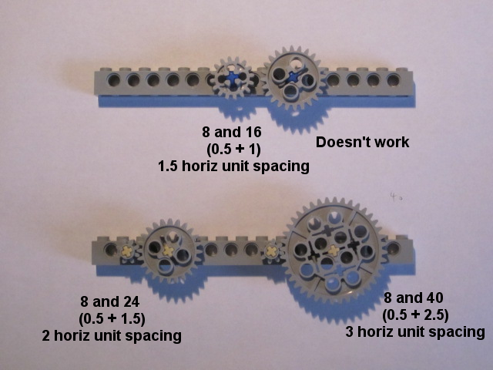
Gears
NB: tan (smooth), blue (snug)
Gear Teeth [number] | Gear Radius [horiz units]
8 | 0.5
16 | 1
24 | 1.5
40 | 2.5
Gear size in horizontal units demands integer-sized spacing:

Slide 9
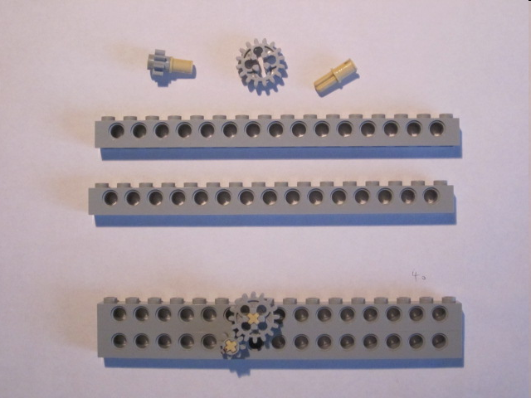
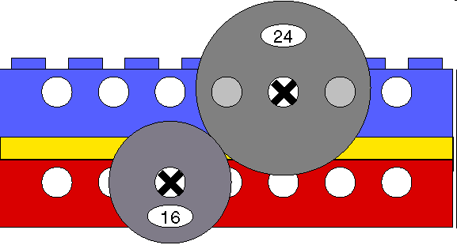
Gears: Getting away with non-integer spacing
Recall that 2 stacked bricks = 1 vertical unit
Recall that for a beam, space between holes = 1 horiz unit
Thus diagonal space =
i.e. close enough for a 16:8 or 2:1 gear ratio
Exercise 1-3: Construct a 3:2 gear train
Answer:
Hint: Use a plate to space two beams. Use 24T and 16T gears

Slide 10
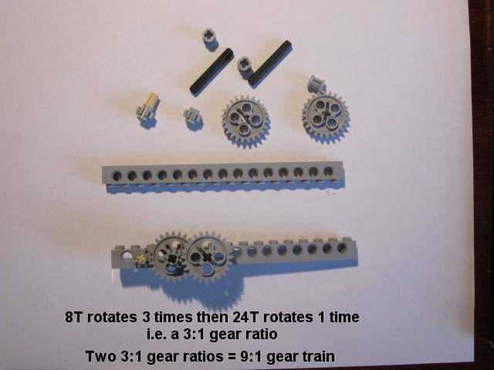
Exercise 1-4: Construct a 9:1 gear train
Answer:
Hint: Use two 3:1 gear trains

Slide 11
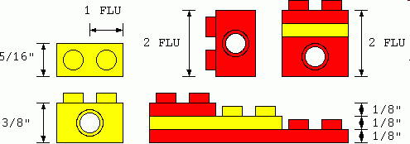
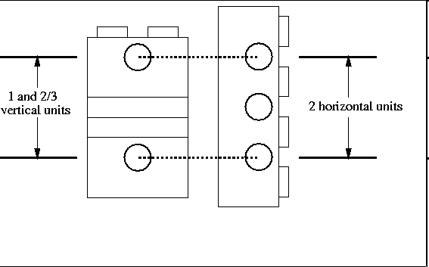

Slide 12
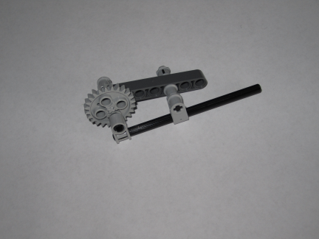
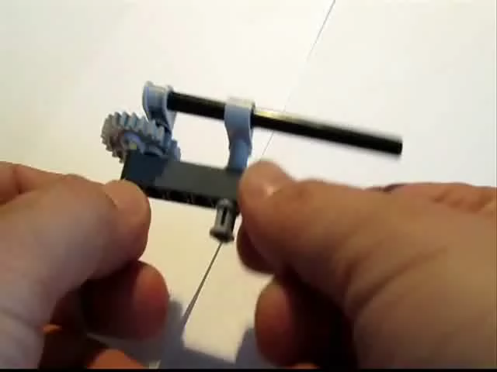
Exercise 2: Simple Crank
Lego Simple Crank
Video

Slide 13
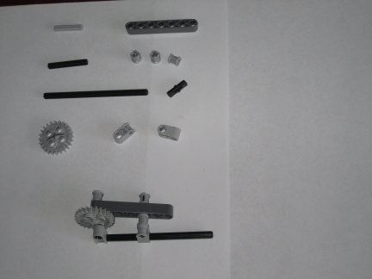
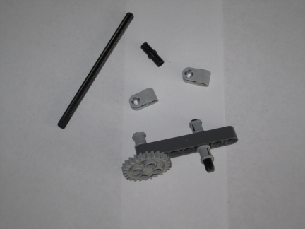
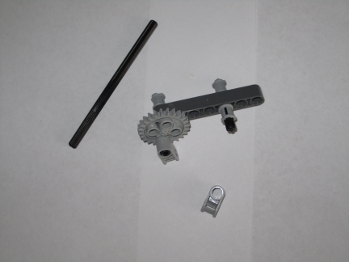
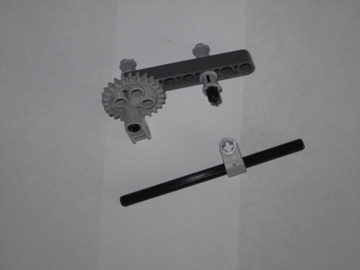
Axle 3
4519
Beam 7
32524
3x Bush
3713
Axle 4
3705
Pin with Friction
4459
Axle 10
3707
2x 1x2 Axle/Pin
6556
Gear 24 Tooth
3648
Step 1: Parts for Simple Crank (seen on bottom)
Step 2: Pin the Gear to Beam. Bush Axle 4 to Beam
Step 3: Mount Axle/Pin on Gear with Pin
Step 4: Pass Axle 10 thru Axle/Pin and mount on assembly

Slide 14
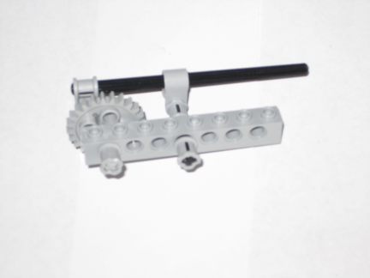
Exercises
2-1 Replace Beam with Brick to re-construct a simple cran
Simple Crank using Brick

Slide 15
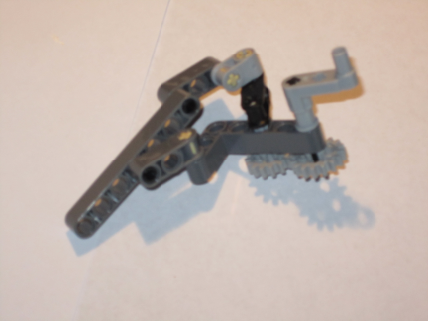
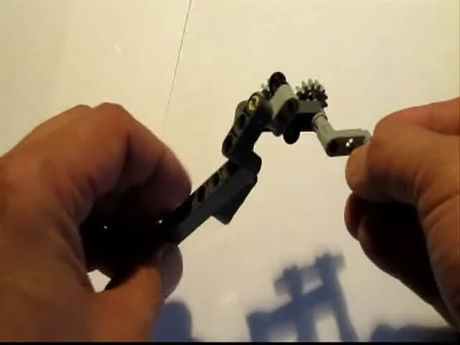
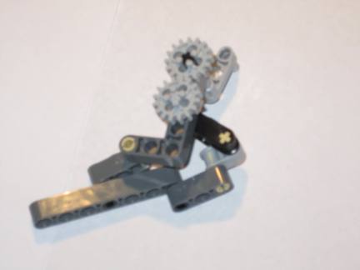
Exercises
2-2 Construct the following crank (more complex)

Slide 16
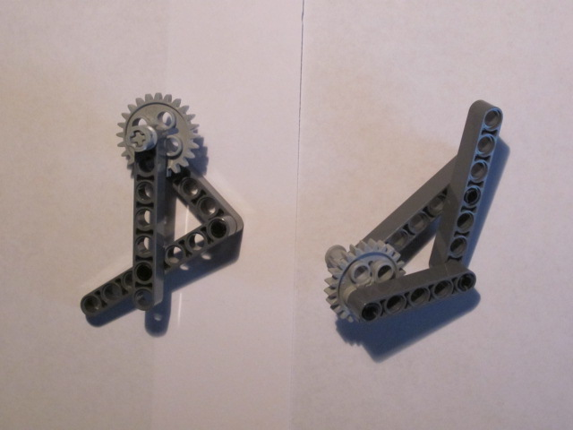
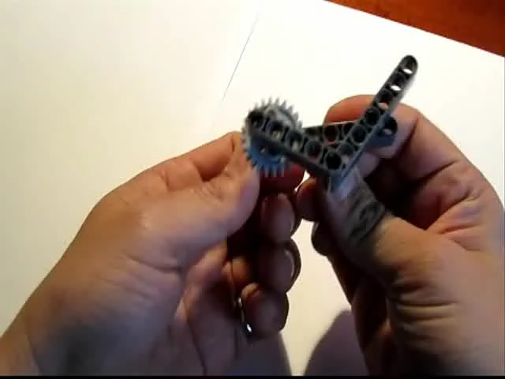
Exercise 3: The Crank and 3-Bar Linkage
Isogawa’s Lego Crank 3-Bar Linkage
Video

Slide 17
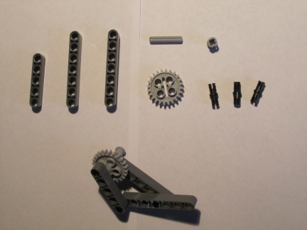
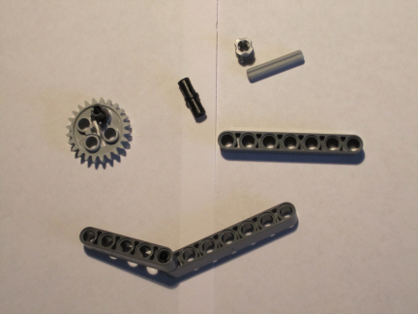
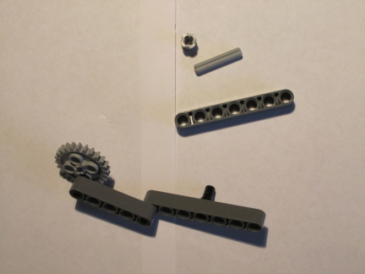
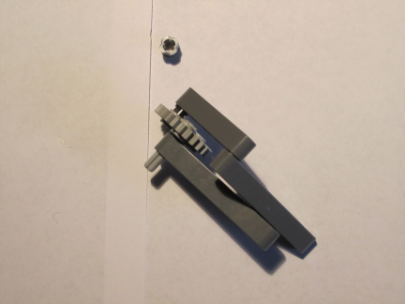
2x Beam 7
32524
Axle 3
4519
Bush
3713
Beam 5
32316
Gear 24 Tooth
3648
3x Pin
with Friction
4459
Step 1: Parts. NB: Contrast parts 4459 and 3673
Step 2: Pin the Gear. Join Beam 5 and Beam 7
Step 3: Pin Beam 7 and Gear to Beam 5
Step 4: Axle and bush the Gear. Join 2 Beam 7s.

Slide 18
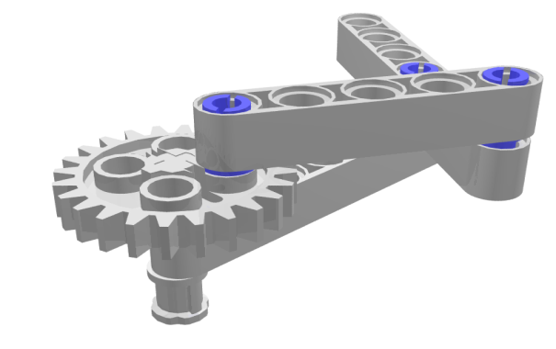
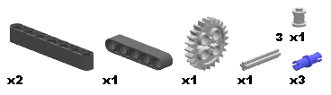

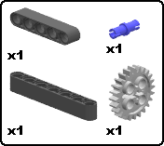


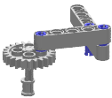
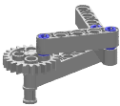


MLCAD Building Instructions and POV Rendering
Rendered Image
Bill of Materials (BOM)

Slide 19
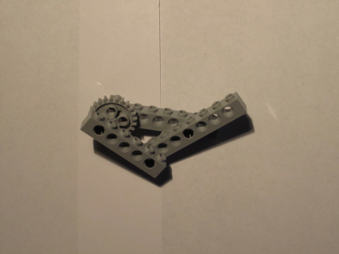
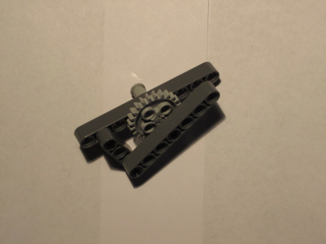
Exercises
3-1 Replace Beams with Bricks to construct the following 3-Bar Crank (left)
3-2 Construct the following 3-Bar Crank (right)
1x Technic Brick 1x6 with holes
3894
2x Technic Brick 1x8 with holes
3702
Left: 3-Bar Crank using Bricks
Right: 3-Bar with Crank near Middle

Slide 20
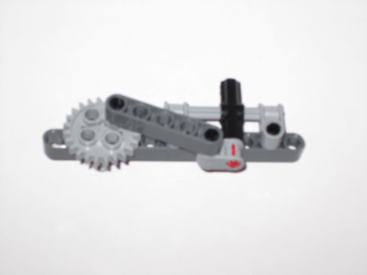
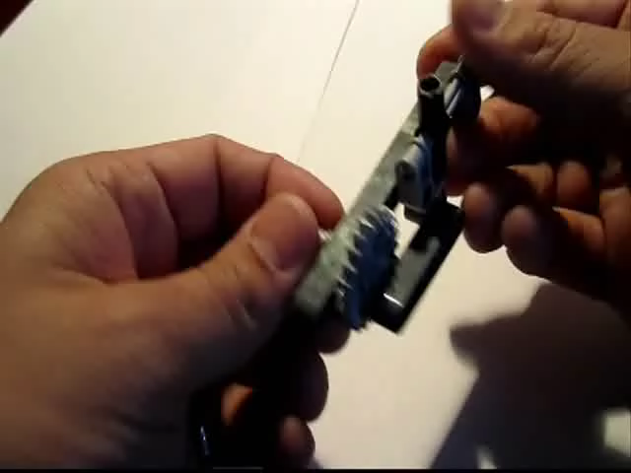
Exercise 4: The Crankshaft
Isogawa’s Lego Crankshaft
Video

Slide 21
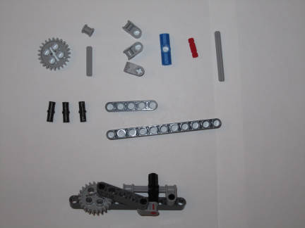
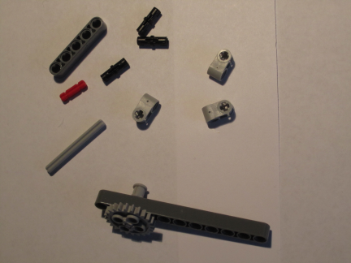
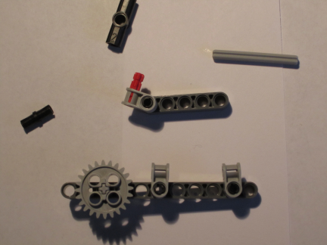
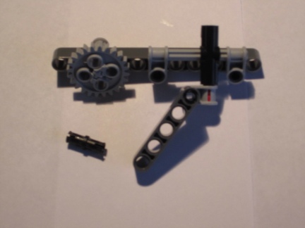
Bush
3713
Angle Connector #2 (180)
32034
Gear 24 Tooth
3648
Axle 2 Notched
32062
Axle 5
32073
Axle 3
4519
3x 1x2 Axle/Pin
6556
Beam 5
32316
4x Pin
with Friction
4459
Beam 11
32525
Step 1: Parts.
Step 2: Pin the Gear to Beam 11
Step 3: Pin Axle/Pins to Beams 5 and 11
Step 4: Thread Axle 5 thru Angle Connector. Pin Beam

Slide 22
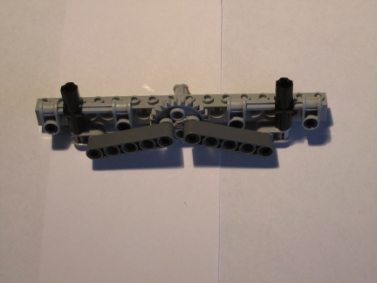
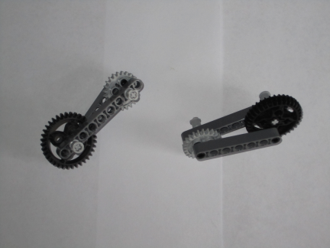
Exercises
4-1 Replace Beams with Bricks to construct the following Crankshaft (left)
4-2 Construct the following (right). Rotate Grey Gear. Black Gear output?
1x Technic Brick 1x16 with holes
3703
Left: Double Crankshaft using Bricks
Right: Crank and Lever (front and rear views)

