Slide 1
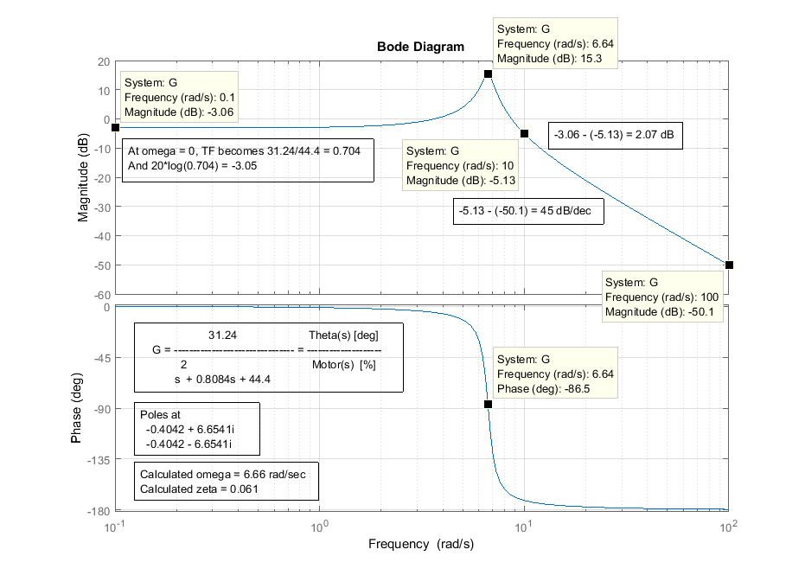




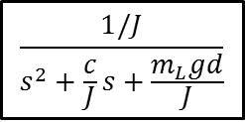









12/12/18
$$\text{TF}\text{ = }\frac{31.24}{s^{2}+0.8084s+44.4}=\frac{Θ\left(s\right)}{M\left(s\right)}$$
$$\frac{1/J}{s^{2}+\frac{c}{J}s+\frac{m_{L}gd}{J}}$$
$$\frac{0.00018}{0.00033}=0.545$$
$$Μ\left(s\right)$$
$$K_{m}$$
$$Τ\left(s\right)$$
$$Θ^{∗}\left(s\right)$$
$$Θ\left(s\right)$$
$$\frac{50}{31}$$
$$0.00018$$
$$\frac{1/0.00033}{s^{2}+0.485s+53.96}$$
$$\frac{180}{3.14}$$
[deg]
[%]
$$\left[\frac{Nm}{\%}\right]$$
[rad]
[deg]
$$\frac{0.00018}{0.00033}×\frac{180}{3.14}=0.545×57.3=31.24$$

