Slide 1
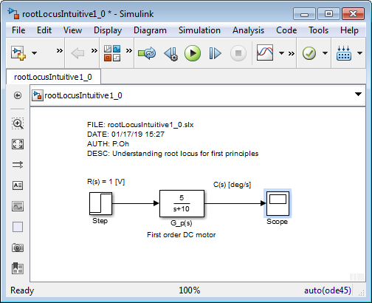
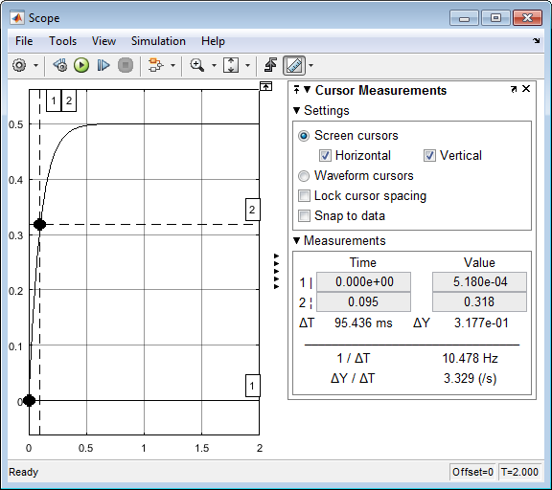
01/17/19

Slide 2
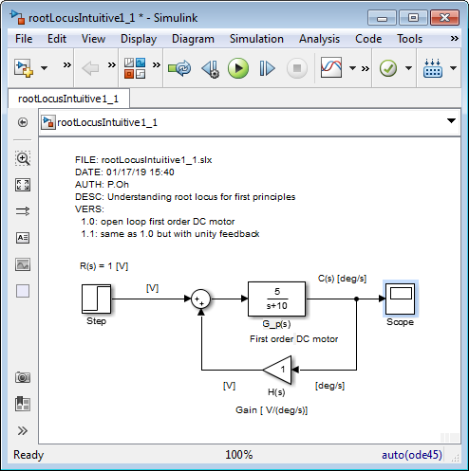
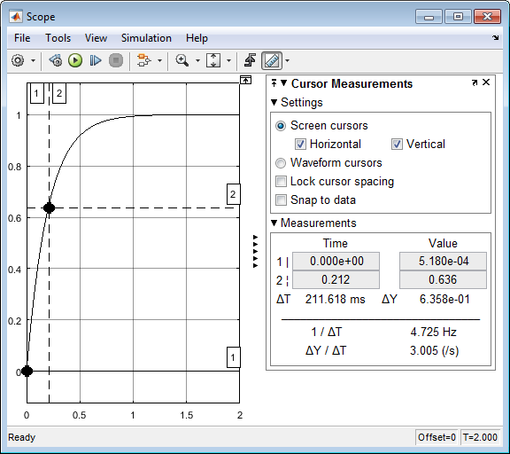
01/17/19

Slide 3
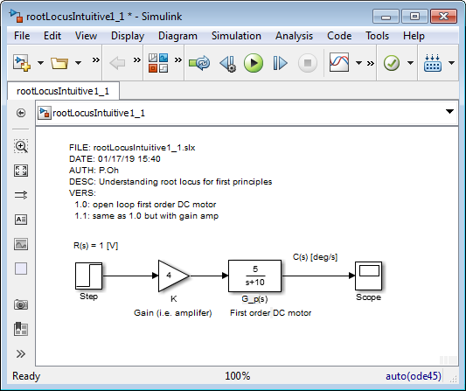
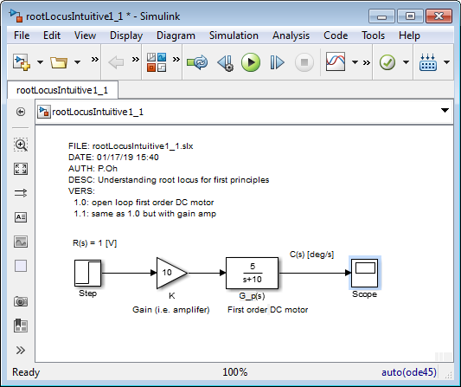
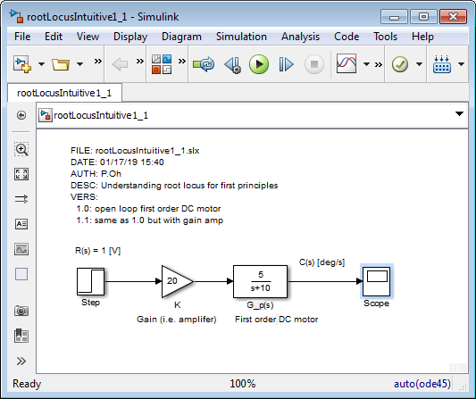
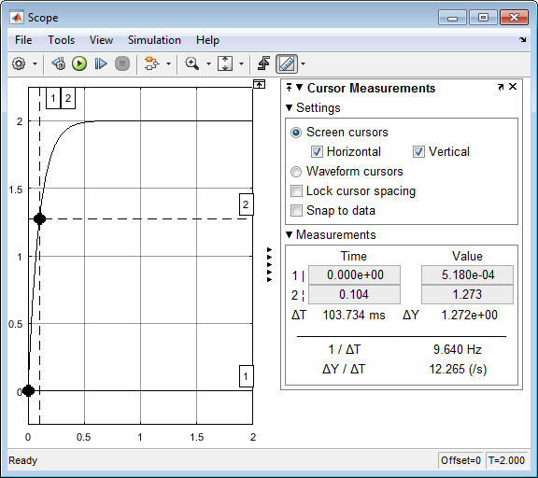
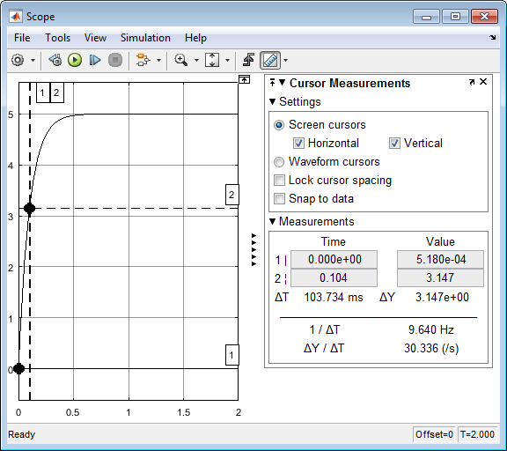
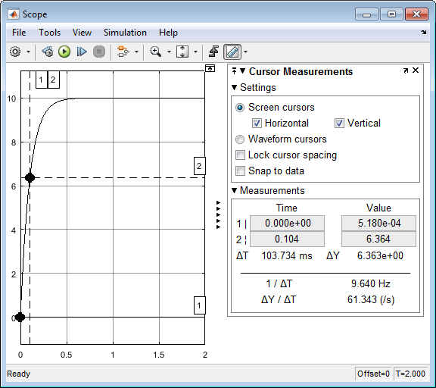
01/17/19

Slide 4
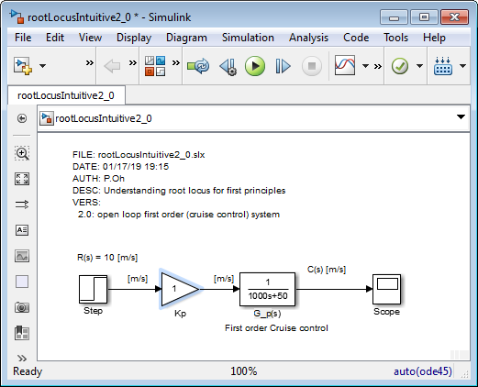
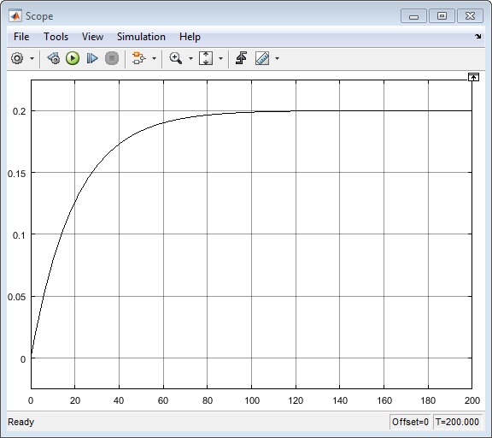
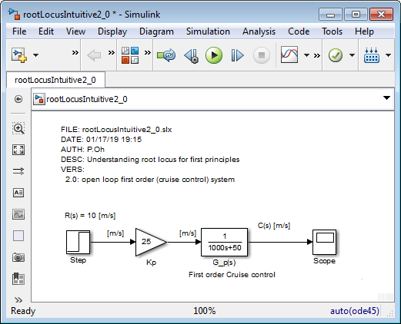
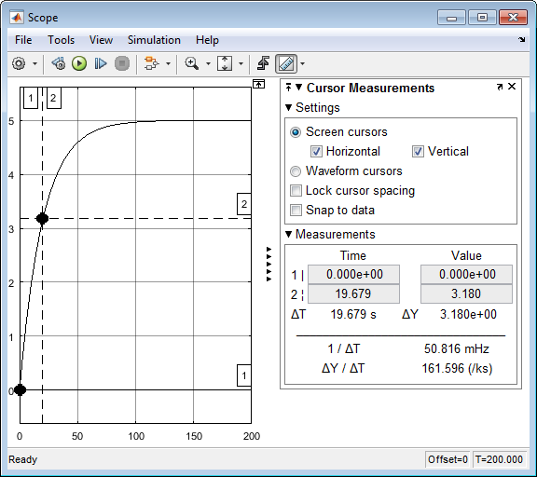
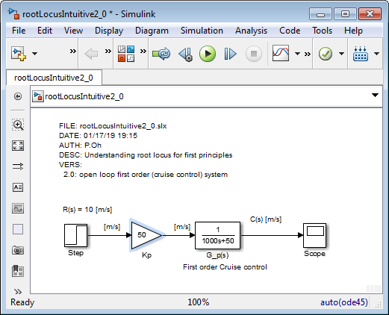
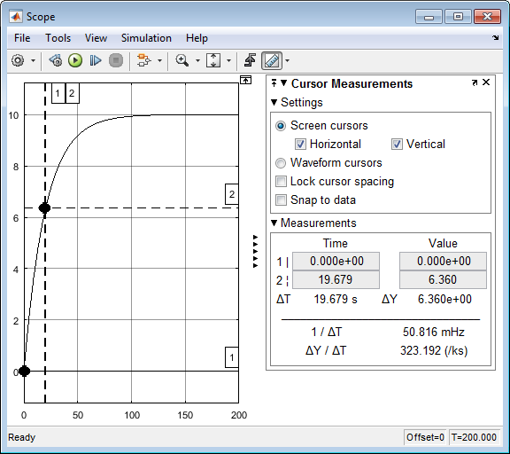






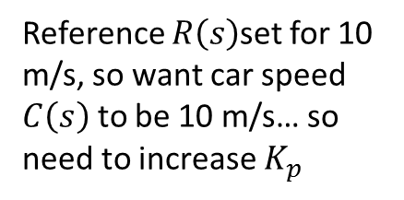
\labviewCourseDevelopment\labview=0X-RootLocus\pptRootLocusNotesAndFigures011719.pptx
01/17/19
Michigan reference: Cruise Control example
http://ctms.engin.umich.edu/CTMS/index.php?example=CruiseControl&section=ControlRootLocus
Reference $R\left(s\right)$set for 10 m/s, so want car speed $C\left(s\right)$ to be 10 m/s… so need to increase $K_{p}$
$$K_{p}=25$$
$c_{ss}=5;t_{r}=19.7$ sec
$$K_{p}=50$$
$c_{ss}=10;t_{r}=19.7$ sec

Slide 5
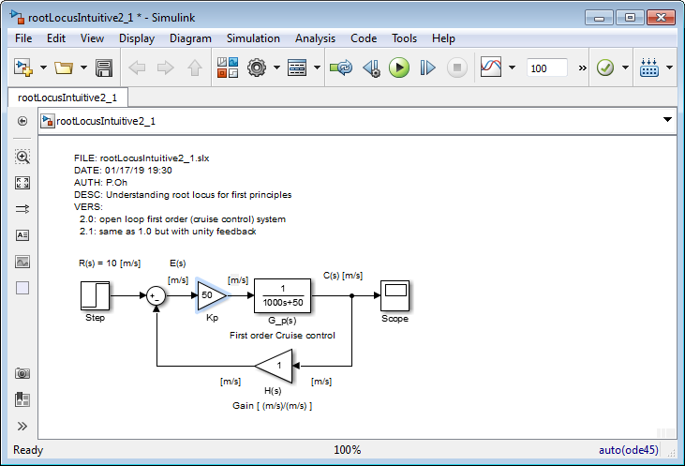

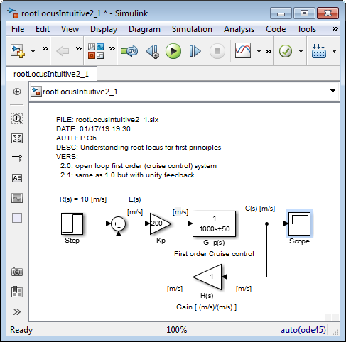
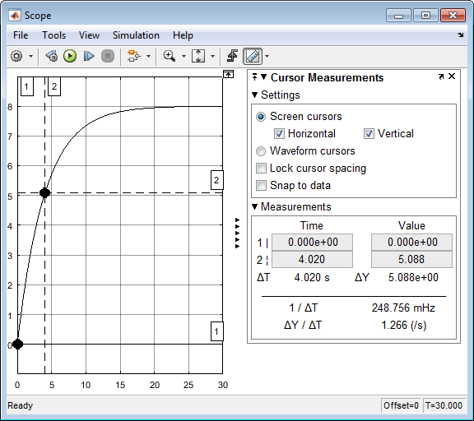
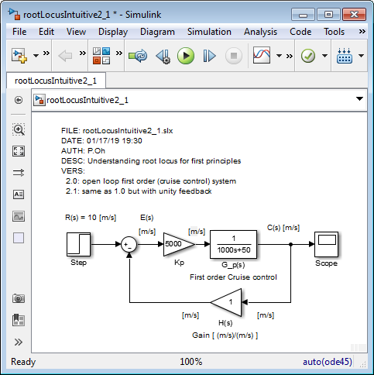





01/17/19
What happens when have (unit) feedback?
$K_{p}=50$ but with simply fed back the car’s speed
$c_{ss}=5;t_{r}=9.8 \text{sec}\text{ (}\text{with} \text{feedback}\text{) }\text{vs}\text{. }19.7$ sec (just open-loop). Rise time improves!
$K_{p}=2$00
$c_{ss}=8;t_{r}=4.02$ sec
$$K_{p}=5000$$
$c_{ss}=9.89.;t_{r}=0.215$ sec

Slide 6
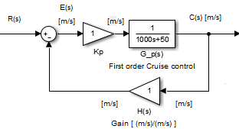
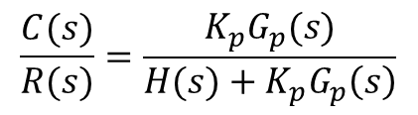
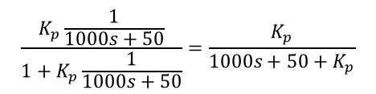


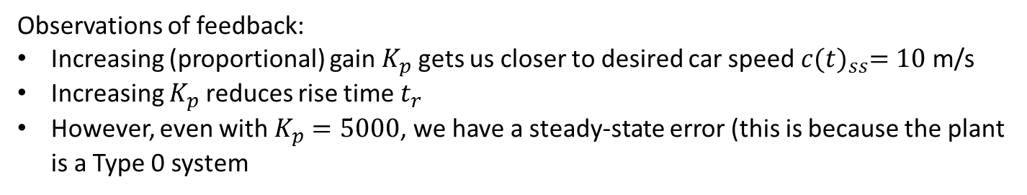


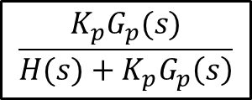
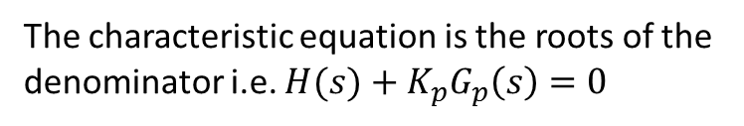
01/17/19
Observations of feedback:
Increasing (proportional) gain $K_{p}$ gets us closer to desired car speed $c{(t)}_{ss}=10$ m/s
Increasing $K_{p}$ reduces rise time $t_{r}$
However, even with $K_{p}=5000$, we have a steady-state error (this is because the plant is a Type 0 system
Wouldn’t be great if we can “predict” what the (closed-loop feedback) output would be (i.e. $c{(t)}_{ss}$) given different values of $K_{p}$? This is what the root locus plot does
$$G_{p}(s)$$
$$C\left(s\right)=E\left(s\right)K_{p}G_{p}\left(s\right)=K_{p}G_{p}(s)\left\{R\left(s\right)−H(s)C(s)\right\}$$
$$C\left(s\right)\left\{H(s)+K_{p}G_{p}\left(s\right)\right\}=K_{p}G_{p}\left(s\right)R(s)$$
$$\frac{C(s)}{R(s)}=\frac{K_{p}G_{p}(s)}{H(s)+K_{p}G_{p}\left(s\right)}$$
Hence:
Is the equivalent TF
$$R(s)$$
$$C\left(s\right)$$
$$\frac{K_{p}G_{p}(s)}{H(s)+K_{p}G_{p}\left(s\right)}$$
The characteristic equation is the roots of the denominator i.e. $H(s)+K_{p}G_{p}\left(s\right)=0$
$$\frac{K_{p}\frac{1}{1000s+50}}{1+K_{p}\frac{1}{1000s+50}}=\frac{K_{p}}{1000s+50+K_{p}}$$
Note to self: when s=0 and take limit, we see steady-state response matches of the graphs in previous slide

Slide 7
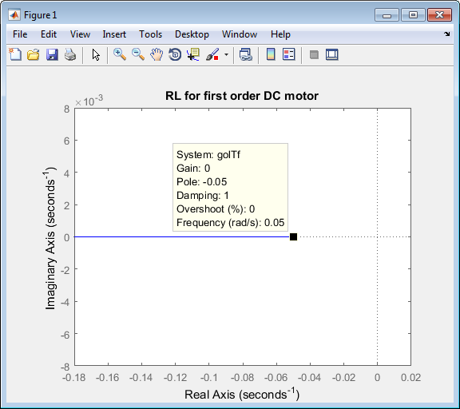
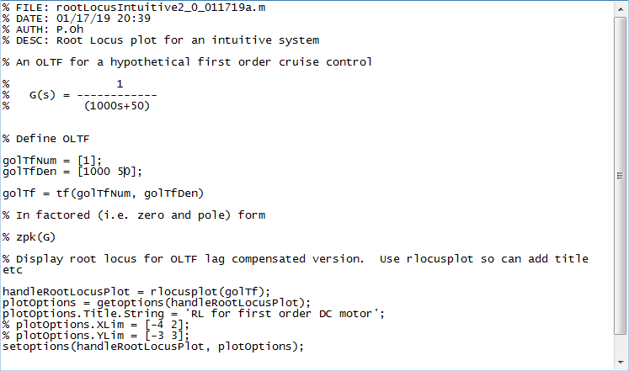
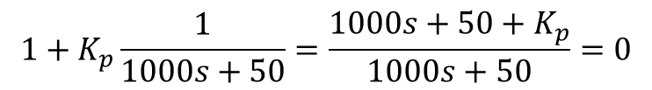

$$1+K_{p}\frac{1}{1000s+50}=\frac{1000s+50+K_{p}}{1000s+50}=0$$
01/17/19
$$1+K_{p}G_{p}\left(s\right)=0$$
Next time: Not sure how the above RL helps us “predict” response… i.e. if trace along the loci for a gain, say near 200, we still don’t know the output value…

Slide 8
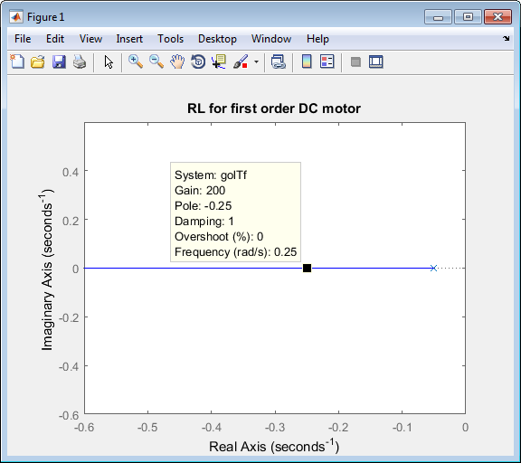
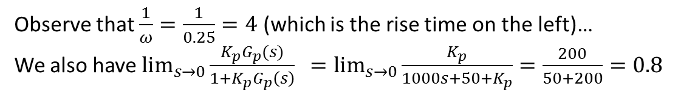
01/17/19
How does the above values from the RL (left) correspond to output response (right)?
Observe that $\frac{1}{ω}=\frac{1}{0.25}=4$ (which is the rise time on the left)…
We also have $\lim_{s→0}{\frac{K_{p}G_{p}(s)}{1+K_{p}G_{p}\left(s\right)} =\lim_{s→0}{\frac{K_{p}}{1000s+50+K_{p}}=\frac{200}{50+200}=0.8}}$
Note to self: Should be 8, not 0.8… missing something…

Slide 9
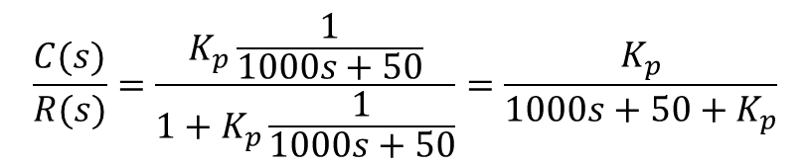

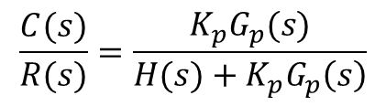

01/19/19
Recall from 01/17/19, that with (unity) feedback, we can (almost) get to the desired steady-state response
$$K_{p}=5000$$
$c_{ss}=9.89.;t_{r}=0.215$ sec
Recall from 01/17/19, that the CLTF for the above block diagram was
$$\frac{C(s)}{R(s)}=\frac{K_{p}\frac{1}{1000s+50}}{1+K_{p}\frac{1}{1000s+50}}=\frac{K_{p}}{1000s+50+K_{p}}$$
$$\frac{C(s)}{R(s)}=\frac{K_{p}G_{p}(s)}{H(s)+K_{p}G_{p}\left(s\right)}$$
Or

Slide 10
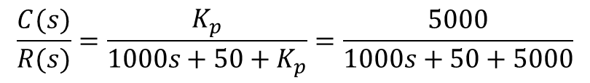
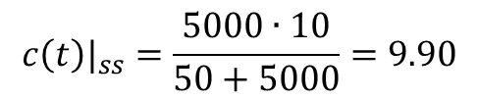
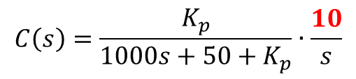
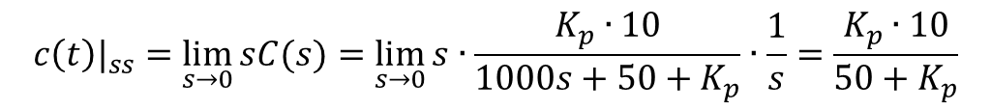
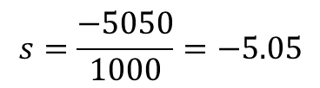


01/19/19
If we have step input $R\left(s\right)≐\frac{10}{s}$ (recall that command is 10 m/s) then have
$$C\left(s\right)=\frac{K_{p}}{1000s+50+K_{p}}∙\frac{10}{s}$$
But recall that Final Value Theorem says that
$$c\left(t\right)|_{ss}=\lim_{t→∞}{c(t)≡\lim_{s→0}{sC(s)}}$$
$$c\left(t\right)|_{ss}=\lim_{s→0}{sC(s)}=\lim_{s→0}{s∙\frac{K_{p}∙10}{1000s+50+K_{p}}∙\frac{1}{s}}=\frac{K_{p}∙10}{50+K_{p}}$$
Thus for our case, we have
Recall (previous slide and from 01/17/19), that for $K_{p}≐5000$ we had $c\left(t\right)|_{ss}=9.89$
$$c\left(t\right)|_{ss}=\frac{5000∙10}{50+5000}=9.90$$
Which is the same, thus QED
For this particular case ($K_{p}≐5000$) the CLTF is
$$\frac{C(s)}{R(s)}=\frac{K_{p}}{1000s+50+K_{p}}=\frac{5000}{1000s+50+5000}$$
So, the CLTF pole is
$$s=\frac{−5050}{1000}=−5.05$$

Slide 11
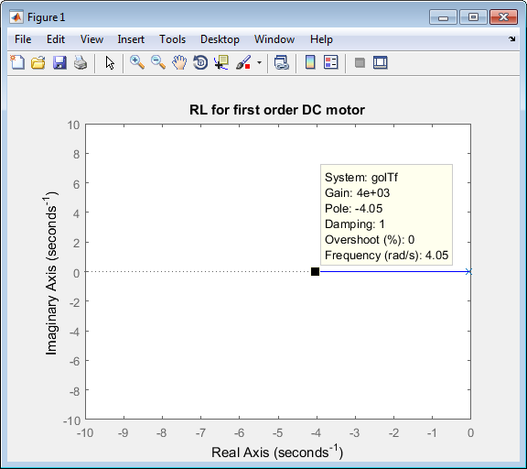
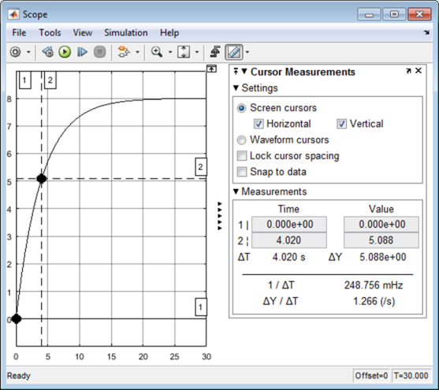
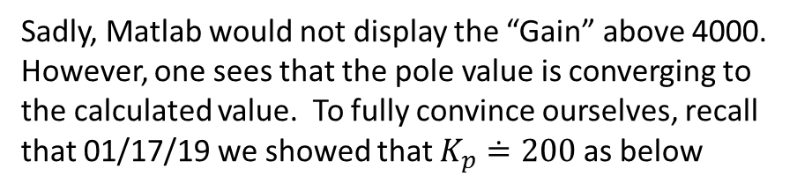
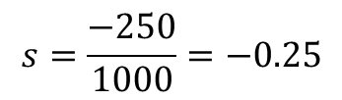
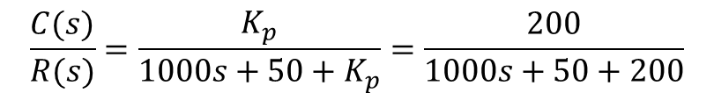
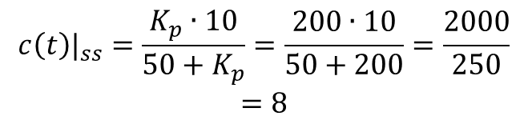
01/19/19
Sadly, Matlab would not display the “Gain” above 4000. However, one sees that the pole value is converging to the calculated value. To fully convince ourselves, recall that 01/17/19 we showed that $K_{p}≐200$ as below
The resulting CLTF would be
$$\frac{C(s)}{R(s)}=\frac{K_{p}}{1000s+50+K_{p}}=\frac{200}{1000s+50+200}$$
So, the CLTF pole is
$$s=\frac{−250}{1000}=−0.25$$
Thus QED
We also see for $K_{p}≐200$ that the steady-state would be
$$c\left(t\right)|_{ss}=\frac{K_{p}∙10}{50+K_{p}}=\frac{200∙10}{50+200}=\frac{2000}{250}$$
$$=8$$
Thus QED

Slide 12
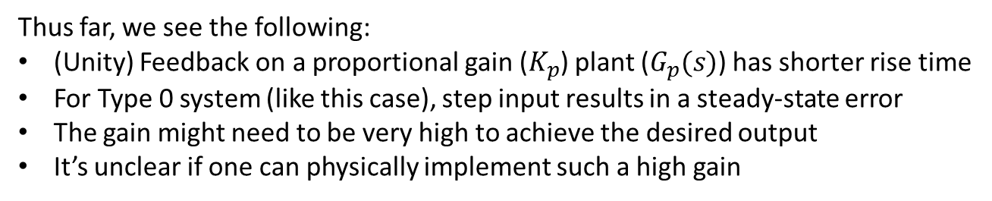

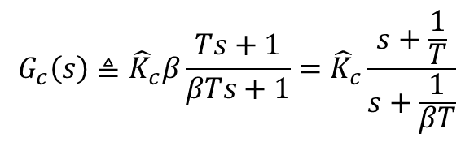
01/19/19
Thus far, we see the following:
(Unity) Feedback on a proportional gain ($K_{p}$) plant ($G_{p}(s)$) has shorter rise time
For Type 0 system (like this case), step input results in a steady-state error
The gain might need to be very high to achieve the desired output
It’s unclear if one can physically implement such a high gain
Lag control attempts to improve steady-state response. So, we can try to eliminate the steady-state error.
For our current design system, say $K_{p}≐200$, the error is quite high (10 m/s – 8 m/s = 2 m/s)
Let’s try to reduce this error by a 100th, i.e. we can live with 0.02 m/s of error…
$$G_{c}\left(s\right)≜{\hat{K}}_{c}β\frac{Ts+1}{βTs+1}={\hat{K}}_{c}\frac{s+\frac{1}{T}}{s+\frac{1}{βT}}$$
where ${\hat{K}}_{c}$: Gain of the lag compensator
Note to self: I believe that to reduce the error by a 100th, one sets $β≐100$
Next time: Try to create and test a lag compensator with the above equation and $β$

Slide 13
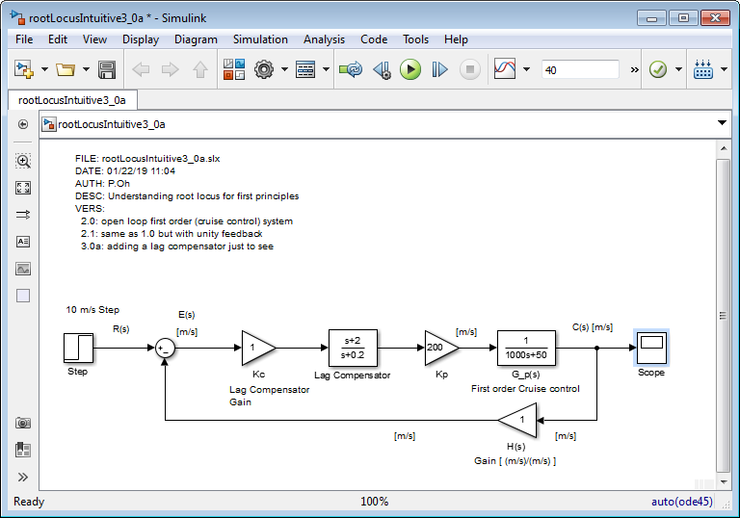
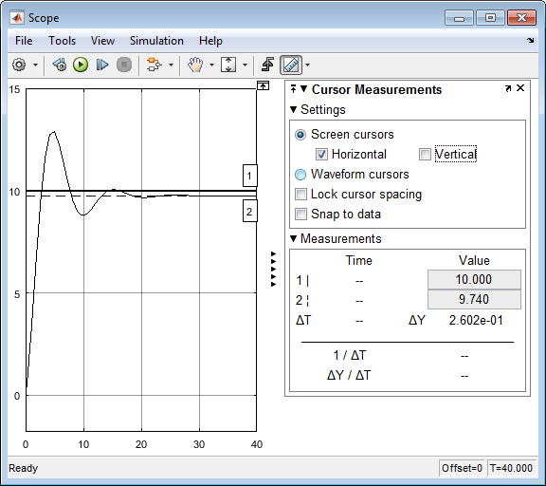
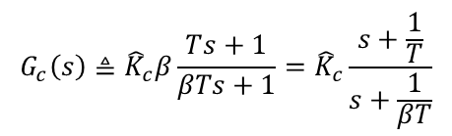



01/22/19
Recall from 01/19/19 that for $K_{p}≐200$, the steady-state error = 2 m/s
Let’s try to reduce this error by a 10th, i.e. we can live with 0.2 m/s of error…
$$G_{c}\left(s\right)≜{\hat{K}}_{c}β\frac{Ts+1}{βTs+1}={\hat{K}}_{c}\frac{s+\frac{1}{T}}{s+\frac{1}{βT}}$$
where ${\hat{K}}_{c}$: Gain of the lag compensator
To reduce the error by a 10th, one sets $β≐10$ and one has pole and zero near origin, so try:
$$G_{c}\left(s\right)≜{\hat{K}}_{c}\frac{s+\frac{1}{0.5}}{s+\frac{1}{β0.5}}={\hat{K}}_{c}\frac{s+2}{s+\frac{1}{5}}={\hat{K}}_{c}\frac{s+2}{s+0.2}$$
Observe: $e_{ss}=0.26$ m/s which is what we designed for

Slide 14



Uncompensated system (01/19/19)
Lag Compensated system (01/22/19)
01/22/19
$c_{ss}=8.0;t_{r}=4.$020 sec with $K_{p}≐200$
$c_{ss}=9.74;t_{r}=1.721$ sec with $K_{p}≐200$
Contrasting the above, we see that Lag Compensation introduces overshoot (and a shorter rise-time). This makes sense because Lag is like a $\frac{1}{s+0.2}≈\frac{1}{s}$ integrator.
Q1: Can one change ${\hat{K}}_{c}$ from “1” to another value, to reduce overshoot?
Next time: show RL for the lag compensated opened loop transfer function

Slide 15










01/23/19
Goal: Plot Root Locus of the following:
$$G_{c}(s)$$
$$G_{p}(s)$$
$$C\left(s\right)=K_{c}G_{c}{K_{p}G}_{p}E=K_{c}G_{c}K_{p}G_{p}\left\{R−CH\right\}$$
But say that
$$H(s)≐1$$
$$C\left(s\right)\left\{1+K_{c}G_{c}K_{p}G_{p}\right\}=K_{c}G_{c}K_{p}G_{p}R(s)$$
$$\frac{C(s)}{R(s)}=\frac{K\frac{s+z}{s+p}∙\frac{1}{1000s+50}}{1+K\frac{s+z}{s+p}∙\frac{1}{1000s+50}}$$
$$\frac{C(s)}{R(s)}=\frac{K_{c}G_{c}K_{p}G_{p}}{1+K_{c}G_{c}K_{p}G_{p}}$$
Where $K≜K_{c}K_{p}$
$$\frac{C(s)}{R(s)}=\frac{K(s+z)}{\left(s+p\right)\left(1000s+50\right)+K(s+z)}$$
This would be the opened loop TF $G_{o}(s)$
Note to self: I think the above might be wrong… see my ogataExample7.2-Notes-011419a.pptx

Slide 16











01/23/19
Using Ogata Example 7-2 (pg. 420) as guidance…
R(s)
$$\frac{C(s)}{R(s)}=\frac{G_{p}(s)}{1+G_{p}\left(s\right)}≜G(s)$$
$$R(s)$$
$$C\left(s\right)$$
$$\frac{G_{p}(s)}{1+G_{p}\left(s\right)}$$
$$\frac{\frac{1}{1000s+50}}{1+\frac{1}{1000s+50}}=\frac{1}{1000s+50+1}$$
Lag Compensated System is:
$$G_{c}(s)$$
$$G_{p}(s)$$
$$G_{c}\left(s\right)=K_{c}\frac{s+z}{s+p}$$
Where $z=2$ and $p=−0.2$
$$G_{c}\left(s\right)G\left(s\right)=K_{c}\frac{s+z}{s+p}∙\frac{1}{1000s+51}=K\left[\frac{s+2}{s+0.2}∙\frac{1}{1000s+51}\right]$$
Plot the RL of this

Slide 17


01/23/19
Looks like the same on U Michigan Cruise Control site (with zero = 0.3 and pole = 0.03
Next time: try things like sgrid(0.6, 0.36) and using the rlocfind command again

Slide 18
01/23/19

Slide 19
01/23/19

Slide 20
01/23/19

