Slide 1
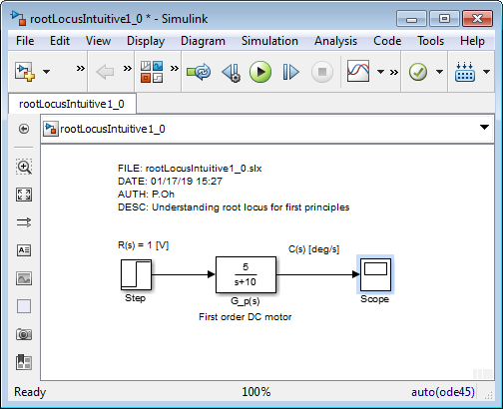
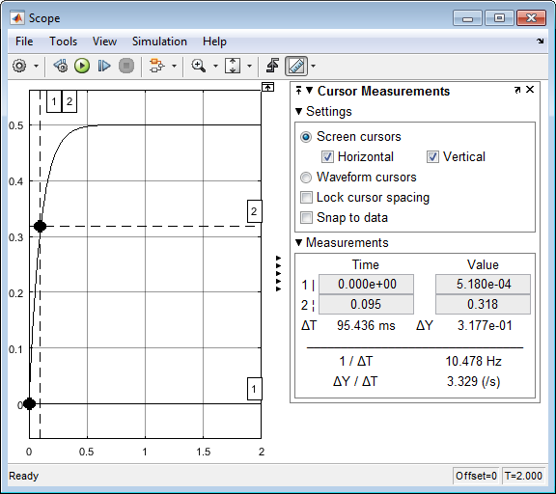
01/17/19

Slide 2
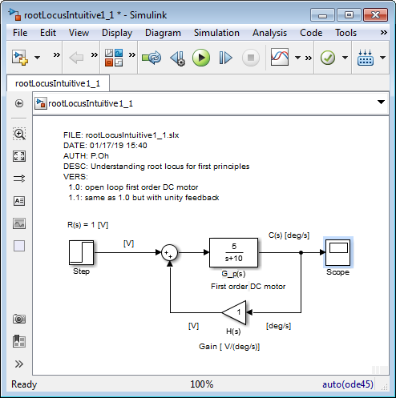
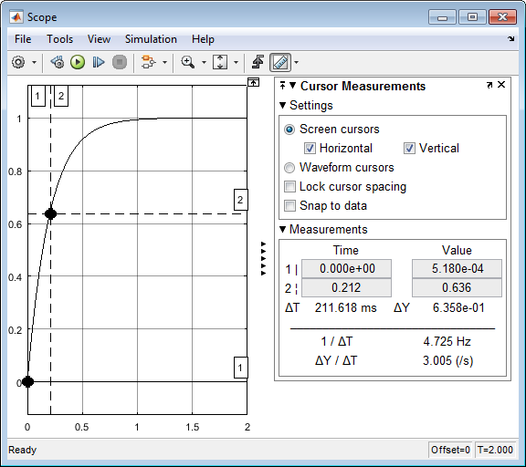
01/17/19

Slide 3
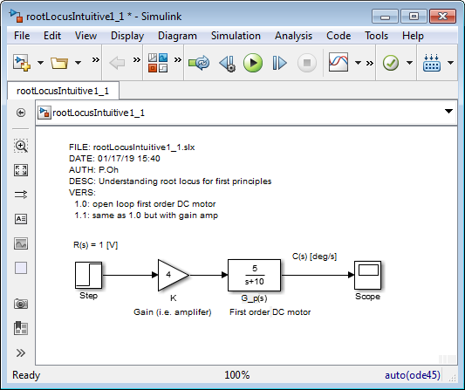
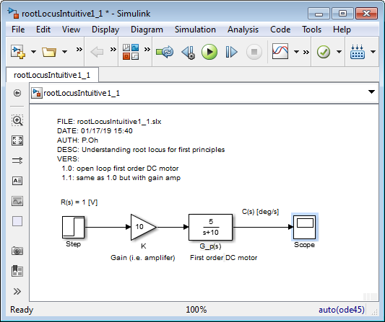
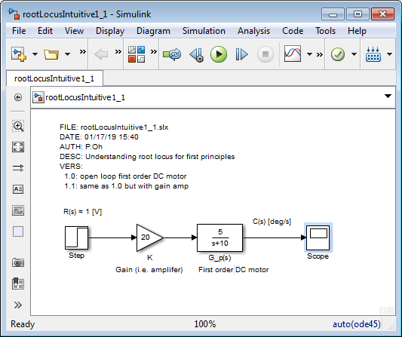
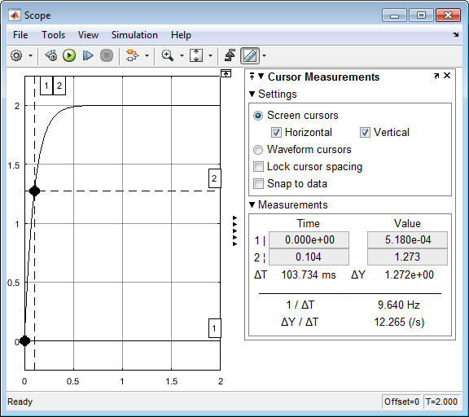
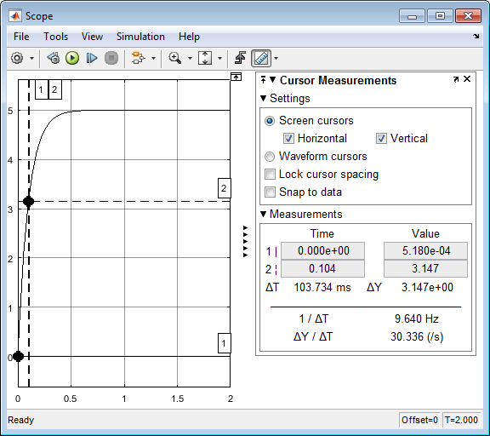
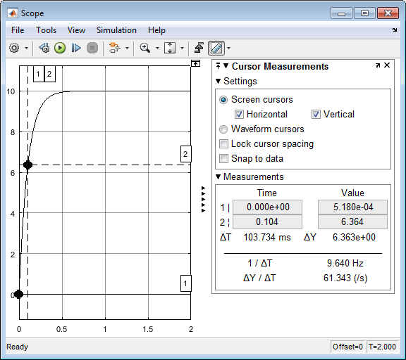
01/17/19

Slide 4
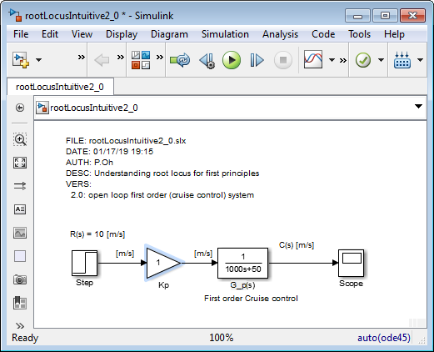
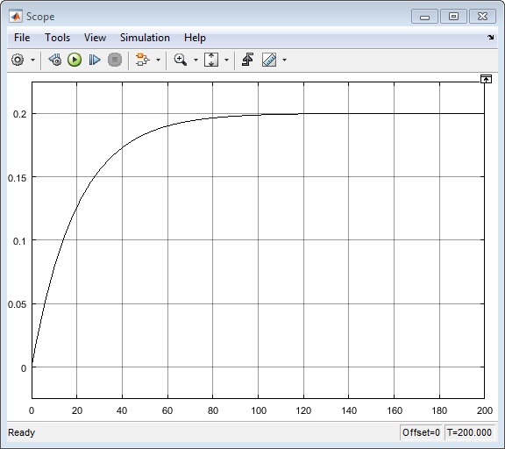
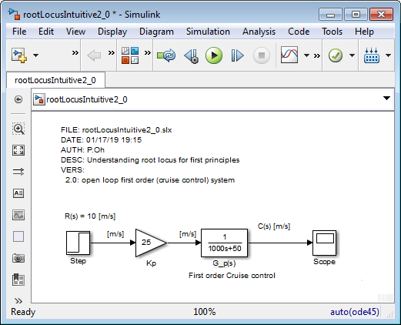
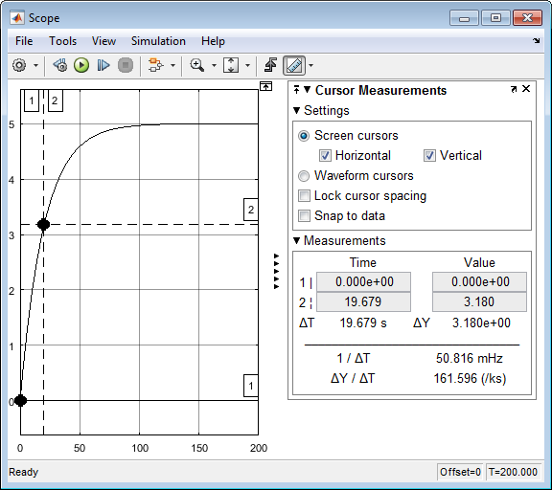
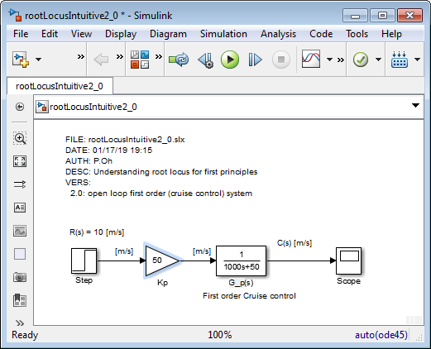
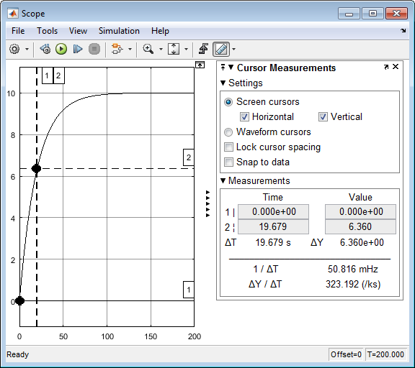






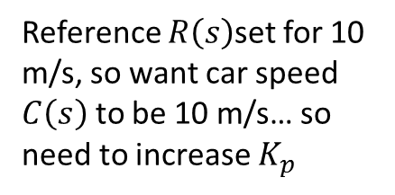
\labviewCourseDevelopment\labview=0X-RootLocus\pptRootLocusNotesAndFigures011719.pptx
01/17/19
Michigan reference: Cruise Control example
http://ctms.engin.umich.edu/CTMS/index.php?example=CruiseControl&section=ControlRootLocus
Reference $R\left(s\right)$set for 10 m/s, so want car speed $C\left(s\right)$ to be 10 m/s… so need to increase $K_{p}$
$$K_{p}=25$$
$c_{ss}=5;t_{r}=19.7$ sec
$$K_{p}=50$$
$c_{ss}=10;t_{r}=19.7$ sec

Slide 5
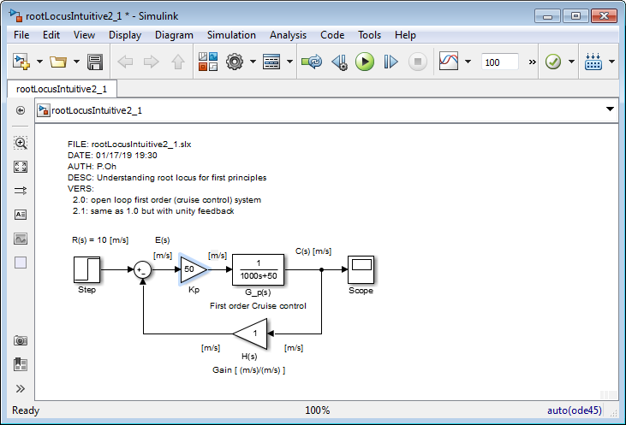

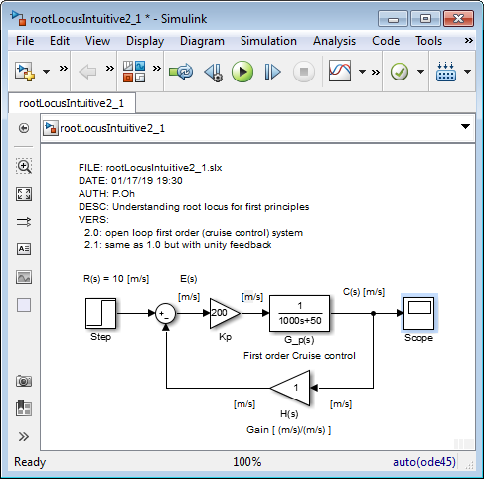
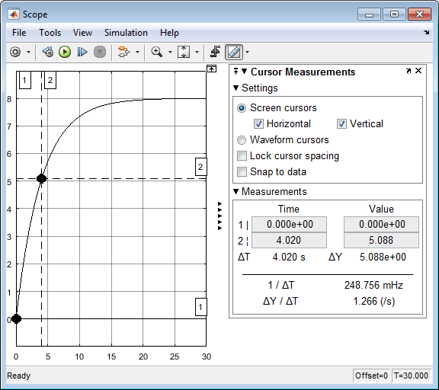
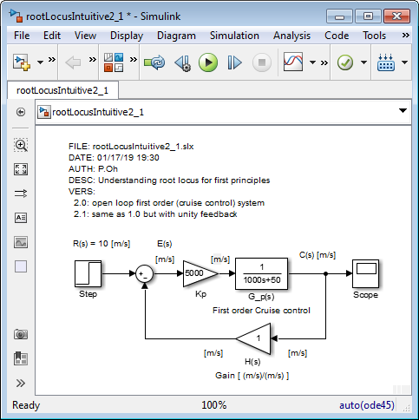





01/17/19
What happens when have (unit) feedback?
$K_{p}=50$ but with simply fed back the car’s speed
$c_{ss}=5;t_{r}=9.8 \text{sec}\text{ (}\text{with} \text{feedback}\text{) }\text{vs}\text{. }19.7$ sec (just open-loop). Rise time improves!
$K_{p}=2$00
$c_{ss}=8;t_{r}=4.02$ sec
$$K_{p}=5000$$
$c_{ss}=9.89.;t_{r}=0.215$ sec

Slide 6
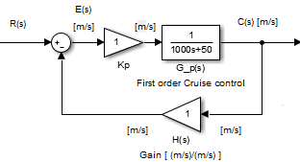
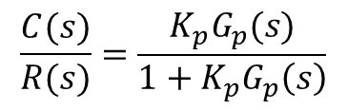
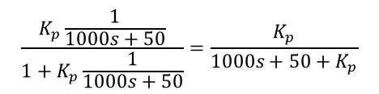


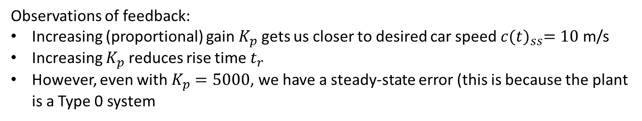


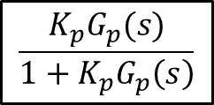
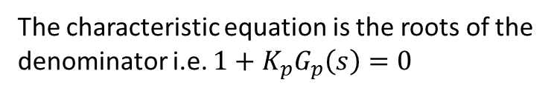
01/17/19
Observations of feedback:
Increasing (proportional) gain $K_{p}$ gets us closer to desired car speed $c{(t)}_{ss}=10$ m/s
Increasing $K_{p}$ reduces rise time $t_{r}$
However, even with $K_{p}=5000$, we have a steady-state error (this is because the plant is a Type 0 system
Wouldn’t be great if we can “predict” what the (closed-loop feedback) output would be (i.e. $c{(t)}_{ss}$) given different values of $K_{p}$? This is what the root locus plot does
$$G_{p}(s)$$
$$C\left(s\right)=E\left(s\right)K_{p}G_{p}\left(s\right)=K_{p}G_{p}(s)\left\{R\left(s\right)−C(s)\right\}$$
$$C\left(s\right)\left\{1+K_{p}G_{p}\left(s\right)\right\}=K_{p}G_{p}\left(s\right)R(s)$$
$$\frac{C(s)}{R(s)}=\frac{K_{p}G_{p}(s)}{1+K_{p}G_{p}\left(s\right)}$$
Hence:
Is the equivalent TF
$$R(s)$$
$$C\left(s\right)$$
$$\frac{K_{p}G_{p}(s)}{1+K_{p}G_{p}\left(s\right)}$$
The characteristic equation is the roots of the denominator i.e. $1+K_{p}G_{p}\left(s\right)=0$
$$\frac{K_{p}\frac{1}{1000s+50}}{1+K_{p}\frac{1}{1000s+50}}=\frac{K_{p}}{1000s+50+K_{p}}$$
Note to self: when s=0 and take limit, we see steady-state response matches of the graphs in previous slide

Slide 7
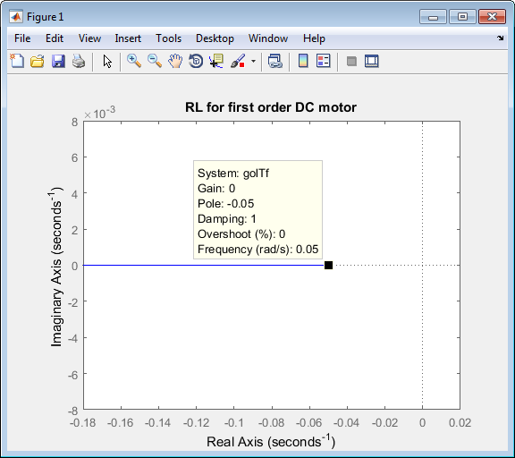
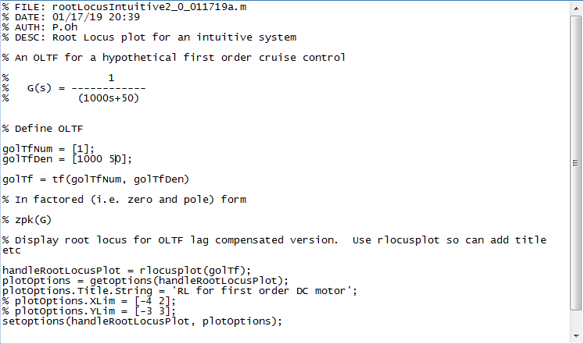
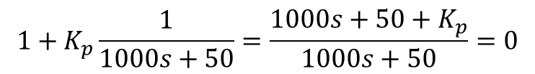

$$1+K_{p}\frac{1}{1000s+50}=\frac{1000s+50+K_{p}}{1000s+50}=0$$
01/17/19
$$1+K_{p}G_{p}\left(s\right)=0$$
Next time: Not sure how the above RL helps us “predict” response… i.e. if trace along the loci for a gain, say near 200, we still don’t know the output value…

Slide 8
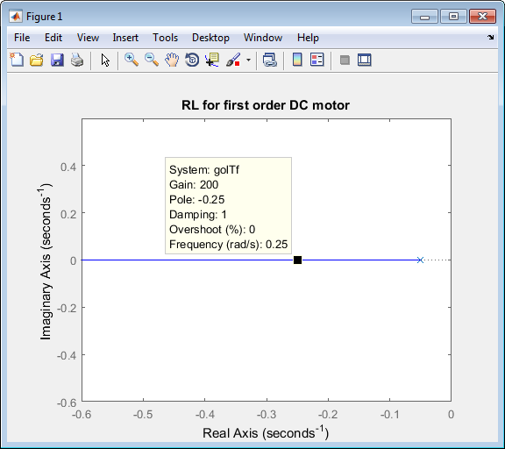
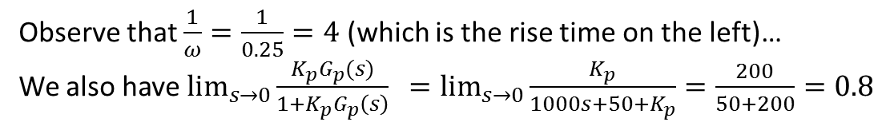
01/17/19
How does the above values from the RL (left) correspond to output response (right)?
Observe that $\frac{1}{ω}=\frac{1}{0.25}=4$ (which is the rise time on the left)…
We also have $\lim_{s→0}{\frac{K_{p}G_{p}(s)}{1+K_{p}G_{p}\left(s\right)} =\lim_{s→0}{\frac{K_{p}}{1000s+50+K_{p}}=\frac{200}{50+200}=0.8}}$
Note to self: Should be 8, not 0.8… missing something…

