Slide 1
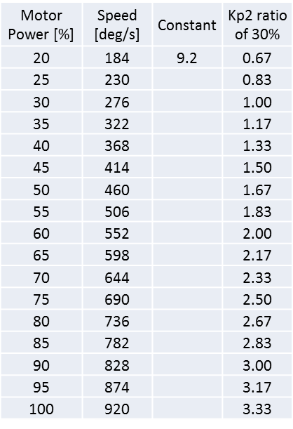
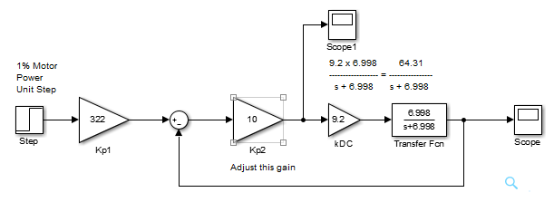
02/11/19
The 02/06/19 notes ended with some comments that sounded negative. Namely, that the NXT Motor/Wheel or Motor/Crank was not a suitable system to motivate unity (proportional) feedback and Root Locus; the rise time was simply too short.
Looking online for some DC speed control examples, many have short rise times. With such observation, I have renewed hope. Recall that 02/04/19 I began using 30% motor power and 02/06/19 wanted to have 460 deg/s output (which would correspond to a ~50% motor power. 02/06/19 experiments and (close-up) on simulations revealed saturation; motor power commands would (far exceed) 100%.
But this dawned on me: Let’s try commanding a lower desired speed.
Instead of 460 deg/s, perhaps try 322 deg/s (or 35% motor power)
Q1. What motor power needs does Simulink predict is needed?
nxtMotorSimulink021119d.slx
A1. Short answer: Even at $K_{p2}≐1$, motor power still > 100%

Slide 2
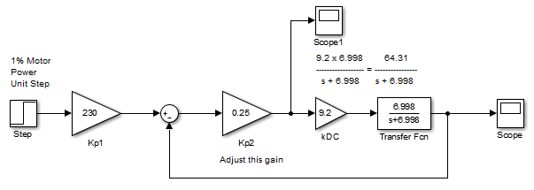
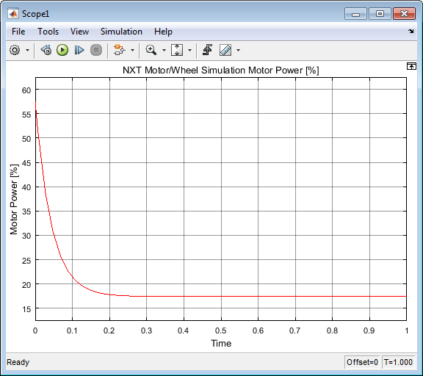
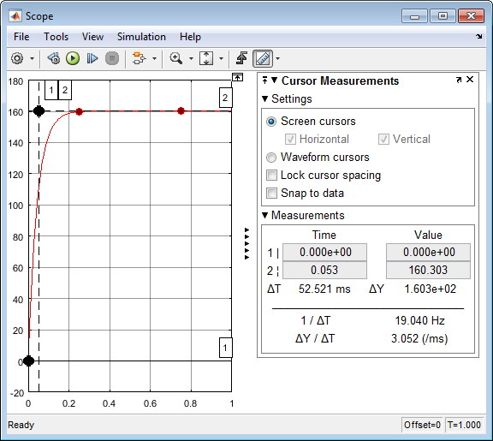
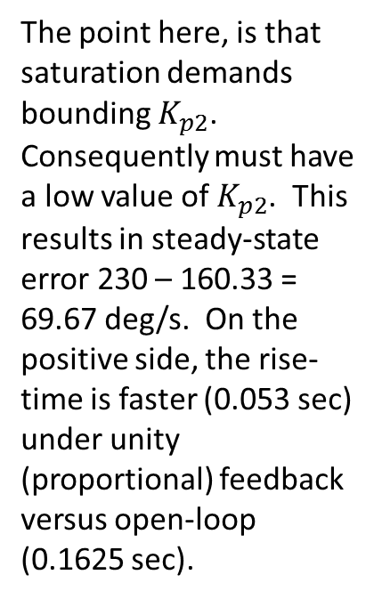
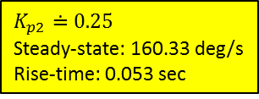

02/11/19
nxtMotorSimulink021119d.slx
The point here, is that saturation demands bounding $K_{p2}$. Consequently must have a low value of $K_{p2}$. This results in steady-state error 230 – 160.33 = 69.67 deg/s. On the positive side, the rise-time is faster (0.053 sec) under unity (proportional) feedback versus open-loop (0.1625 sec).
$$K_{p2}≐0.25$$
Peak (initial) motor power = ~57%
$$K_{p2}≐0.25$$
Steady-state: 160.33 deg/s
Rise-time: 0.053 sec
Q2. Lag compensation reduces steady-state error. But would motor power need > 100%

Slide 3
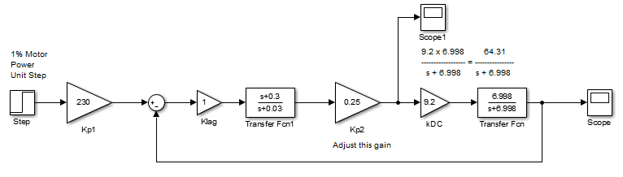
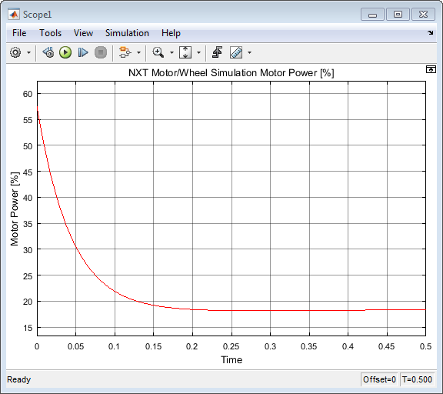
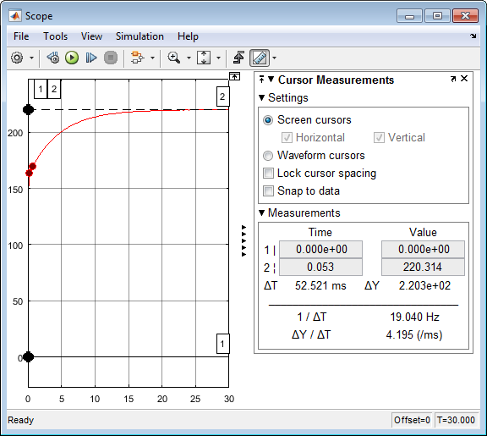
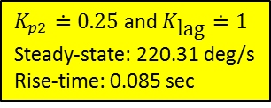
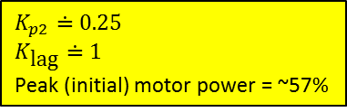
02/11/19
Q2. Lag compensation reduces steady-state error. But would motor power need > 100%
A2. As seen below, peak (initial) motor power is still ~57%
nxtMotorSimulink021119e.slx
So, things look promising. For the pole and zero values to the left, we still have steady-state error of 230-220.31 = 9.7 deg/sec.
But one can tweak the lag compensation pole and zero values to reduce the steady state error more.
$$K_{p2}≐0.25$$
$$K_{\text{lag}}≐1$$
Peak (initial) motor power = ~57%
$K_{p2}≐0.25$ and $K_{\text{lag}}≐1$
Steady-state: 220.31 deg/s
Rise-time: 0.085 sec
Q3. So, what does the root locus look like with the lag compensator?

Slide 4
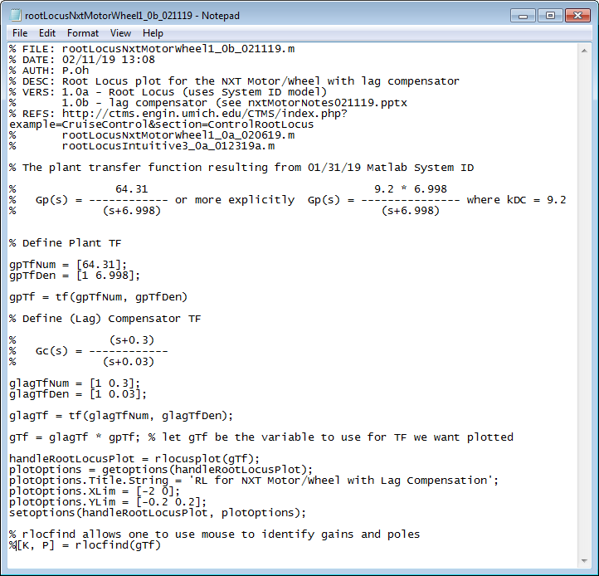
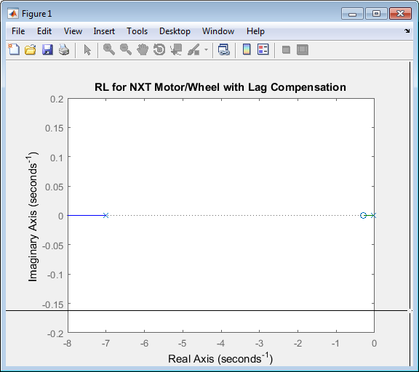
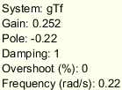
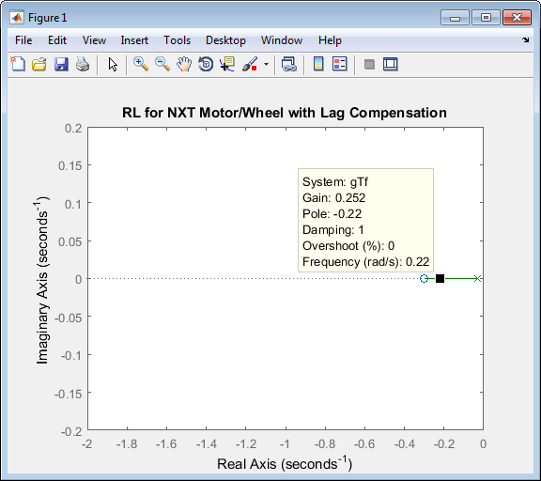
02/11/19
Q3. So, what does the root locus look like with the lag compensator?
A3. Below is rootLocusNxtMotorWheel1_0b_021119.m with $G_{c}\left(s\right)≐K_{\text{lag}}\frac{s+0.3}{s+0.03}$ and $K_{\text{lag}}≐1$
Close-up RL

Slide 5
02/11/19

