Slide 1
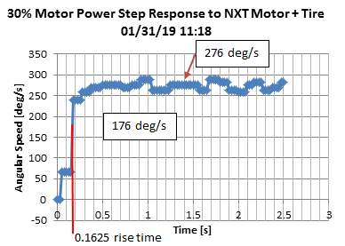
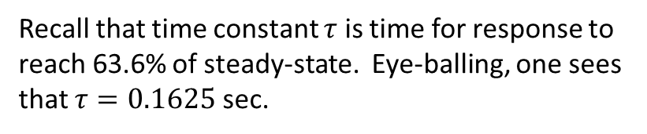
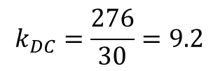
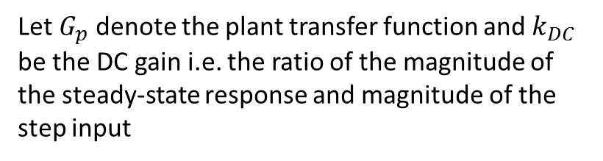
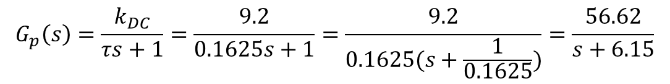
01/31/19
Preamble: Over the past few days, an NXT motor stand (with tire) with Hi Technic Angle Sensor was constructed. The goals are: (1) compare open-loop with unity feedback; (2) show root locus; and (3) possibly design compensators (e.g. lag). Below is the result of F:\nationalInstruments\paulOhNxtLabviewProjects\helloWorld-MotorControlWithDial\nxtMotorStepResponse1_0a.vi
Recall that time constant $τ$ is time for response to reach 63.6% of steady-state. Eye-balling, one sees that $τ=0.1625$ sec.
Let $G_{p}$ denote the plant transfer function and $k_{DC}$ be the DC gain i.e. the ratio of the magnitude of the steady-state response and magnitude of the step input
$$k_{DC}=\frac{276}{30}=9.2$$
$$G_{p}\left(s\right)=\frac{k_{DC}}{τs+1}=\frac{9.2}{0.1625s+1}=\frac{9.2}{0.1625(s+\frac{1}{0.1625})}=\frac{56.62}{s+6.15}$$

Slide 2
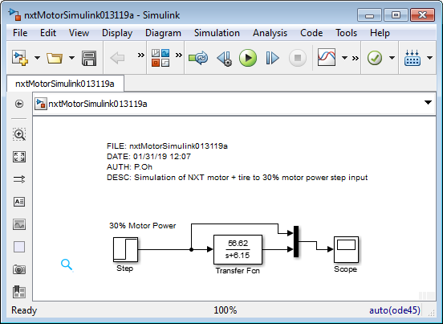
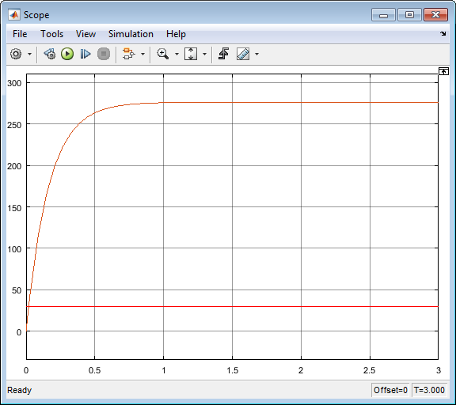
01/31/19
Simulink appears to have similar step response as experimental one

Slide 3
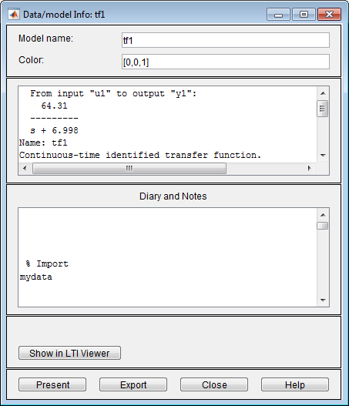
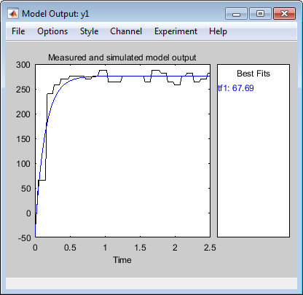
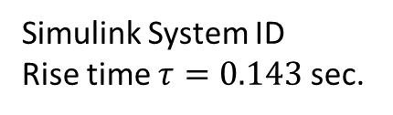
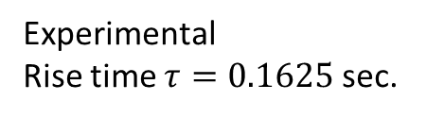

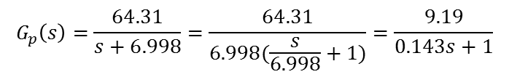
01/31/19
$$G_{p}\left(s\right)=\frac{56.62}{s+6.15}=\frac{9.2}{0.1625s+1}$$
$$G_{p}\left(s\right)=\frac{64.31}{s+6.998}=\frac{64.31}{6.998(\frac{s}{6.998}+1)}=\frac{9.19}{0.143s+1}$$
Experimental
Rise time $τ=0.1625$ sec.
Simulink System ID
Rise time $τ=0.143$ sec.
Next time: Add gain to nxtMotorSimulink01311b.slx to analyze desired response. For example, suppose want 300 RPM, what value of gain should be used? Compare open-loop proportional gain vs. unity feedback proportional gain

Slide 4
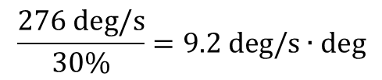
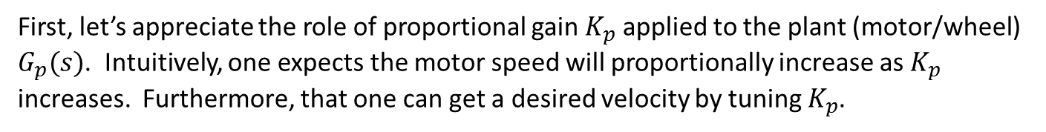
02/04/19
From 01/31/19, Matlab System ID provided a model. The model’s results appear somewhat close to that from experimental data.
First, let’s appreciate the role of proportional gain $K_{p}$ applied to the plant (motor/wheel) $G_{p}(s)$. Intuitively, one expects the motor speed will proportionally increase as $K_{p}$ increases. Furthermore, that one can get a desired velocity by tuning $K_{p}$.
To begin, 01/31/19 experimentally showed that a 30% motor power input results in 276 deg/s. Assuming proportionality, this results in:
$$\frac{276 \text{deg}\text{/}\text{s}}{30\%}=9.2 \text{deg}\text{/}\text{s}∙\text{deg}$$
Motor Power [%] | Speed [deg/s] | Constant
20 | 184 | 9.2
25 | 230
30 | 276
35 | 322
40 | 368
45 | 414
50 | 460
55 | 506
60 | 552
65 | 598
70 | 644
75 | 690
80 | 736
85 | 782
90 | 828
95 | 874
100 | 920
The table on the left is an Excel calculation with this constant for various motor power values
Let’s apply some of these values on the System ID derived $G_{p}$
Note to self: I realized after creating this table, that one should express a proportionality constant explicitly… hence the next slides

Slide 5
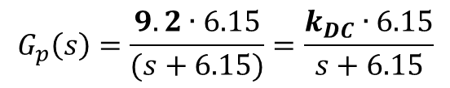
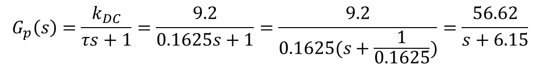
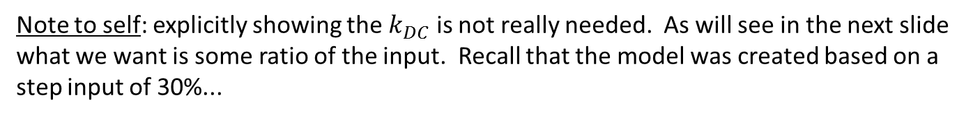
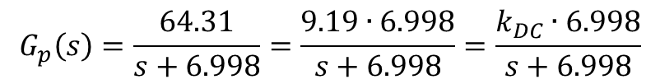
02/04/19
Recall from 01/31/19 had the form:
$$G_{p}\left(s\right)=\frac{k_{DC}}{τs+1}=\frac{9.2}{0.1625s+1}=\frac{9.2}{0.1625(s+\frac{1}{0.1625})}=\frac{56.62}{s+6.15}$$
Expressing this more explicitly:
$$G_{p}\left(s\right)=\frac{9.2∙6.15}{(s+6.15)}=\frac{k_{DC}∙6.15}{s+6.15}$$
For, the System ID derived model, one has:
$$G_{p}\left(s\right)=\frac{64.31}{s+6.998}=\frac{9.19∙6.998}{s+6.998}=\frac{k_{DC}∙6.998}{s+6.998}$$
Note to self: explicitly showing the $k_{DC}$ is not really needed. As will see in the next slide what we want is some ratio of the input. Recall that the model was created based on a step input of 30%...

Slide 6
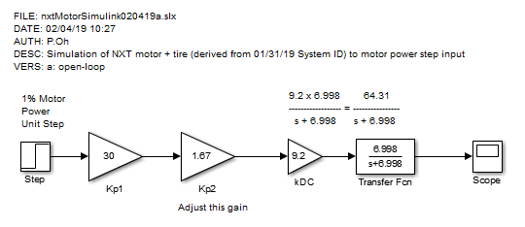
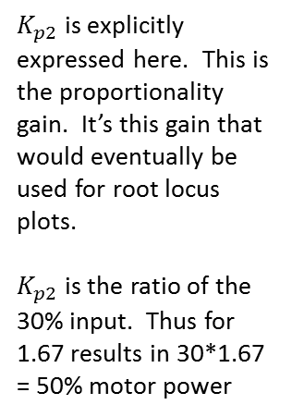
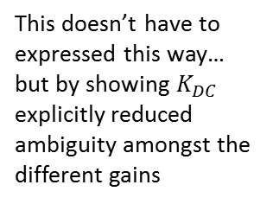
02/04/19
This doesn’t have to expressed this way… but more explicitly shows that the unit step is 30%
This doesn’t have to expressed this way… but by showing $K_{DC}$ explicitly reduced ambiguity amongst the different gains
$K_{p2}$ is explicitly expressed here. This is the proportionality gain. It’s this gain that would eventually be used for root locus plots.
$K_{p2}$ is the ratio of the 30% input. Thus for 1.67 results in 30*1.67 = 50% motor power

Slide 7
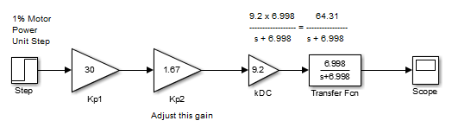
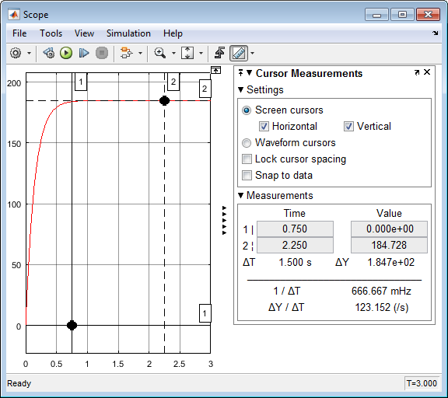







02/04/19
Motor Power [%] | Speed [deg/s] | Constant | Kp2 ratio of 30%
20 | 184 | 9.2 | 0.67
25 | 230 |  | 0.83
30 | 276 |  | 1.00
35 | 322 |  | 1.17
40 | 368 |  | 1.33
45 | 414 |  | 1.50
50 | 460 |  | 1.67
55 | 506 |  | 1.83
60 | 552 |  | 2.00
65 | 598 |  | 2.17
70 | 644 |  | 2.33
75 | 690 |  | 2.50
80 | 736 |  | 2.67
85 | 782 |  | 2.83
90 | 828 |  | 3.00
95 | 874 |  | 3.17
100 | 920 |  | 3.33
$K_{p2}=0.67$ yield 20% and 184 deg/s
$K_{p2}=1.0$ yield 30% and 276 deg/s
$K_{p2}=1.33$ yield 40% and 367 deg/s
$K_{p2}=1.$67 yield 50% and 460 deg/s

Slide 8
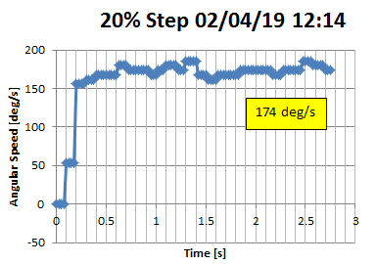

02/04/19
OK… let’s capture experimental results. One wonders if the real plant (motor/wheel) will give the same speed values. Intuitively, there should be differences: (1) being non-linear, the motor speed output is not perfectly proportional to motor power input; and (2) being a Type 0 system, there should be discrete steady-state error.
Hopefully, by showing the (1) and (2), we can motivate unity-feedback and root locus
Wrote F:\nationalInstruments\paulOhNxtLabviewProjects\helloWorld-MotorControlWithDial\nxtMotorStepResponse1_1a.vi
Results of experimental (left) vs. simulation with System ID derived model (right)
$K_{p2}=0.67$ yield 20% and 184 deg/s

Slide 9
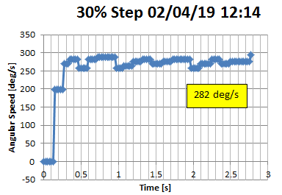
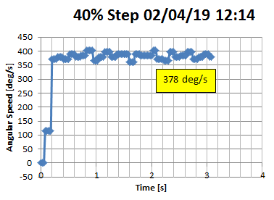


02/04/19
$K_{p2}=1.0$ yield 30% and 276 deg/s
$K_{p2}=1.33$ yield 40% and 367 deg/s

Slide 10
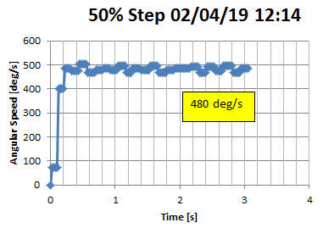
02/04/19
$K_{p2}=1.$67 yield 50% and 460 deg/s
Observations: Experimental data shows “noise”; the steady-state velocity fluctuates (eye-balling, it can be +/- 10 degree/s. Also, values are (somewhat) different (up to +/- 20 deg/s) from simulated ones.

Slide 11
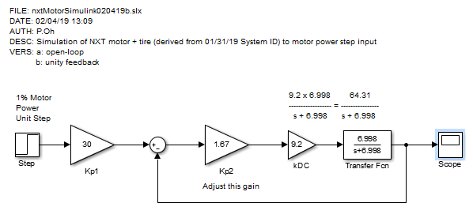

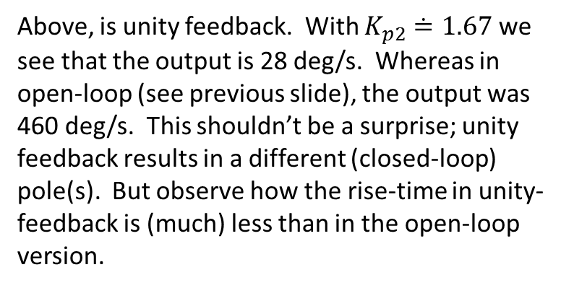
02/04/19
Above, is unity feedback. With $K_{p2}≐1.67$ we see that the output is 28 deg/s. Whereas in open-loop (see previous slide), the output was 460 deg/s. This shouldn’t be a surprise; unity feedback results in a different (closed-loop) pole(s). But observe how the rise-time in unity-feedback is (much) less than in the open-loop version.

Slide 12
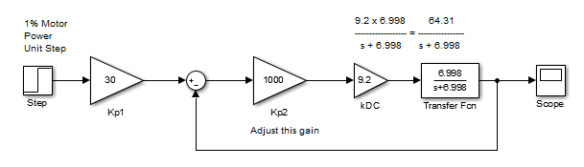
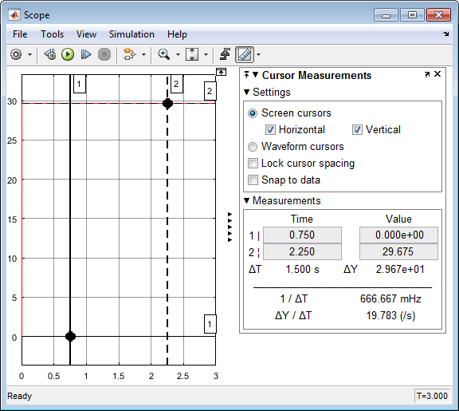





02/04/19
$K_{p2}≐10$ yields 29.675 deg/s
$K_{p2}≐100$ yields 29.969 deg/s
$K_{p2}≐1000$ yields 29.998 deg/s
One observes that increasing $K_{p2}$ simply gets the output to be closer to the input value (30).
Question: So, what does one have to do, to get the desired output e.g. 460 deg/s?

Slide 13
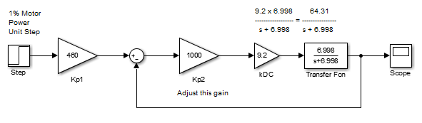



02/04/19
In essence, by invoking unity feedback, one has changed the problem. (Note to self: call it a regulator?). So, the input is now the desired output value.
$K_{p1}≐$460 yields 460.171 deg/s
Next time: See if I can implement this unity feedback experimentally… possible concern: NXT motor has saturation (i.e. max 100% motor power)
$K_{p2}≐1000$ yields 29.998 deg/s

Slide 14
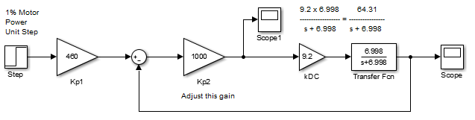
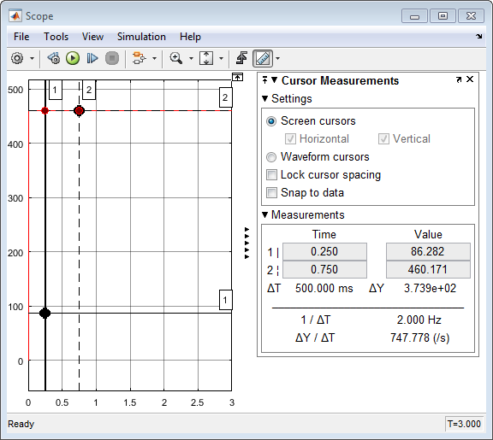
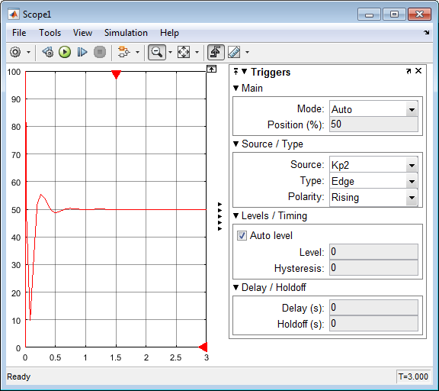

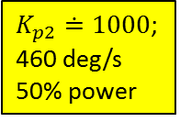
02/06/19
I did not document this, but yesterday 02/05/19 I attempted unity feedback on Labview: nxtMotorStepResponse1_2a.vi. However, performance appeared strange. I think it was due to saturation (where I implemented a “In Range and Coerce” block.
Recall nxtMotorSimulink020419c.slx
Let’s show responses to different $K_{p2}$
One observes that for a short time, motor power > 100%
i.e. Saturation!
$K_{p2}≐1000$; 460 deg/s
50% power

Slide 15
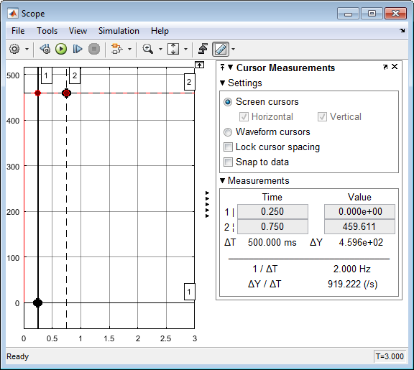
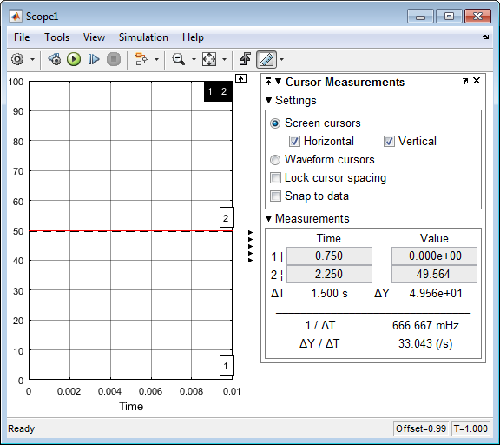
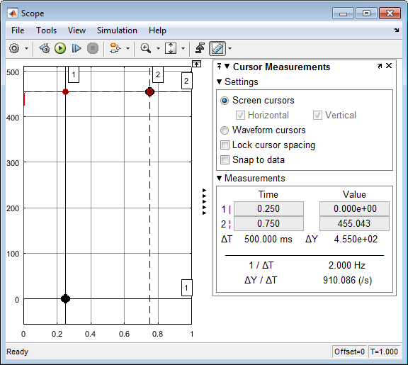
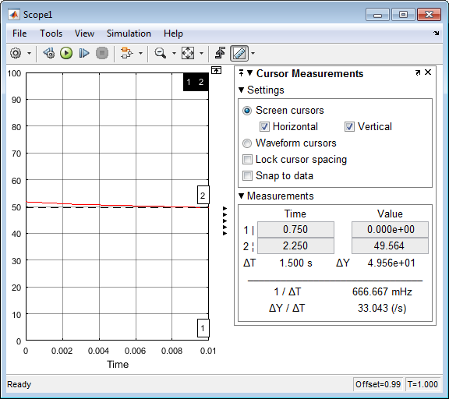
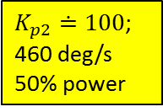
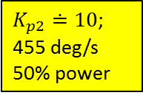
02/06/19
$K_{p2}≐100$; 460 deg/s
50% power
$K_{p2}≐10$; 455 deg/s
50% power

Slide 16
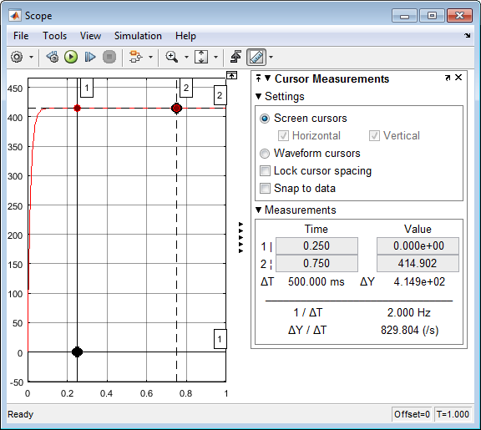
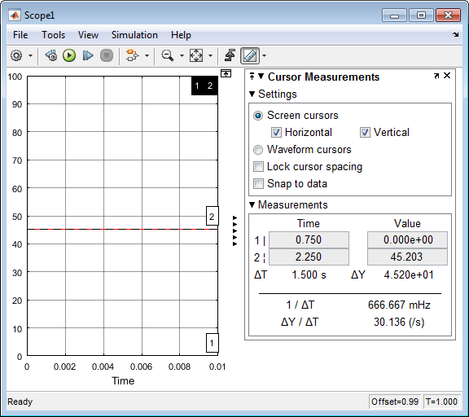

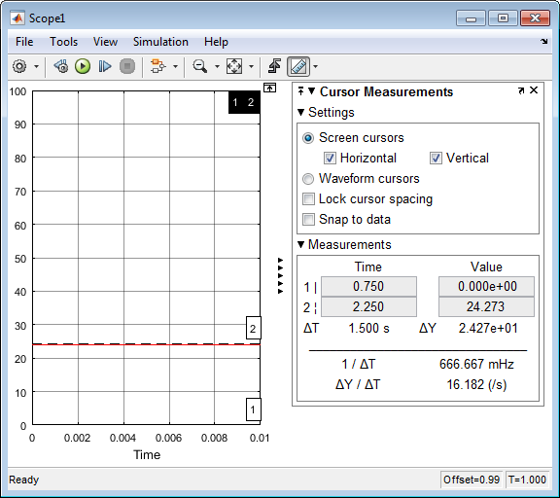
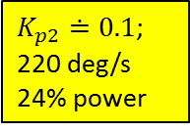
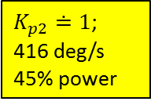
02/06/19
$K_{p2}≐1$;
416 deg/s
45% power
$K_{p2}≐0.1$;
220 deg/s
24% power

Slide 17
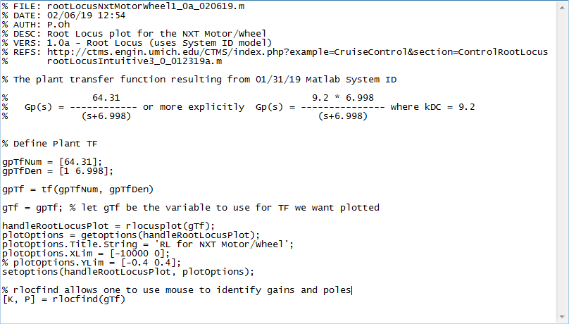
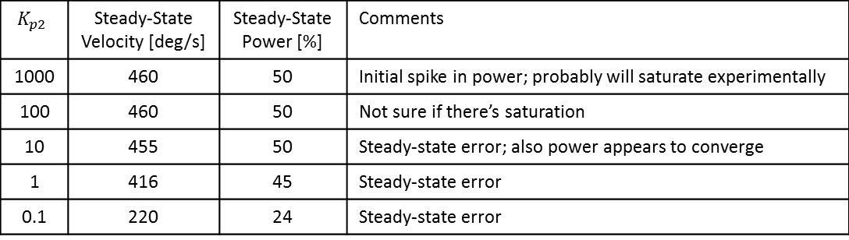
02/06/19
$$K_{p2}$$ | Steady-State Velocity [deg/s] | Steady-State Power [%] | Comments
1000 | 460 | 50 | Initial spike in power; probably will saturate experimentally
100 | 460 | 50 | Not sure if there’s saturation
10 | 455 | 50 | Steady-state error; also power appears to converge
1 | 416 | 45 | Steady-state error
0.1 | 220 | 24 | Steady-state error
Matlab rlocfind command

Slide 18
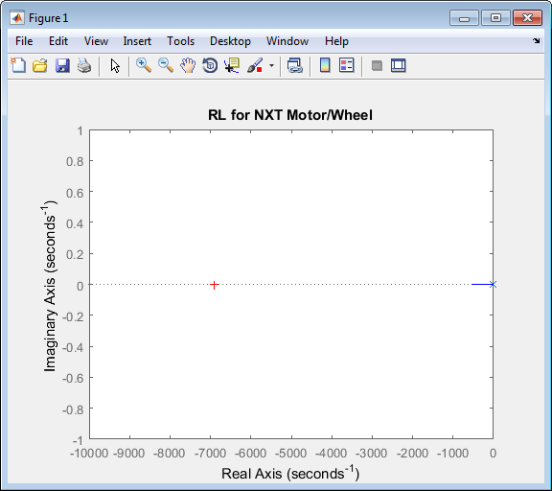


02/06/19
The above is a result of executing rootLocusNxtMotorWheel1_0a_020619.m. We see that it displays the RL plot, and then one can click a spot, and the command window shows the gain e.g. $K_{p2}=107.3019$ and resulting pole location $s=−6907.6$

Slide 19



02/06/19
Re-running nxtMotorSimulink020419c.slx with $K_{p2}≐100$ (but for 0.01 seconds)
We observe that there is indeed saturation… Moreover, the rise time is unrealistically short

Slide 20

02/06/19
Observations
Large $K_{p2}$ (e.g. > 100) is unrealistic experimentally; motor will saturate
I tried $K_{p2}≐1…7$ and while there’s (smaller) steady-state error, upon close examination, there is still saturation
Lower $K_{p2}$ (e.g. < 1 like 0.5) results in larger steady-state errors (80+ deg/sec) . Not clear from simulation if there is saturation
Thoughts
NXT Motor/Wheel may not be a good example; the rise-time of this 1st order plant is rather short
May need a system with a larger load (e.g. NXT motor on a conveyor) which has larger rise-time (say, about 1 second worth) at lower power (say 30% motor power)
Could have NXT motor with gear reduction so that conveyor moves very slowly

Slide 21
02/06/19

