Slide 1
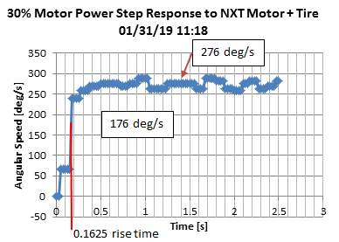
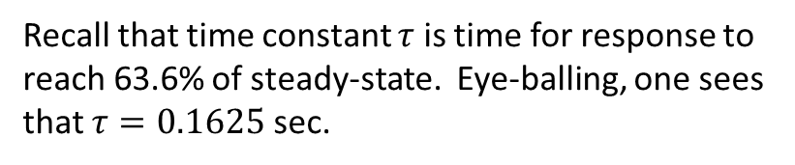
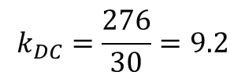
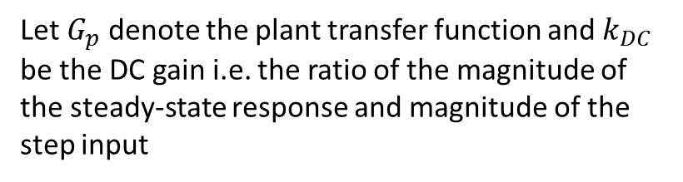
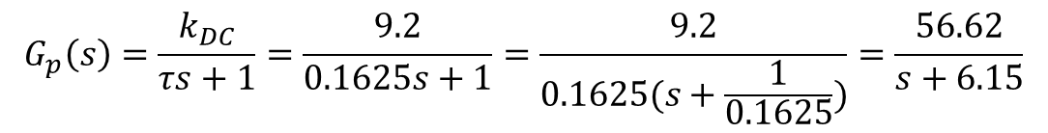
01/31/19
Preamble: Over the past few days, an NXT motor stand (with tire) with Hi Technic Angle Sensor was constructed. The goals are: (1) compare open-loop with unity feedback; (2) show root locus; and (3) possibly design compensators (e.g. lag). Below is the result of F:\nationalInstruments\paulOhNxtLabviewProjects\helloWorld-MotorControlWithDial\nxtMotorStepResponse1_0a.vi
Recall that time constant $τ$ is time for response to reach 63.6% of steady-state. Eye-balling, one sees that $τ=0.1625$ sec.
Let $G_{p}$ denote the plant transfer function and $k_{DC}$ be the DC gain i.e. the ratio of the magnitude of the steady-state response and magnitude of the step input
$$k_{DC}=\frac{276}{30}=9.2$$
$$G_{p}\left(s\right)=\frac{k_{DC}}{τs+1}=\frac{9.2}{0.1625s+1}=\frac{9.2}{0.1625(s+\frac{1}{0.1625})}=\frac{56.62}{s+6.15}$$

Slide 2
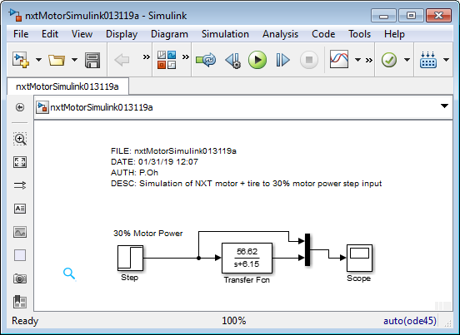
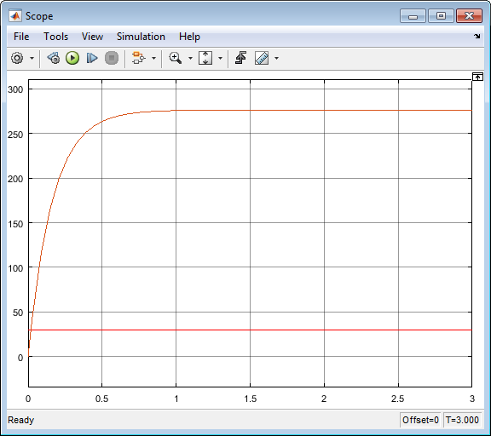
01/31/19
Simulink appears to have similar step response as experimental one

Slide 3
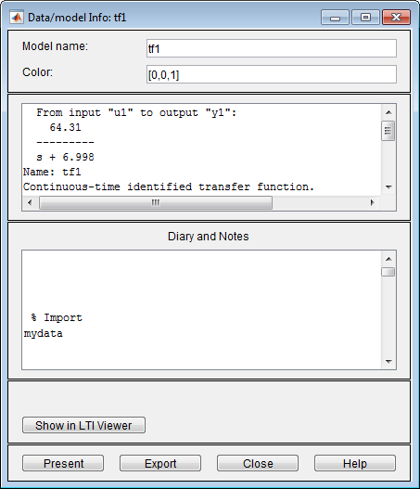
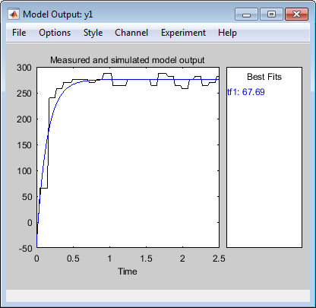
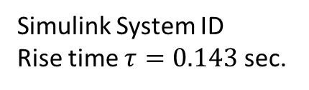
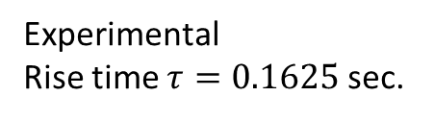

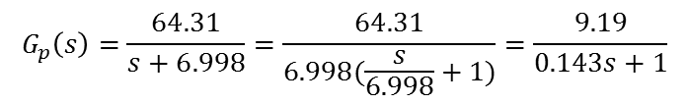
01/31/19
$$G_{p}\left(s\right)=\frac{56.62}{s+6.15}=\frac{9.2}{0.1625s+1}$$
$$G_{p}\left(s\right)=\frac{64.31}{s+6.998}=\frac{64.31}{6.998(\frac{s}{6.998}+1)}=\frac{9.19}{0.143s+1}$$
Experimental
Rise time $τ=0.1625$ sec.
Simulink System ID
Rise time $τ=0.143$ sec.
Next time: Add gain to nxtMotorSimulink01311b.slx to analyze desired response. For example, suppose want 300 RPM, what value of gain should be used? Compare open-loop proportional gain vs. unity feedback proportional gain

Slide 4
01/31/19

