Slide 1
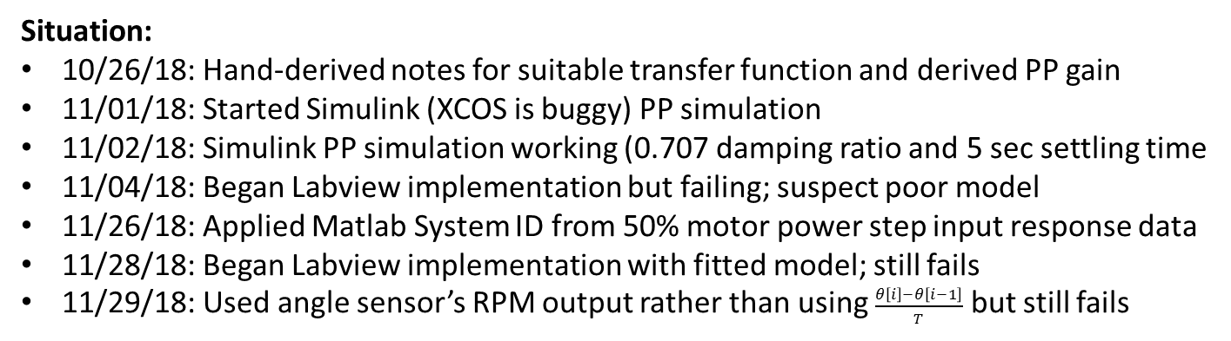
Goal: Pole Placement of LEGO DCP via Simulink and Labview (notes created: 11/29/18)
Situation:
10/26/18: Hand-derived notes for suitable transfer function and derived PP gain
11/01/18: Started Simulink (XCOS is buggy) PP simulation
11/02/18: Simulink PP simulation working (0.707 damping ratio and 5 sec settling time
11/04/18: Began Labview implementation but failing; suspect poor model
11/26/18: Applied Matlab System ID from 50% motor power step input response data
11/28/18: Began Labview implementation with fitted model; still fails
11/29/18: Used angle sensor’s RPM output rather than using $\frac{θ\left[i\right]−θ\left[i−1\right]}{T}$ but still fails

Slide 2
Damped Compound Pendulum Equations of Motion
(3)
Linearized 2nd order differential equation assumes small angles
Bar length [m]
Pivot to CG distance [m]
Mass of pendulum [kg]
Moment of Inertia
Viscous damping coefficient

Slide 3
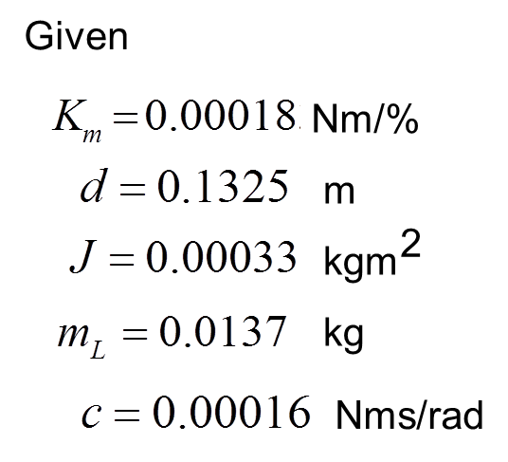
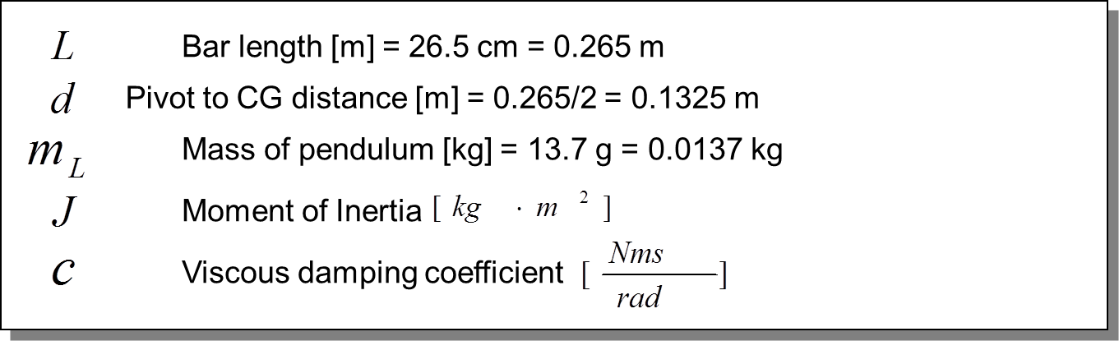






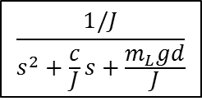













DCP Plant Model
$$\frac{1/J}{s^{2}+\frac{c}{J}s+\frac{m_{L}gd}{J}}$$
$$\frac{0.00018}{0.00033}=0.545$$
$$Μ\left(s\right)$$
$$K_{m}$$
$$Τ\left(s\right)$$
$$Θ^{∗}\left(s\right)$$
$$Θ\left(s\right)$$
$$\frac{50}{31}$$
$$0.00018$$
$$\frac{1/0.00033}{s^{2}+0.485s+53.96}$$
$$\frac{180}{3.14}$$
[deg]
[%]
$$\left[\frac{Nm}{\%}\right]$$
[rad]
[deg]
$M(s)$ is motor power input [%]
$K_{m}$ is gain and derived in nxtLabview-SimulinkTesting-111218a.pdf Equations (5)-(7)
$$\frac{0.00018}{0.00033}=0.545$$
$$\frac{0.00018∗1∗180}{0.00033∗3.14}=0.545\frac{180}{3.14}=31.27$$
$$Μ\left(s\right)$$
$$Θ^{∗}\left(s\right)$$
$$Μ\left(s\right)$$
$$Θ\left(s\right)$$
Used this TF initially
$$\frac{0.545}{s^{2}+0.485s+53.96}$$
$$\frac{31.27}{s^{2}+0.485s+53.96}$$
[%]
[rad]
[%]
[deg]

Slide 4
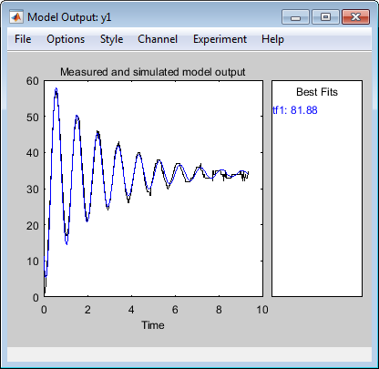
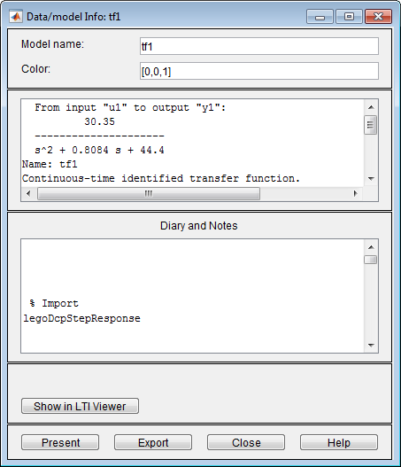








11/26/18: Suspecting that poor model caused Labview PP to fail, Matlab System ID toolbox was used
Blue: Simulated step response
Red: Experimental step response
$$\text{TF}\text{ = }\frac{30.35}{s^{2}+0.8084s+44.4}=\frac{Θ\left(s\right)}{M\left(s\right)}$$
$$\text{TF}\text{ = }\frac{31.27}{s^{2}+0.485s+53.96}=\frac{Θ\left(s\right)}{M\left(s\right)}$$
Matlab System ID
Hand calculations
Poles = $−0.4042±6.6511i$
Poles = $−0.2425±7.3417i$
$$θ=\tan^{−1}{\frac{0.4042}{6.6511}=0.061 \text{deg}}$$
$$θ=\tan^{−1}{\frac{0.2425}{7.3417}=0.033 \text{deg}}$$
$$ζ=\sin{0.061=0.061}$$
$$ζ=\sin{0.033=0.033}$$
$$ω_{n}=\sqrt{{0.4042}^{2}+{6.6511}^{2}}=\sqrt{0.1634+44.23}=\sqrt{44.40}=6.66$$
$$ω_{n}=\sqrt{{0.2425}^{2}+{7.3417}^{2}}=\sqrt{0.059+53.9}=\sqrt{53.96}=7.34$$

Slide 5








Pole Placement Design
r
u
.
x
x = F x + G u
H
ol
y
ol
ol
$$u=r−Kx$$
u = -Kx
Using fitted TF, derived state-space representation
$$\text{TF}\text{ = }\frac{30.35}{s^{2}+0.8084s+44.4}=\frac{Θ\left(s\right)}{M\left(s\right)}$$
$$\left[\begin{matrix}\dot{x_{1}} \\ \dot{x_{2}}\end{matrix}\right]=\left[\begin{matrix}0 & 1 \\ −44.4 & −0.8084\end{matrix}\right]\left[\begin{matrix}x_{1} \\ x_{2}\end{matrix}\right]+\left[\begin{matrix}0 \\ 30.35\end{matrix}\right]\vec{m}$$
$$F_{ol}$$
$$G_{ol}$$
$$\vec{y}=\left[\begin{matrix}1 & 0\end{matrix}\right]\left[\begin{matrix}x_{1} \\ x_{2}\end{matrix}\right]+\left[0\right]$$
$$H_{ol}$$
$$J_{ol}$$

Slide 6




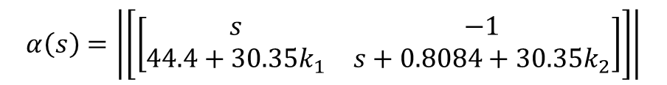

Characteristic equation $α\left(s\right)=\text{det}\left\{sI−\left(F_{ol}−G_{ol}K\right)\right\}$
$$α\left(s\right)=\left|\left[\begin{matrix}s & 0 \\ 0 & s\end{matrix}\right]−\left(\left[\begin{matrix}0 & 1 \\ −44.4 & −0.8084\end{matrix}\right]−\left[\begin{matrix}0 \\ 30.35\end{matrix}\right]\left[\begin{matrix}k_{1} & k_{2}\end{matrix}\right]\right)\right|$$
$$α\left(s\right)=\left|\left[\left[\begin{matrix}s & −1 \\ 44.4+30.35k_{1} & s+0.8084+30.35k_{2}\end{matrix}\right]\right]\right|$$
$$α\left(s\right)=s^{2}+\left(0.8084+30.35k_{2}\right)s+(44.4+30.35k_{1})$$
(1)
If desire $ζ≐0.707$ and $t_{s}≐5$sec then can show poles $s_{1,2}=−0.799±0.799i$
$$α_{\text{desired}}(s)=s^{2}+1.598s+1.276≐s^{2}+α_{1}s+α_{0}$$
(2)
Equating (1) and (2) yields
$$0.8084+30.35k_{2}≡1.598$$
$$k_{2}=0.026$$
$$44.4+30.35k_{1}≡1.276$$
$$k_{1}=−1.42$$
Gains $k$ give the desired dynamics. This is non-regulator, so need$N=−{\left(H_{ol}{\left(F_{ol}−G_{ol}K\right)}^{−1}G_{ol}\right)}^{−1}$ to get $θ_{ss}=1$ as steady-state value
i.e. $u=Nr−Kx$

Slide 7
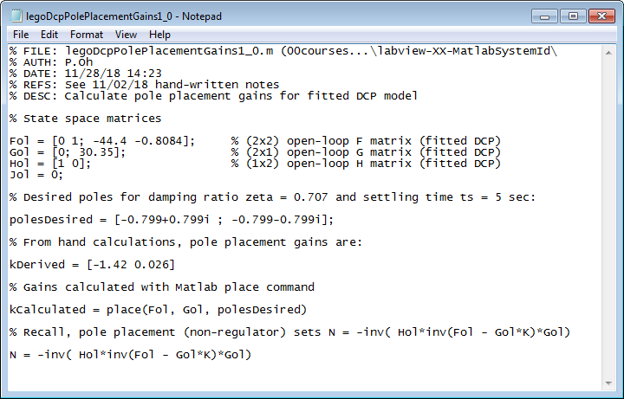
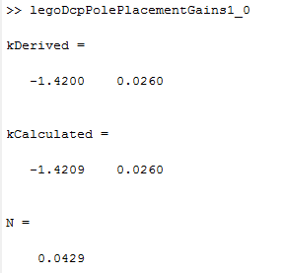
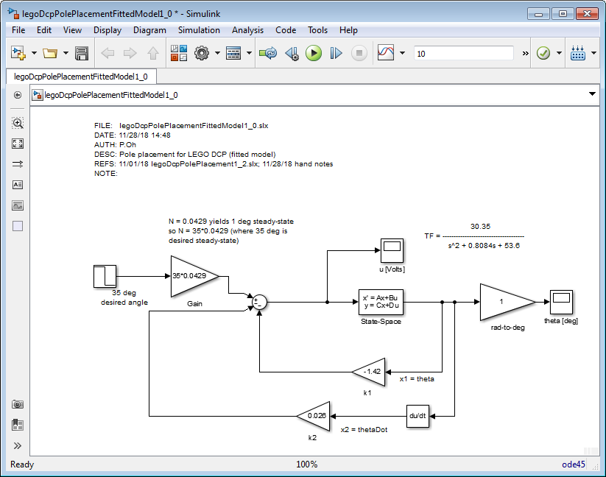
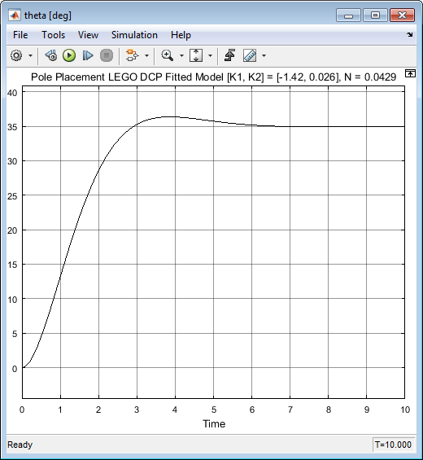
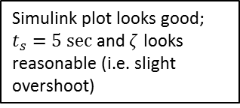
Matlab place function yields same result as hand calculation
N scale factor calculated
00courses\...\labview-XX-MatlabSystemId\legoDcpPolePlacementGains1_0.m
Simulink plot looks good;
$t_{s}=5 \text{sec}$ and $ζ$ looks reasonable (i.e. slight overshoot)
FILE: legoDcpPolePlacementFittedModel1_0.slx
Scope output for fitted DCP model with PID

Slide 8
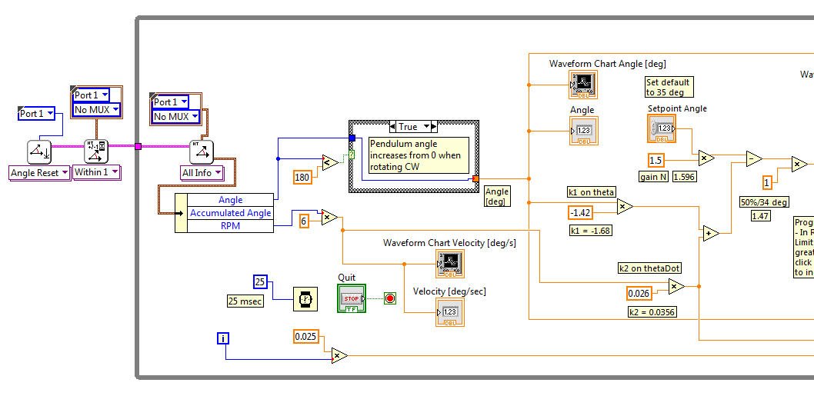
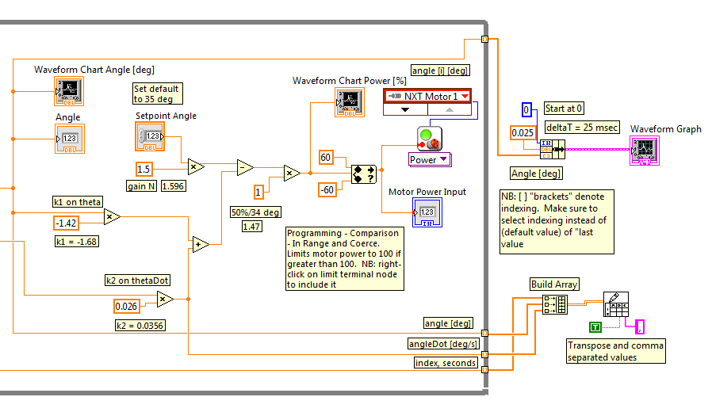
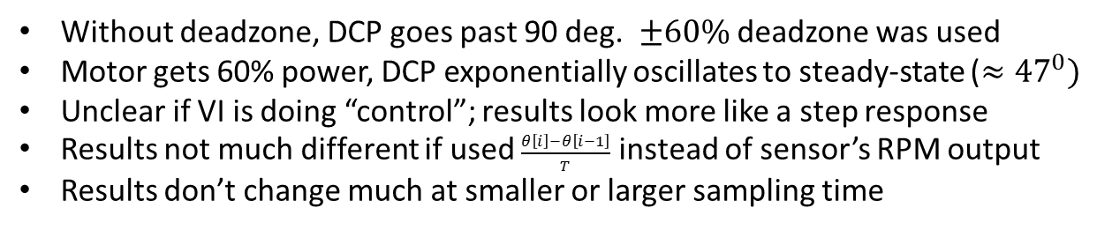
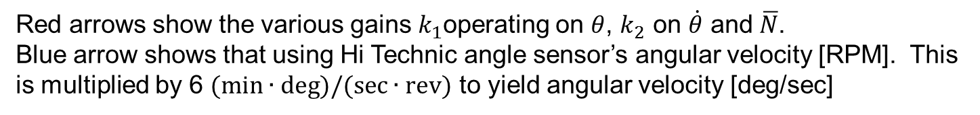
.\8 nxtDcpPolePlacement\nxtLabviewDcpPolePlacement2_0c.vi (11/29/18)
Matlab calculated $N=0.0429$. This would yield $θ_{ss}=1 \text{deg}\text{.}$ Thus for 35 deg, should have $\overline{N}=0.0429∗35=1.5$
Red arrows show the various gains $k_{1}$operating on $θ$, $k_{2}$ on $\dot{θ}$ and $\overline{N}$.
Blue arrow shows that using Hi Technic angle sensor’s angular velocity [RPM]. This is multiplied by 6 $(\text{m}\text{in}∙\text{deg}\text{)/(}\text{sec}∙\text{rev}\text{)}$ to yield angular velocity [deg/sec]
Results:
Without deadzone, DCP goes past 90 deg. $±60\%$ deadzone was used
Motor gets 60% power, DCP exponentially oscillates to steady-state ($≈{47}^{0})$
Unclear if VI is doing “control”; results look more like a step response
Results not much different if used $\frac{θ\left[i\right]−θ\left[i−1\right]}{T}$ instead of sensor’s RPM output
Results don’t change much at smaller or larger sampling time

Slide 9
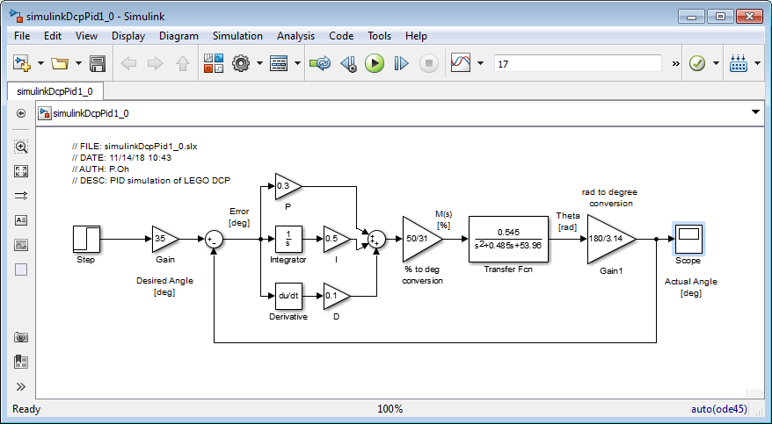

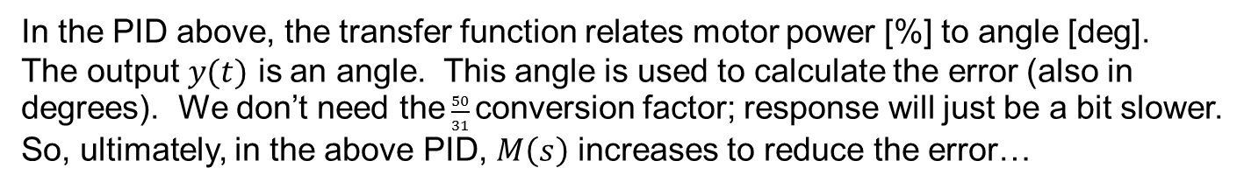
12/01/18
Q1: What is $r(t)$? Is it an angle (in degrees)? Is it motor power (in %)?
Recall, that we have PID:
$$\frac{0.545}{s^{2}+0.485s+53.96}∗ \frac{180}{3.14}=\frac{31.22}{s^{2}+0.485s+53.96}$$
In the PID above, the transfer function relates motor power [%] to angle [deg].
The output $y(t)$ is an angle. This angle is used to calculate the error (also in degrees). We don’t need the $\frac{50}{31}$conversion factor; response will just be a bit slower.
So, ultimately, in the above PID, $M\left(s\right)$ increases to reduce the error…

Slide 10
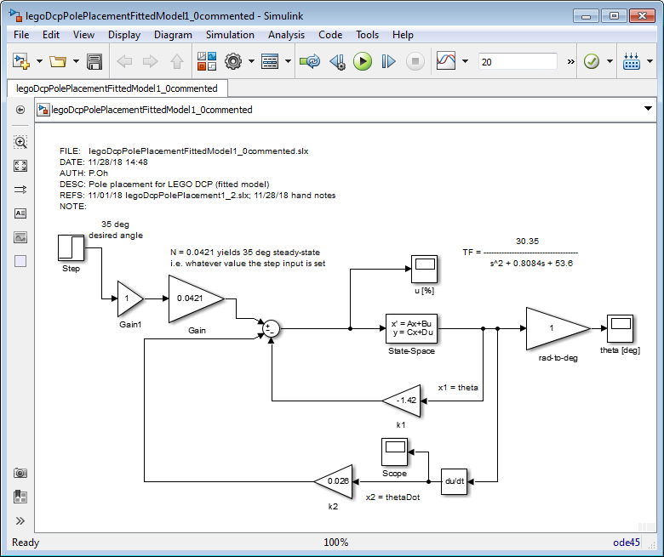
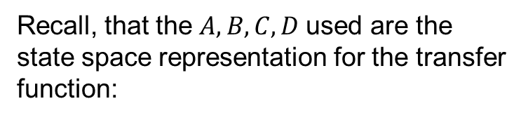
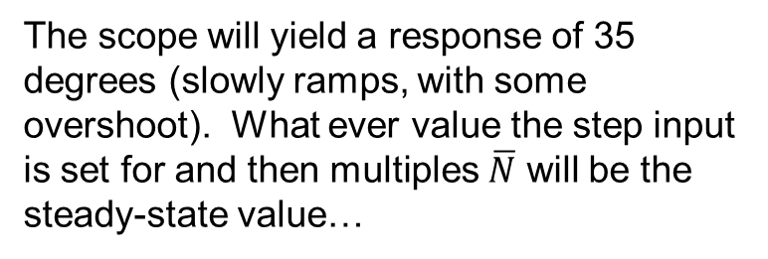

The scope will yield a response of 35 degrees (slowly ramps, with some overshoot). What ever value the step input is set for and then multiples $\overline{N}$ will be the steady-state value…
Recall, that the $A, B, C, D$used are the state space representation for the transfer function:
$$\frac{0.00018∗1∗180}{0.00033∗3.14}=0.545\frac{180}{3.14}=31.27$$
$$Μ\left(s\right)$$
$$Θ\left(s\right)$$
$$\frac{31.27}{s^{2}+0.485s+53.96}$$
[%]
[rad]
r
u
.
x
y
x = F x + G u
H
ol
ol
ol
$$u=r−Kx$$
u = -Kx

Slide 11




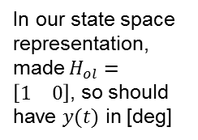


$$\frac{31.22}{s^{2}+0.485s+53.96}$$
$$\overline{N}r$$
u
.
$$Θ\left(s\right)$$
y
x = F x + G u
x
$$\frac{0.00018∗1∗180}{0.00033∗3.14}=0.545\frac{180}{3.14}=31.27$$
+
ol
ol
H
ol
$$Μ\left(s\right)$$
$$Θ\left(s\right)$$
-
$$\frac{31.27}{s^{2}+0.485s+53.96}$$
In our state space representation, made $H_{ol}=\left[\begin{matrix}1 & 0\end{matrix}\right]$, so should have $y(t)$ in [deg]
[%]
[rad]
Kx
This then suggests that $u(t)$ should be motor power [%]
Q2. Given $k_{1}θ$, what is the units for $k_{1}$?
Since ultimately $u(t)$ is [%], then perhaps $k_{1}θ$ is $\frac{\%}{\text{deg}}∙\text{deg}$, hence $k_{1}$is $\left[\frac{\%}{\text{deg}}\right]$
Q3. Given $k_{2}\dot{θ}$, what is the units for $k_{2}$?
Since ultimately $u(t)$ is [%], then perhaps $k_{2}\dot{θ}$ is $\frac{\%}{\frac{\text{deg}}{\text{sec}}}∙\frac{\text{deg}}{\text{sec}}$ then $k_{2}$is $\left[\frac{\%}{\text{deg}\text{/}\text{sec}}\right]$
Observe that we previously calculated $k_{1}=−1.42 \frac{\%}{\text{deg}}$ , $k_{2}=0.0260\frac{\%}{\text{deg}\text{/}\text{sec}}$ , $\overline{N}=0.0429$

Slide 12


Case 1: On start up have $\dot{θ}=θ=0$ degrees
$u=\overline{Nr}−Kx=0.0429r−\left\{−1.42⋅0+0.0260⋅0\right\}=0.0429∗35=1.5015$
Should have $u≈50\%$ hence $r=\frac{50\%}{0.0429}=1165.5$
Case 2: Near steady-state have $\dot{θ}≈0 \text{and} θ=35$ degrees
$u=\overline{Nr}−Kx=0.0429r−\left\{−1.42⋅35+0.0260⋅0\right\}=0.0429r−\left\{−49.7\right\}=0.0429∗1165.5+49.7=50+49.7=99.7$
Should have $u≈50\%$...so, we should not have these
$u=\overline{Nr}−Kx=0.0429r−\left\{−1.42⋅35+0.0260⋅0\right\}=1.5015−\left\{−49.7\right\}==51.2$
Case 3: Ramping towards desired angle have $\dot{θ}≈\text{something} \text{and} θ=20$ degrees
$$u=\overline{Nr}−Kx=0.0429r−\left\{−1.42⋅20+0.0260⋅\dot{θ}\right\}=0.0429r−\left\{−28.4+0.0260\dot{θ}\right\}=0.0429∗1165.5+28.4−0.0260\dot{θ}$$
$≈50+28.4=78.4$
Seems like a lot given that we wanted to ramp slowly (i.e. long settling time)
$$u=\overline{Nr}−Kx=0.0429r−\left\{−1.42⋅20+0.0260⋅\dot{θ}\right\}=1.5015−\left\{−28.4+0.0260\dot{θ}\right\}=29.99$$
Blue-colored text shows that these values look reasonably promising… thus $\overline{N}r=0.0429∗35$
Maybe doesn’t start up because u=1.5015 [%] is too low i.e. dead-zone

Slide 13
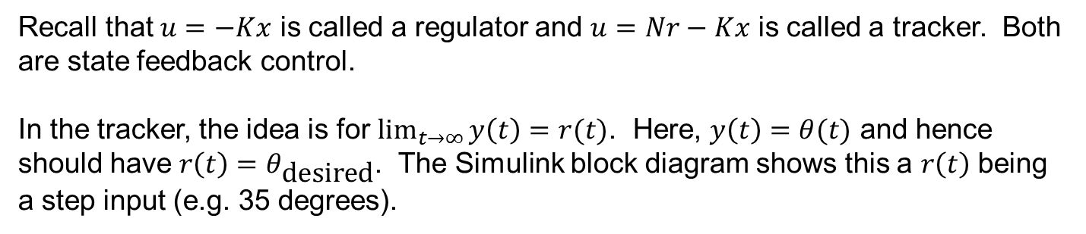
12/05/18
Recall that $u=−Kx$ is called a regulator and $u=Nr−Kx$ is called a tracker. Both are state feedback control.
In the tracker, the idea is for $\lim_{t→∞}{y\left(t\right)=r(t)}$. Here, $y\left(t\right)=θ(t)$ and hence should have $r\left(t\right)=θ_{\text{desired}}$. The Simulink block diagram shows this a $r\left(t\right)$ being a step input (e.g. 35 degrees).

Slide 14



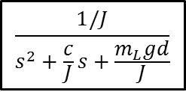







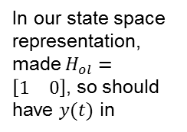




12/06/18
$$\text{TF}\text{ = }\frac{30.35}{s^{2}+0.8084s+44.4}=\frac{Θ\left(s\right)}{M\left(s\right)}$$
$$\frac{1/J}{s^{2}+\frac{c}{J}s+\frac{m_{L}gd}{J}}$$
$$\frac{0.00018}{0.00033}=0.545$$
$$Μ\left(s\right)$$
$$K_{m}$$
$$Τ\left(s\right)$$
$$Θ^{∗}\left(s\right)$$
$$Θ\left(s\right)$$
$$\frac{50}{31}$$
$$0.00018$$
$$\frac{1/0.00033}{s^{2}+0.485s+53.96}$$
$$\frac{180}{3.14}$$
[deg]
[%]
$$\left[\frac{Nm}{\%}\right]$$
[rad]
[deg]
$$\frac{0.00018}{0.00033}×\frac{180}{3.14}=0.545×57.2=31.22$$
Here, $M\left(s\right)$ is same as $u$
$$\frac{30.35}{s^{2}+0.8084s+44.4}$$
$$Θ\left(s\right)$$
$$r$$
$$\overline{N}r$$
$$u$$
.
$$x$$
$$y$$
$$\overline{N}$$
+
x = F x + G u
H
ol
[deg]
[%]
ol
ol
[deg]
-
In our state space representation, made $H_{ol}=\left[\begin{matrix}1 & 0\end{matrix}\right]$, so should have $y(t)$ in
$$θ, \dot{θ}$$
$$K$$
[deg], [deg/s]

Slide 15






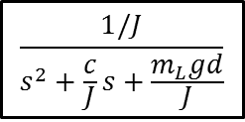
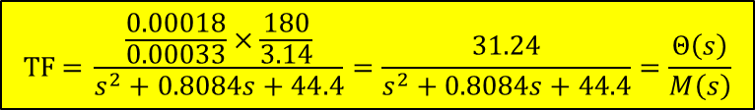

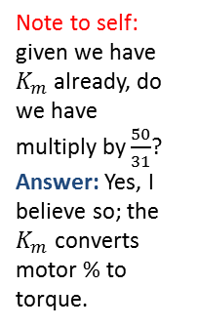




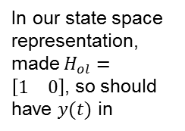





12/06/18
$$\frac{1/J}{s^{2}+\frac{c}{J}s+\frac{m_{L}gd}{J}}$$
$$\frac{0.00018}{0.00033}=0.545$$
$$K_{m} \left[\frac{Nm}{\%}\right]$$
$$U\left(s\right)$$
$$Μ\left(s\right)$$
$$Τ\left(s\right)$$
$$Θ^{∗}\left(s\right)$$
$$Θ\left(s\right)$$
$$\frac{50}{31}$$
$$0.00018$$
$$\frac{1/0.00033}{s^{2}+0.485s+53.96}$$
$$\frac{180}{3.14}$$
[deg]
[%]
$$\left[Nm\right]$$
[rad]
[deg]
$\frac{0.00018}{0.00033}×\frac{180}{3.14}=0.545×57.2=31.2$4
Note to self: given we have $K_{m}$already, do we have multiply by $\frac{50}{31}$?
Answer: Yes, I believe so; the $K_{m}$ converts motor % to torque.
$$\text{TF}\text{ = }\frac{\frac{0.00018}{0.00033}×\frac{180}{3.14}}{s^{2}+0.8084s+44.4}=\frac{31.24}{s^{2}+0.8084s+44.4}=\frac{Θ\left(s\right)}{M\left(s\right)}$$
$$\text{TF}\text{ = }\frac{31.24}{s^{2}+0.8084s+44.4}∙\frac{50}{31}=\frac{50.39}{s^{2}+0.8084s+44.4}=\frac{Θ\left(s\right)}{U\left(s\right)}$$
$$\frac{50.39}{s^{2}+0.8084s+44.4}$$
$$Θ\left(s\right)$$
$$r$$
$$\overline{N}r$$
$$u$$
.
$$x$$
$$y$$
$$\overline{N}$$
+
x = F x + G u
H
ol
[deg]
[deg]
ol
ol
[deg]
-
In our state space representation, made $H_{ol}=\left[\begin{matrix}1 & 0\end{matrix}\right]$, so should have $y(t)$ in
$$θ, \dot{θ}$$
$$K$$
[deg], [deg/s]

Slide 16
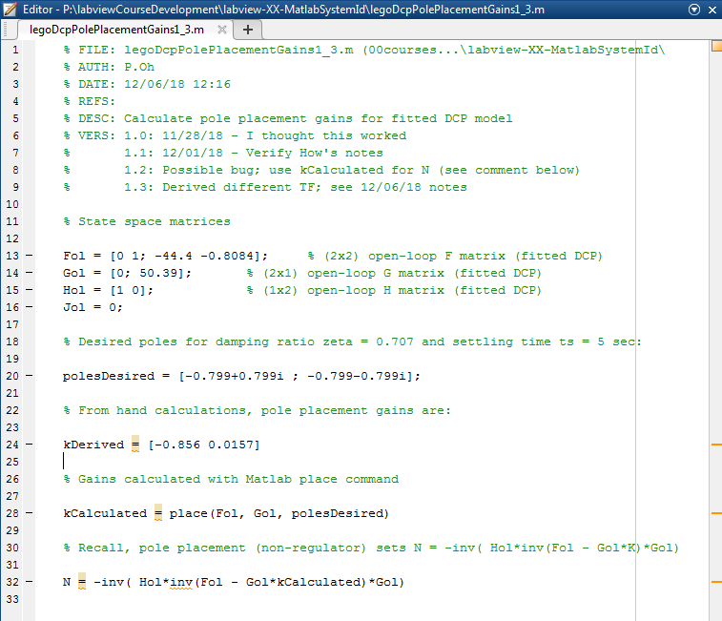
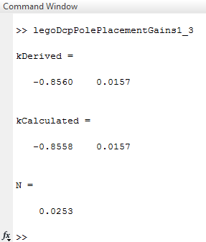













$$\left[\begin{matrix}\dot{x_{1}} \\ \dot{x_{2}}\end{matrix}\right]=\left[\begin{matrix}0 & 1 \\ −44.4 & −0.8084\end{matrix}\right]\left[\begin{matrix}x_{1} \\ x_{2}\end{matrix}\right]+\left[\begin{matrix}0 \\ 50.39\end{matrix}\right]\vec{u}$$
And
$$\vec{y}=\left[\begin{matrix}1 & 0\end{matrix}\right]\left[\begin{matrix}x_{1} \\ x_{2}\end{matrix}\right]+\left[0\right]$$
$$F_{ol}$$
$$G_{ol}$$
$$H_{ol}$$
$$J_{ol}$$
Characteristic equation $α\left(s\right)=\text{det}\left\{sI−\left(F_{ol}−G_{ol}K\right)\right\}$
$$α\left(s\right)=\left|\left[\begin{matrix}s & 0 \\ 0 & s\end{matrix}\right]−\left(\left[\begin{matrix}0 & 1 \\ −44.4 & −0.8084\end{matrix}\right]−\left[\begin{matrix}0 \\ 50.39\end{matrix}\right]\left[\begin{matrix}k_{1} & k_{2}\end{matrix}\right]\right)\right|$$
$$α\left(s\right)=\left|\left[\left[\begin{matrix}s & −1 \\ 44.4+50.39k_{1} & s+0.8084+50.39k_{2}\end{matrix}\right]\right]\right|$$
$$α\left(s\right)=s^{2}+\left(0.8084+50.39k_{2}\right)s+(44.4+50.39k_{1})$$
(1)
If desire $ζ≐0.707$ and $t_{s}≐5$sec then can show poles $s_{1,2}=−0.799±0.799i$
$$α_{\text{desired}}(s)=s^{2}+1.598s+1.276≐s^{2}+α_{1}s+α_{0}$$
(2)
Equating (1) and (2) yields
$k_{2}=0.01$57
$$0.8084+50.39k_{2}≡1.598$$
$$44.4+50.39k_{1}≡1.276$$
$k_{1}=−0.$856
$$\overline{N}=−{\left(H_{ol}{\left(F_{ol}−G_{ol}K\right)}^{−1}G_{ol}\right)}^{−1}$$
$\overline{N}=0.02$53
USB…\labview-XX-MatlabSystemId\legoDcpPolePlacementGains1_3.m

Slide 17
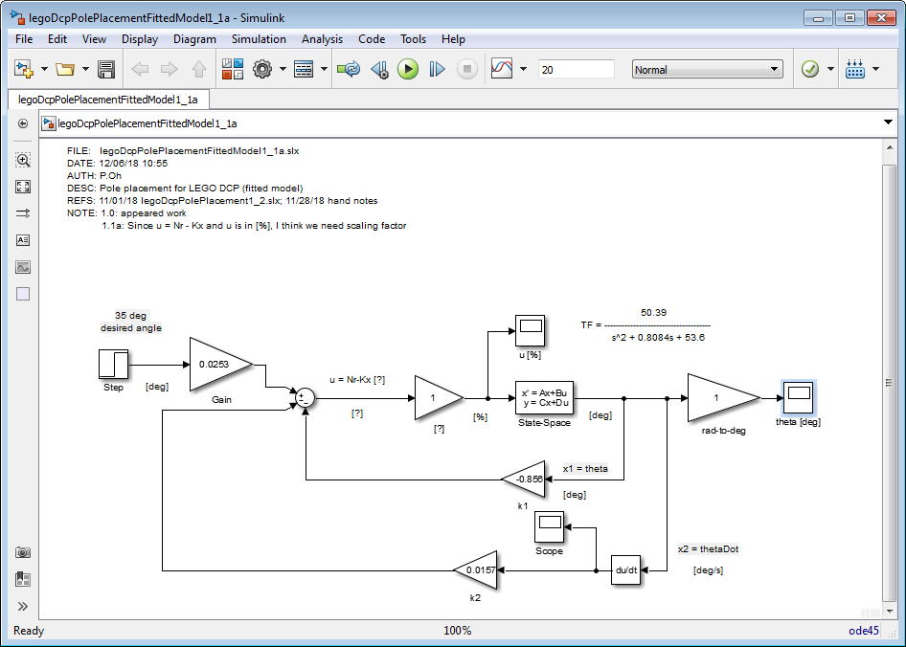
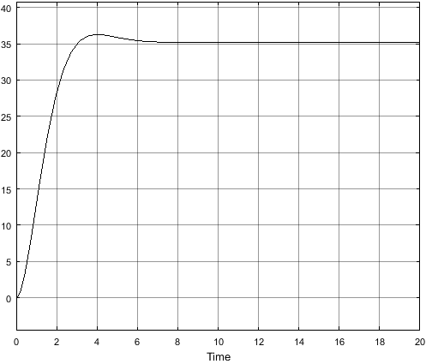

USB…\labview-XX-MatlabSystemId\legoDcpPolePlacementFittedModel1_1a.slx
Case 1: On start up have $\dot{θ}=θ=0$ degrees
$u=\overline{Nr}−Kx=0.0253r−\left\{−0.856⋅0+0.0157⋅0\right\}=0.0253∗35=0.886$
Strange: very little motor power [%]
Case 2: Near steady-state have $\dot{θ}≈0 \text{and} θ=35$ degrees
$u=\overline{Nr}−Kx=0.0253r−\left\{−0.856⋅35+0.0157⋅0\right\}=0.886 −\left\{−29.96\right\}=30.85$
Strange: should be around 50%
Case 3: Ramping towards desired angle have $\dot{θ}≈\text{something} \text{and} θ=20$ degrees
$u=\overline{Nr}−Kx=0.0253r−\left\{−0.856⋅20+0.0157⋅\dot{θ}\right\}=0.886−\left\{−17.2+0.0157\dot{θ}\right\}=18.01+0.0157\dot{θ}$ $≈18.01$
Strange: 18.01% seems low

Slide 18
Case 1: On start up have $\dot{θ}=θ=0$ degrees
$u=\overline{Nr}−Kx=0.0253r−\left\{−0.856⋅0+0.0157⋅0\right\}=0.0253∗35=0.886$
Strange: very little motor power [%]
Case 2: Near steady-state have $\dot{θ}≈0 \text{and} θ=35$ degrees
$u=\overline{Nr}−Kx=0.0253r−\left\{−0.856⋅35+0.0157⋅0\right\}=0.886 −\left\{−29.96\right\}=30.85$
Strange: should be around 50%
Case 3: Ramping towards desired angle have $\dot{θ}≈\text{something} \text{and} θ=20$ degrees
$u=\overline{Nr}−Kx=0.0253r−\left\{−0.856⋅20+0.0157⋅\dot{θ}\right\}=0.886−\left\{−17.2+0.0157\dot{θ}\right\}=18.01+0.0157\dot{θ}$ $≈18.01$
Strange: 18.01% seems low

Slide 20
Extra Slides

Slide 21




$$\dot{x\left(t\right)}=Ax\left(t\right)+Bu\left(t\right)$$
r(t)
u(t)
.
y(t)
A, B, C
$$y\left(t\right)=Cx(t)$$
+
-
x(t)
$$D≐0$$
K
$$u(t)=r−Kx(t)$$

