Slide 1
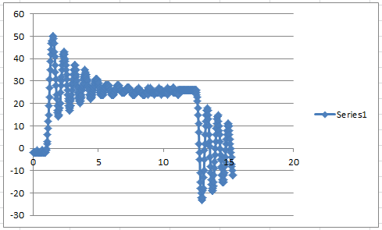
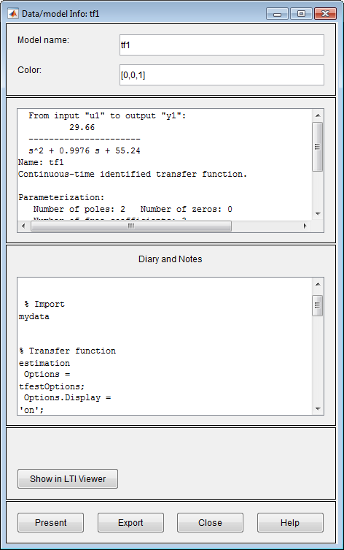


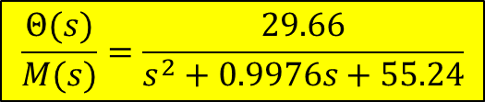
System ID for current LEGO DCP
01/16/19
Recall in late Dec 2018 that I lent Sangsin the LEGO DCP that I’ve been using in the past. The one that I’m now using appears to be slightly different. For 50% step motor power input, seems to have steady-state response of about 26 degrees:
From the above data, Matlab System ID toolbox was used. The resulting model (64.6% fit):
$$\frac{Θ(s)}{M(s)}=\frac{29.66}{s^{2}+0.9976s+55.24}$$
$$\text{TF}\text{ = }\frac{31.27}{s^{2}+0.485s+53.96}$$
$$\text{TF}\text{ = }\frac{30.35}{s^{2}+0.8084s+44.4}$$
Hand calculations (in past)
Matlab System ID (in past)
Since the new one (yellow) looks somewhat similar to past ones, let’s work with it

Slide 2
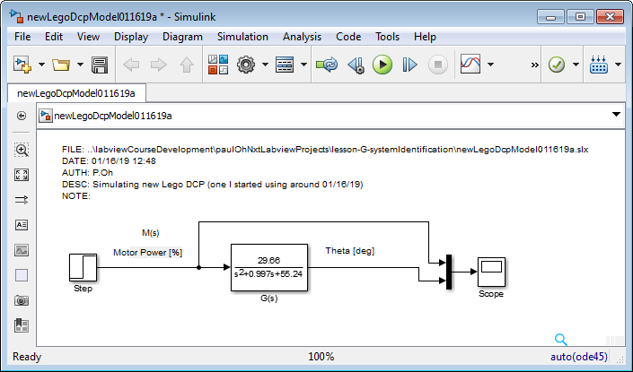
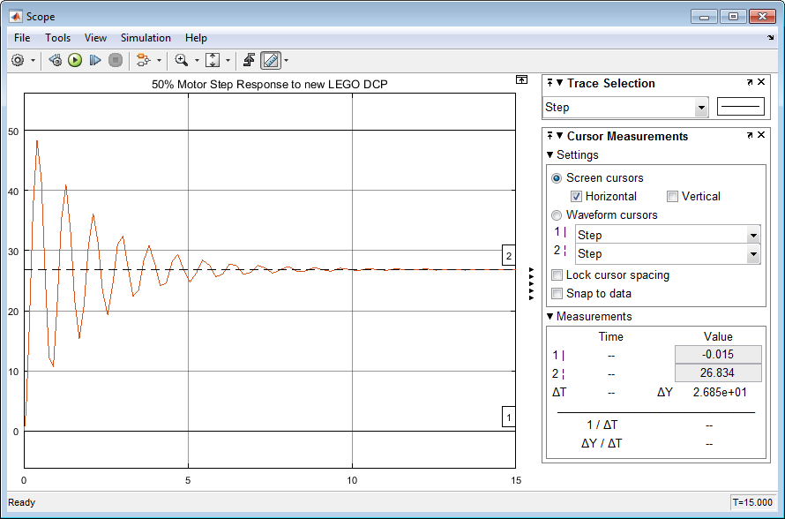
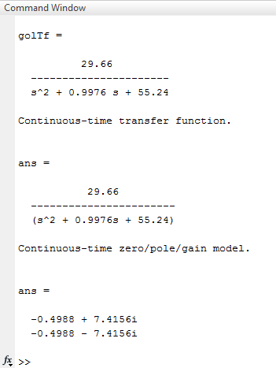
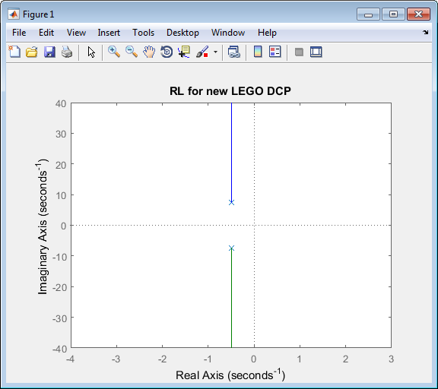

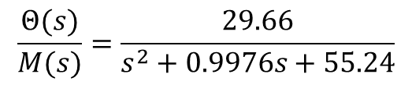
$$\frac{Θ(s)}{M(s)}=\frac{29.66}{s^{2}+0.9976s+55.24}$$
01/16/19
50% motor results in 27 deg steady-state
Root locus plots looks like what is expected. Matlab code reveals poles:
$$s_{1,2}=−0.4988±j7.4156$$

Slide 3
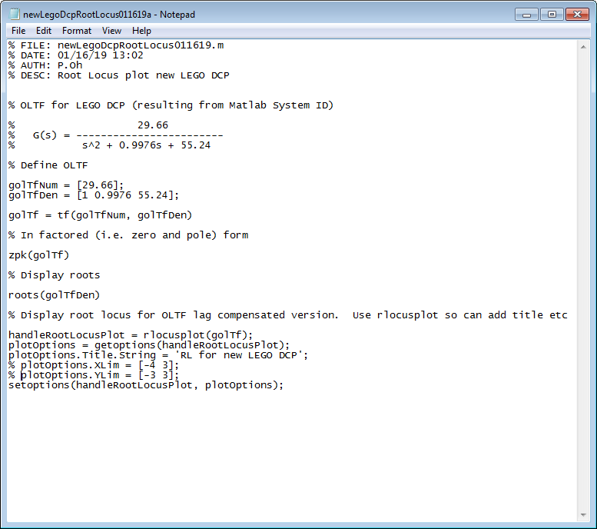
01/16/19

Slide 4
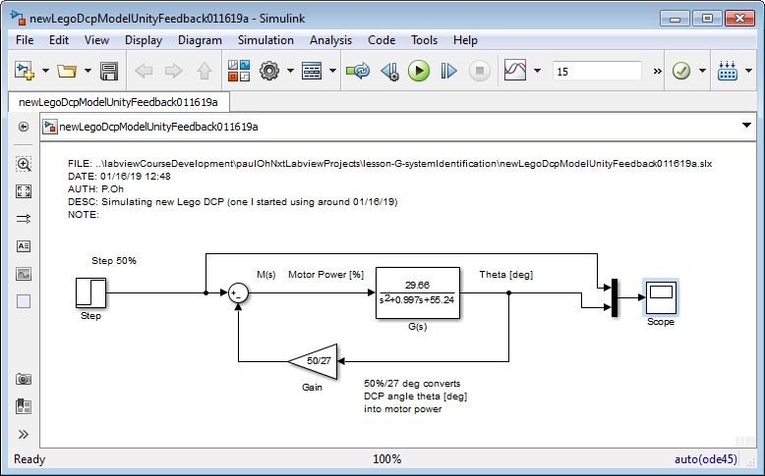
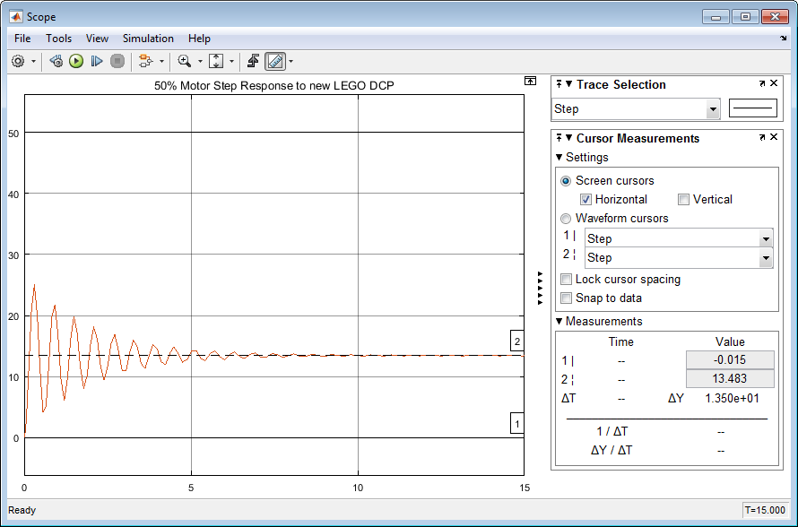
01/16/19
Unity feedback was simulated as below:
We observe with unity feedback, that there is still a lot of vibration (0 to 5 seconds) and that the steady-state value is about 13.5 deg. We want the steady-state to be 27 degrees but will less vibration etc.

