Slide 1
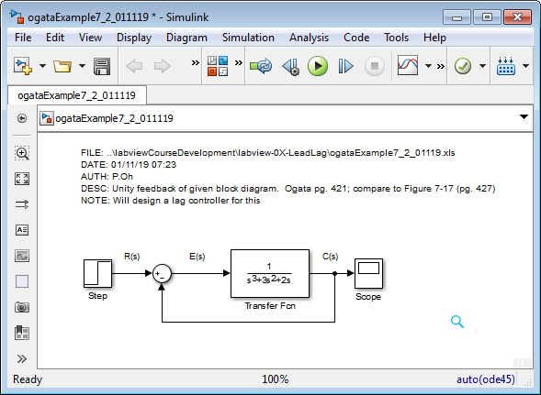
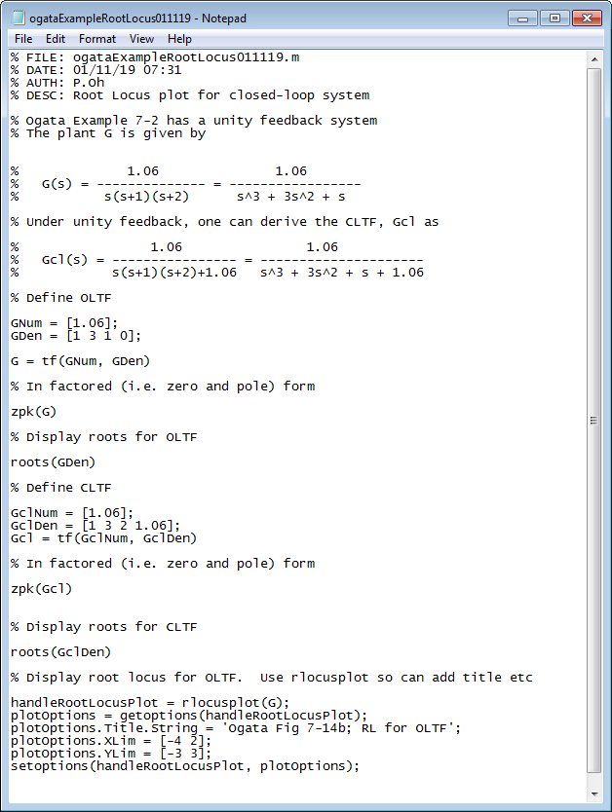
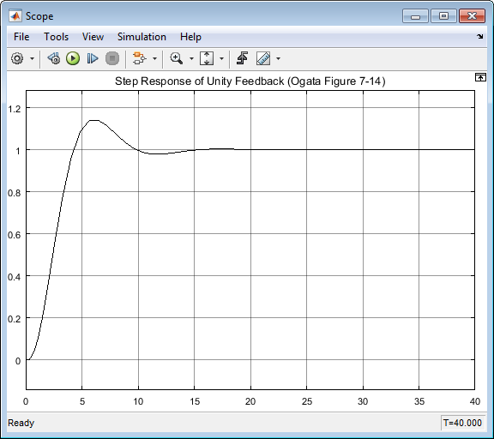
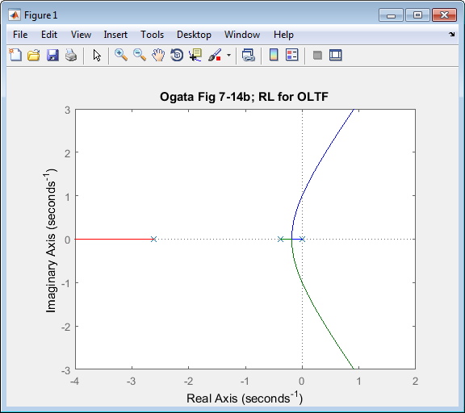
Ogata Example 7-2, pg. 420
01/11/19
Note to self: Numerator should be 1.06.
I discovered this after 01/11/19. Hence Simulink plots are off, but my RL should be still correct

Slide 2
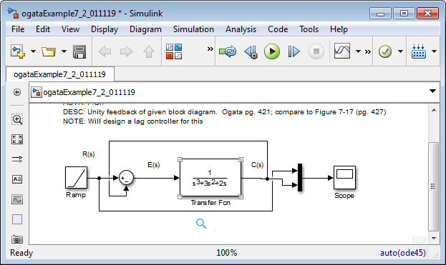
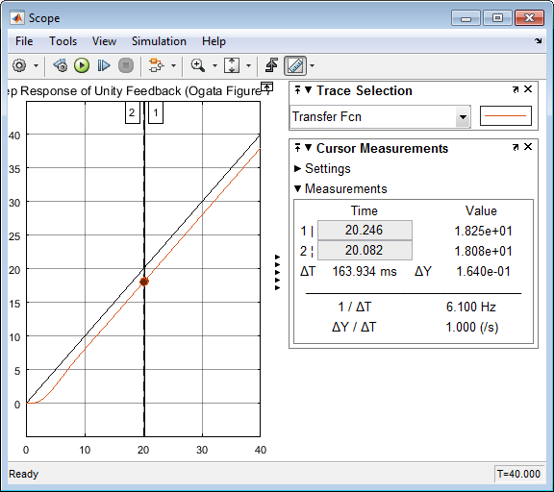
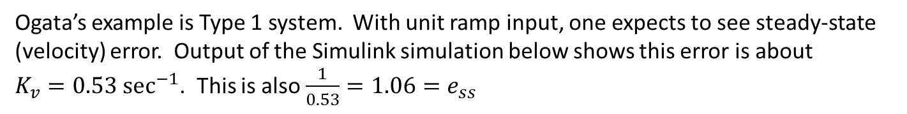

01/11/19
Ogata’s example is Type 1 system. With unit ramp input, one expects to see steady-state (velocity) error. Output of the Simulink simulation below shows this error is about $K_{v}=0.53 {\text{sec}}^{−1}$. This is also $\frac{1}{0.53}=1.06=e_{ss}$
Unit step: so at 20 sec, output is 20
Output at 20 sec however is 18.08
Thus error = 20-18.08 = 1.92 or $K_{v}=\frac{1}{1.92}=0.52 {\text{sec}}^{−1}$

Slide 3
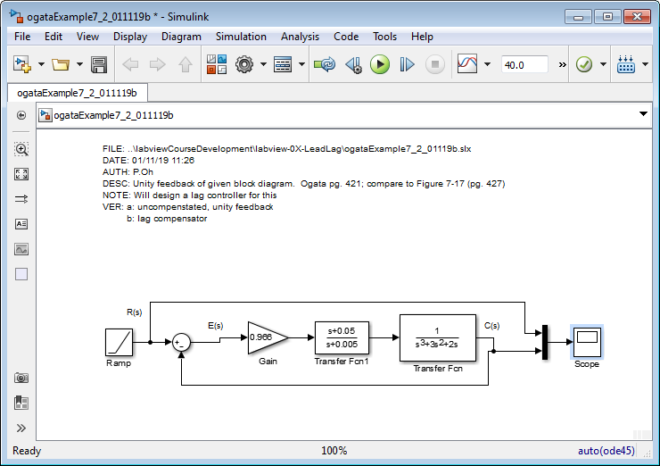
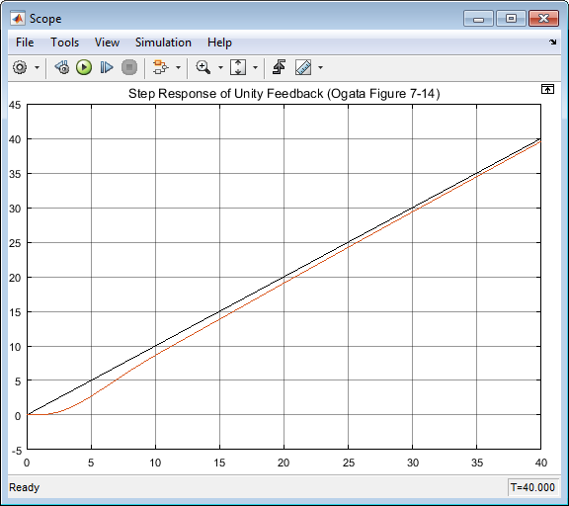
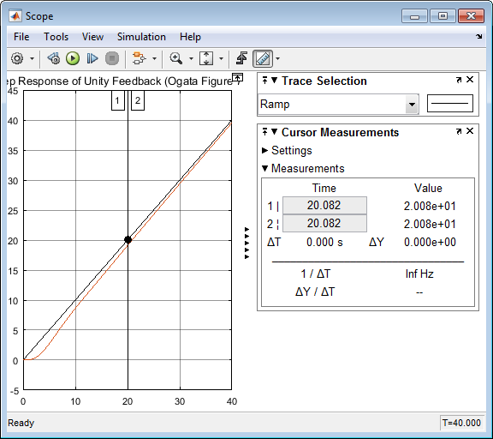

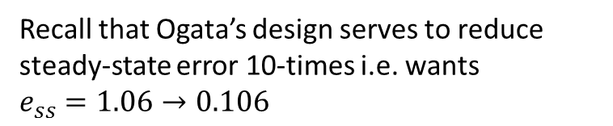
01/11/19
Using Ogata’s Lag Compensator design, the resulting unit ramp input given below
Recall that Ogata’s design serves to reduce steady-state error 10-times i.e. wants $e_{ss}=1.06→0.106$
Unit step: so at 20 sec, output is 20
Output at 20 sec however is 20.08
Thus error = 20-20.08 = 0.09 $≈0.1$
Close-up of output shows that this was successful

Slide 4
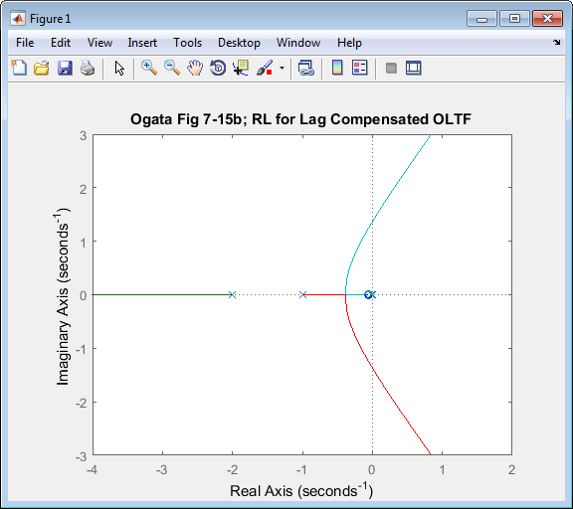
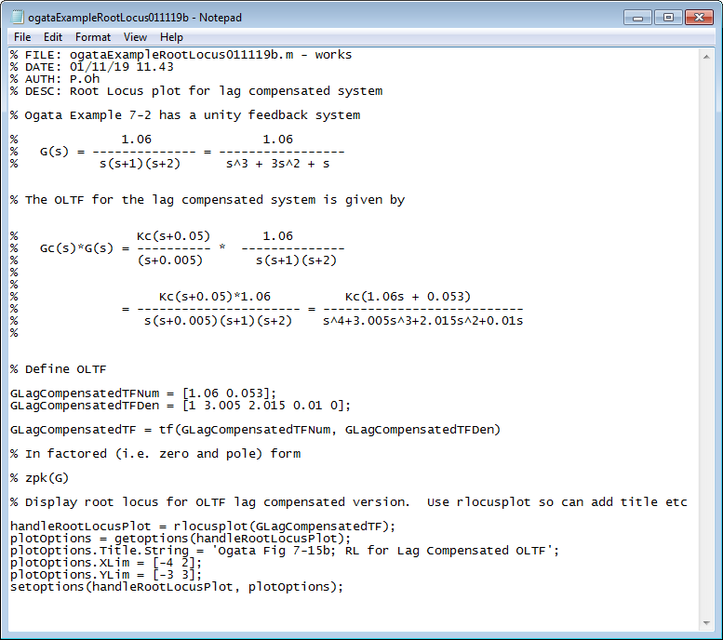
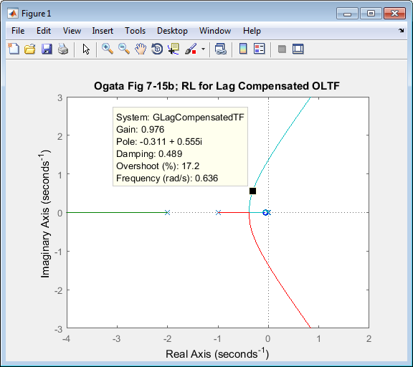
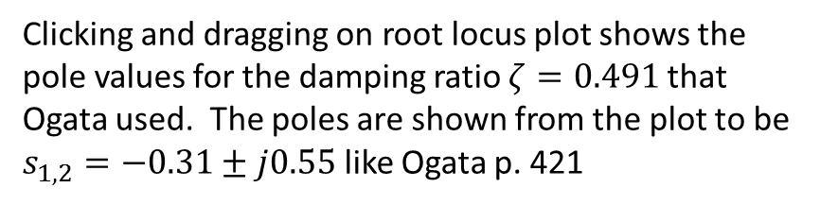
01/11/19
Clicking and dragging on root locus plot shows the pole values for the damping ratio $ζ=0.491$ that Ogata used. The poles are shown from the plot to be $s_{1,2}=−0.31±j0.55$ like Ogata p. 421

Slide 5
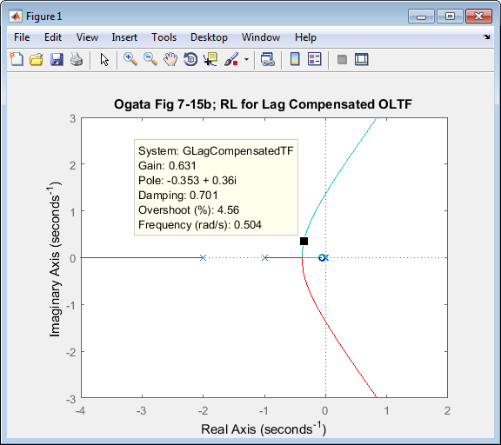
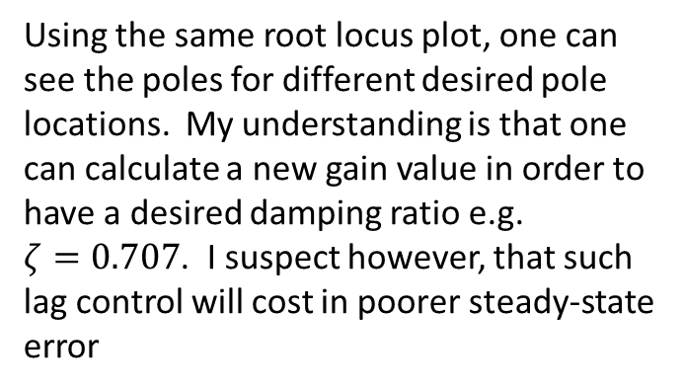
01/11/19
Using the same root locus plot, one can see the poles for different desired pole locations. My understanding is that one can calculate a new gain value in order to have a desired damping ratio e.g. $ζ=0.707$. I suspect however, that such lag control will cost in poorer steady-state error

Slide 6
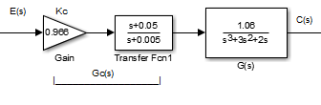
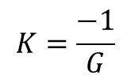


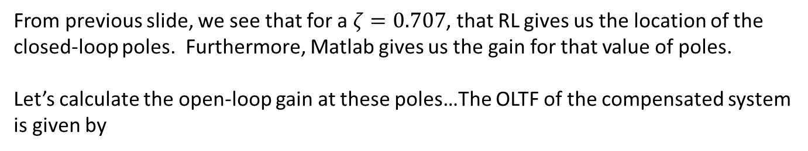
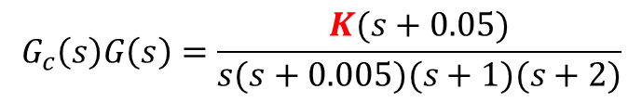
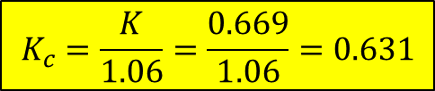
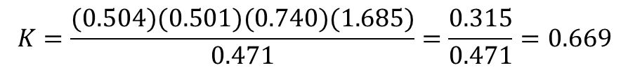
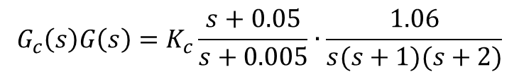
01/14/19
From previous slide, we see that for a $ζ=0.707$, that RL gives us the location of the closed-loop poles. Furthermore, Matlab gives us the gain for that value of poles.
Let’s calculate the open-loop gain at these poles…The OLTF of the compensated system is given by
$$G_{c}\left(s\right)G\left(s\right)=K_{c}\frac{s+0.05}{s+0.005}∙\frac{1.06}{s(s+1)(s+2)}$$
$$G_{c}\left(s\right)G\left(s\right)=\frac{K(s+0.05)}{s(s+0.005)(s+1)(s+2)}$$
Where say $K≜1.06K_{c}$
Rewrite as
$$K=\frac{−1}{G}$$
Where just need magnitude at pole locations
Recall:
$$1+KG=0$$
Hence need
$$K={\left|\frac{s(s+0.005)(s+1)(s+2)}{(s+0.05)}\right|}_{s=−0.353+j0.36}=\left|\frac{(−0.353+j0.36)(−0.348+j0.36)(0.647+j0.36)(1.647+j0.36)}{0.303+j0.36}\right|$$
$$K=\frac{(0.504)(0.501)(0.740)(1.685)}{0.471}=\frac{0.315}{0.471}=0.669$$
Finally have
$$K_{c}=\frac{K}{1.06}=\frac{0.669}{1.06}=0.631$$

Slide 7
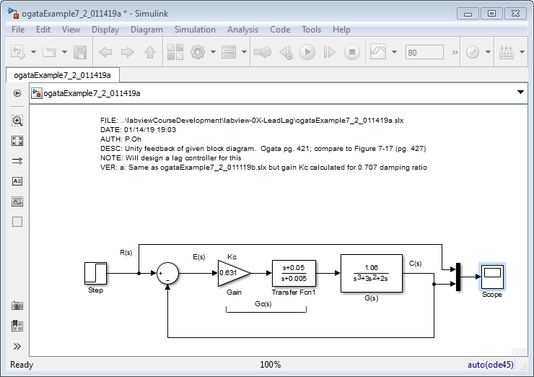
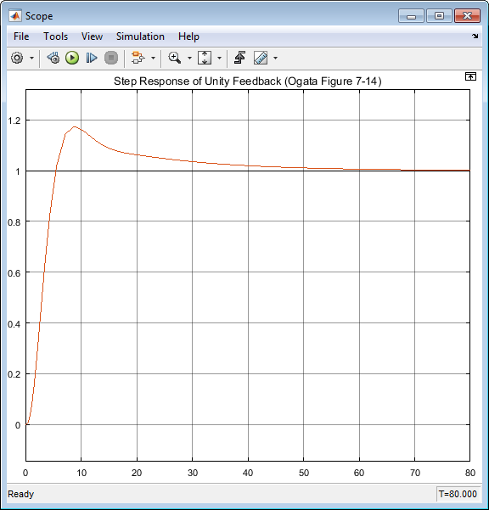
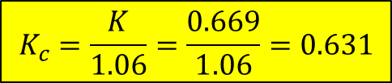
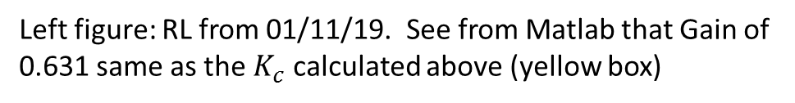
01/14/19
$$K_{c}=\frac{K}{1.06}=\frac{0.669}{1.06}=0.631$$
Left figure: RL from 01/11/19. See from Matlab that Gain of 0.631 same as the $K_{c}$ calculated above (yellow box)

Slide 8
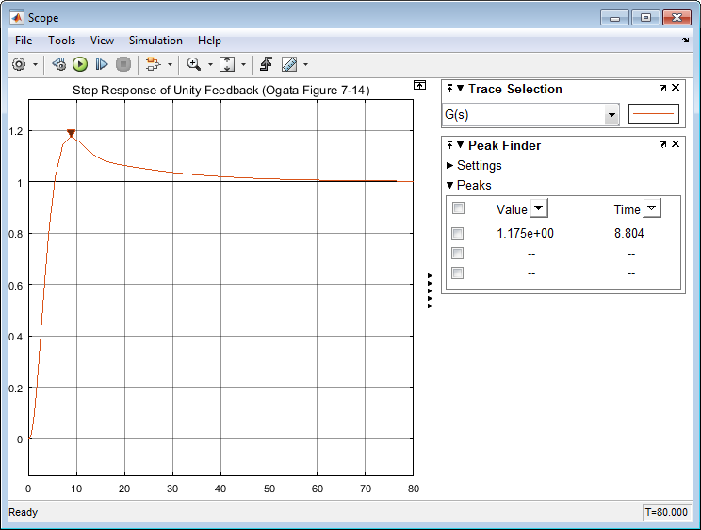



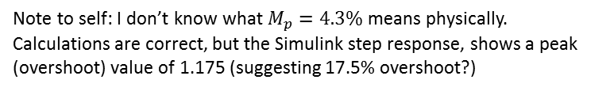





01/14/19
Recall that
$$ω_{n}=\left|−0.353+j0.36\right|=\sqrt{{(−0.353)}^{2}+{\left(0.36\right)}^{2}}=\sqrt{0.125+0.130}$$
=$\sqrt{0.255}=0.504$
$$−0.353+j0.36$$
$$ω_{n}\sqrt{1−ς^{2}}$$
x
$$ζ=\frac{0.353}{0.504}=0.700$$
$$ω_{n}ς≡0.353$$
Hence have
as expected
$$ω_{n}$$
$$M_{p}≈e^{−\frac{πζ}{\sqrt{1−ζ^{2}}}}$$
A formula to recall is:
$$M_{p}=\text{exp}\left(−\frac{π0.707}{\sqrt{1−0.5}}\right)=\text{exp}\left(−\frac{2.221}{0.707}\right)=\text{exp}\left(−3.141\right)=0.0432=4.3\%$$
$$−ω_{n}ζ$$
Note to self: I don’t know what $M_{p}=4.3\%$ means physically. Calculations are correct, but the Simulink step response, shows a peak (overshoot) value of 1.175 (suggesting 17.5% overshoot?)

Slide 9
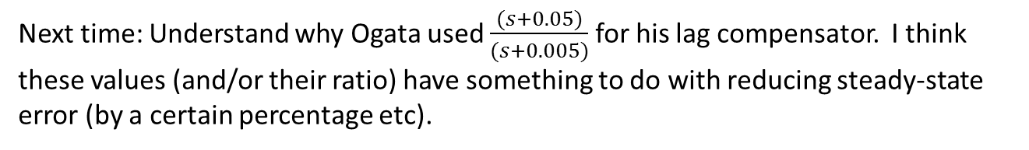
Next time: Understand why Ogata used $\frac{(s+0.05)}{(s+0.005)}$ for his lag compensator. I think these values (and/or their ratio) have something to do with reducing steady-state error (by a certain percentage etc).

