Slide 1
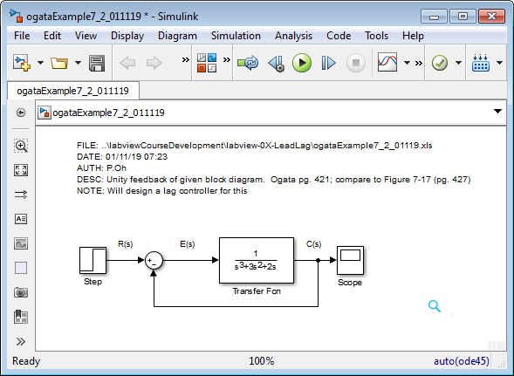
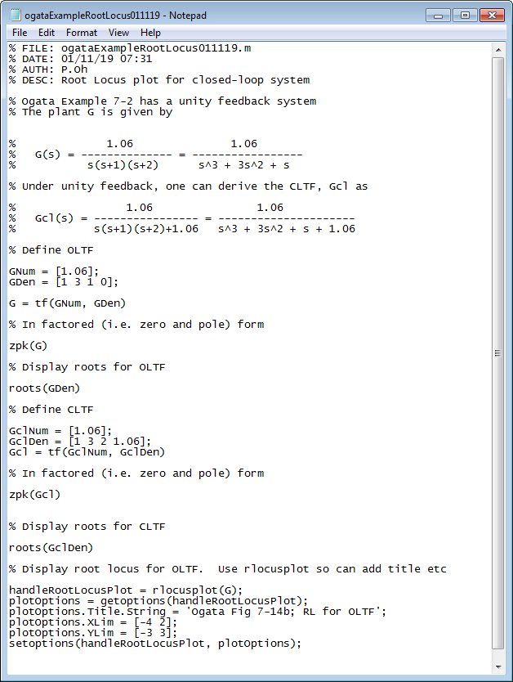
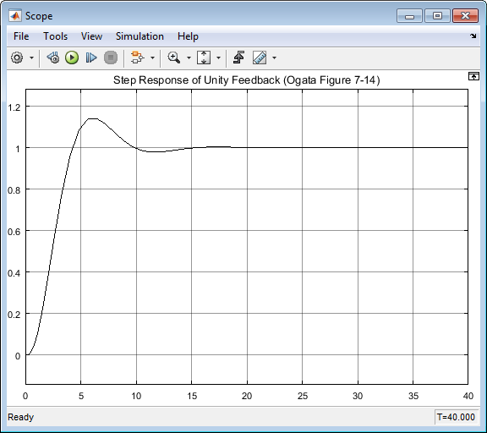
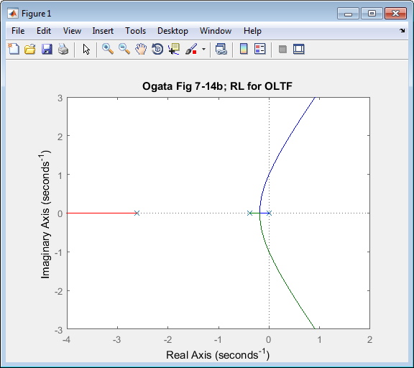
Ogata Example 7-2, pg. 420
01/11/19

Slide 2
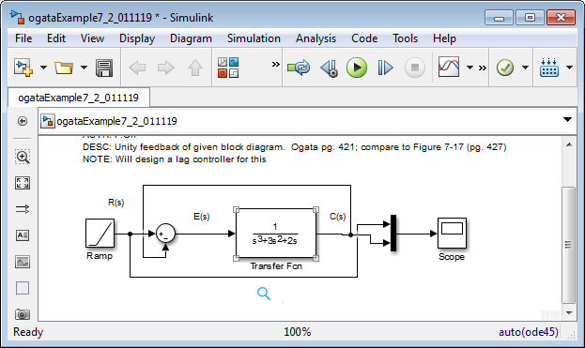
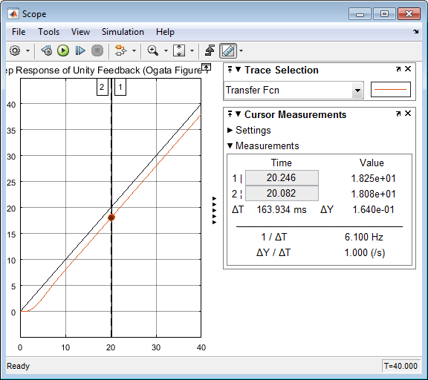
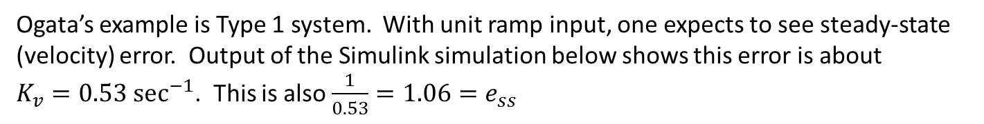

01/11/19
Ogata’s example is Type 1 system. With unit ramp input, one expects to see steady-state (velocity) error. Output of the Simulink simulation below shows this error is about $K_{v}=0.53 {\text{sec}}^{−1}$. This is also $\frac{1}{0.53}=1.06=e_{ss}$
Unit step: so at 20 sec, output is 20
Output at 20 sec however is 18.08
Thus error = 20-18.08 = 1.92 or $K_{v}=\frac{1}{1.92}=0.52 {\text{sec}}^{−1}$

Slide 3
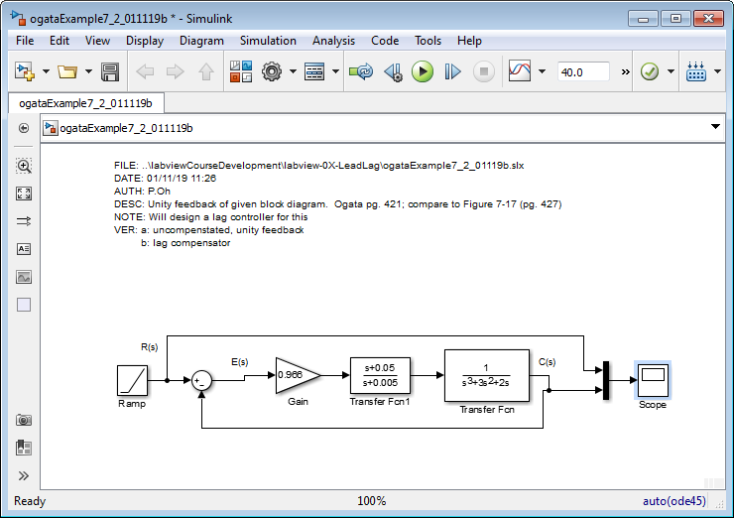
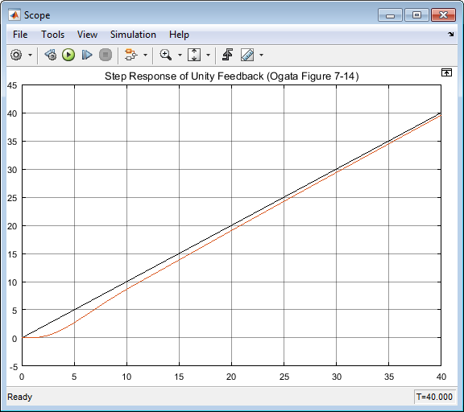
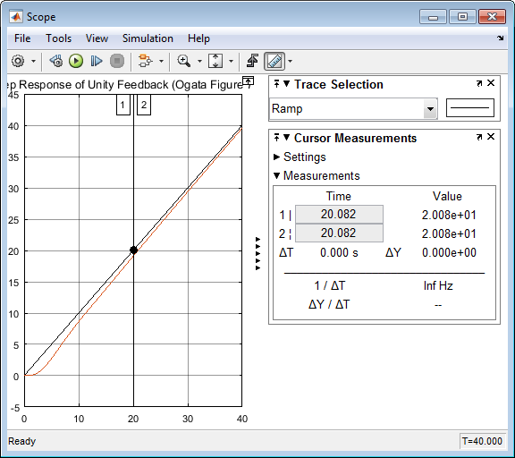

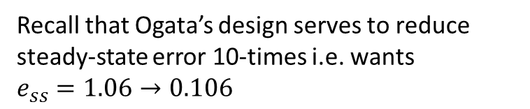
Using Ogata’s Lag Compensator design, the resulting unit ramp input given below
Recall that Ogata’s design serves to reduce steady-state error 10-times i.e. wants $e_{ss}=1.06→0.106$
Unit step: so at 20 sec, output is 20
Output at 20 sec however is 20.08
Thus error = 20-20.08 = 0.09 $≈0.1$
Close-up of output shows that this was successful

Slide 4
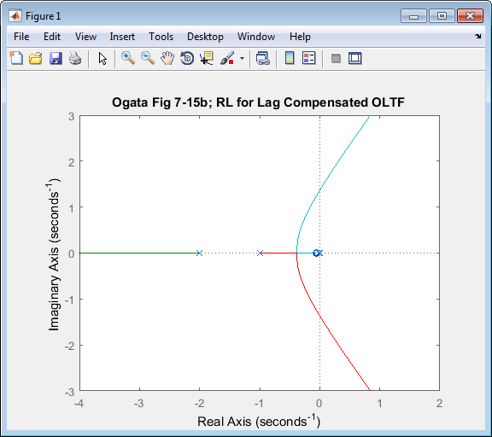
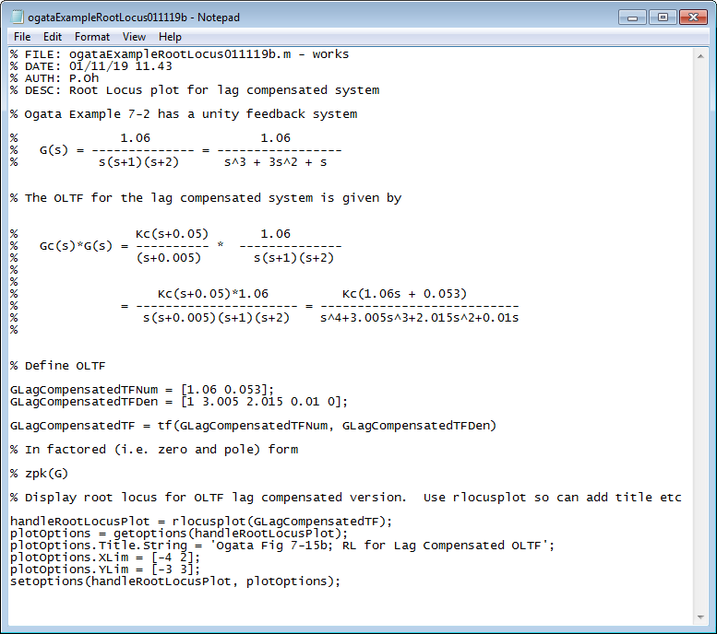
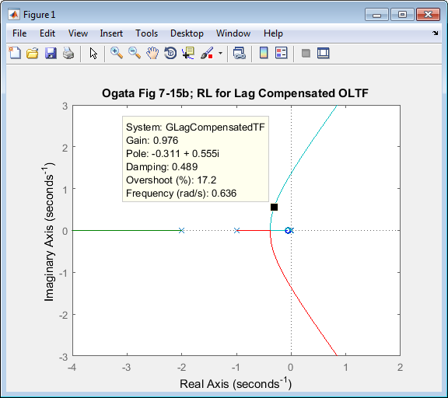
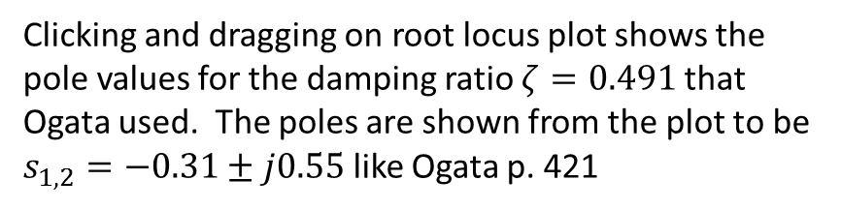
Clicking and dragging on root locus plot shows the pole values for the damping ratio $ζ=0.491$ that Ogata used. The poles are shown from the plot to be $s_{1,2}=−0.31±j0.55$ like Ogata p. 421

Slide 5
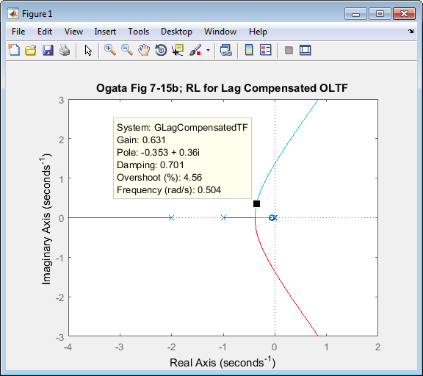
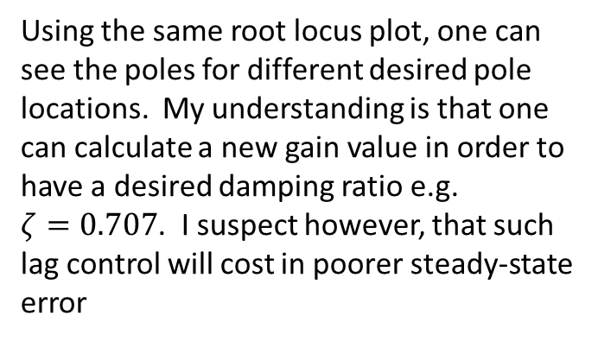
Using the same root locus plot, one can see the poles for different desired pole locations. My understanding is that one can calculate a new gain value in order to have a desired damping ratio e.g. $ζ=0.707$. I suspect however, that such lag control will cost in poorer steady-state error

