Slide 1
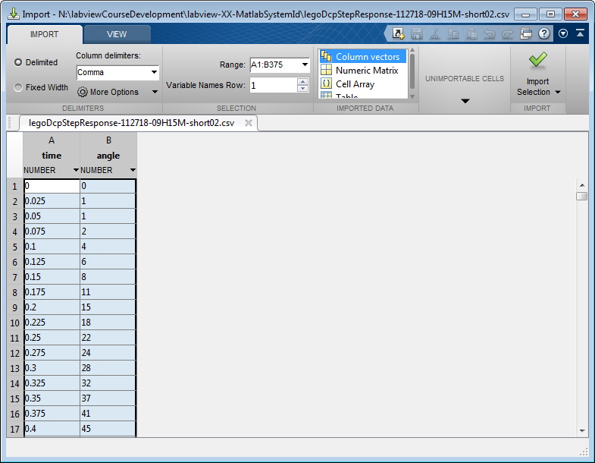
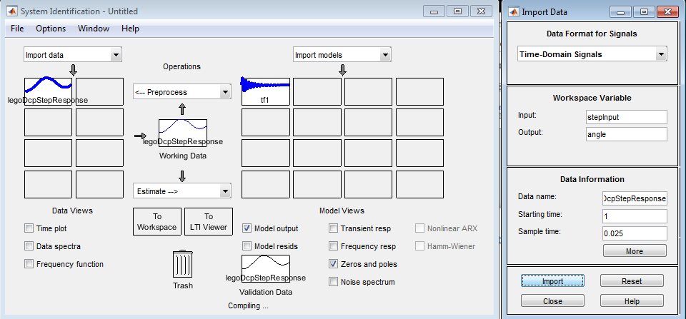
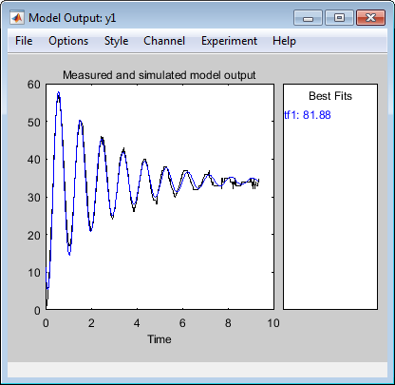
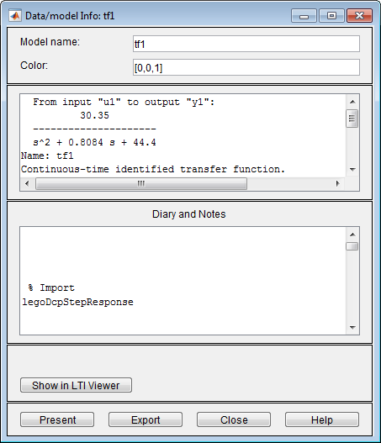


Step 1: I trimmed the CSV step response data to start at 0 sec and 0 deg and set variables to time and angle. I ran ident and set the workspace variables. I also created the stepInput vector using stepInput = (50 + zeros(1, 375))';
Step 2: We then selected Estimate – Transfer Function Models with 2 poles, 0 zeros, continuous-time, and made sure I/O Delay Fixed box was unchecked. This resulted in a 81.88% fit. Right-clicking this fit revealed the transfer function
$$\text{TF}\text{ = }\frac{30.35}{s^{2}+0.8084s+44.4}$$
$$\text{TF}\text{ = }\frac{31.27}{s^{2}+0.485s+53.96}$$
Matlab System ID
Hand calculations

Slide 2








Step 3: Matlab System ID called fit tf1. Used pole(tf1) to determine poles
$$\text{TF}\text{ = }\frac{30.35}{s^{2}+0.8084s+44.4}$$
$$\text{TF}\text{ = }\frac{31.27}{s^{2}+0.485s+53.96}$$
Matlab System ID
Hand calculations
Poles = $−0.4042±6.6511i$
Poles = $−0.2425±7.3417i$
$$θ=\tan^{−1}{\frac{0.4042}{6.6511}=0.061 \text{deg}}$$
$$θ=\tan^{−1}{\frac{0.2425}{7.3417}=0.033 \text{deg}}$$
$$ζ=\sin{0.061=0.061}$$
$$ζ=\sin{0.033=0.033}$$
$$ω_{n}=\sqrt{{0.4042}^{2}+{6.6511}^{2}}=\sqrt{0.1634+44.23}=\sqrt{44.40}=6.66$$
$$ω_{n}=\sqrt{{0.2425}^{2}+{7.3417}^{2}}=\sqrt{0.059+53.9}=\sqrt{53.96}=7.34$$

Slide 3
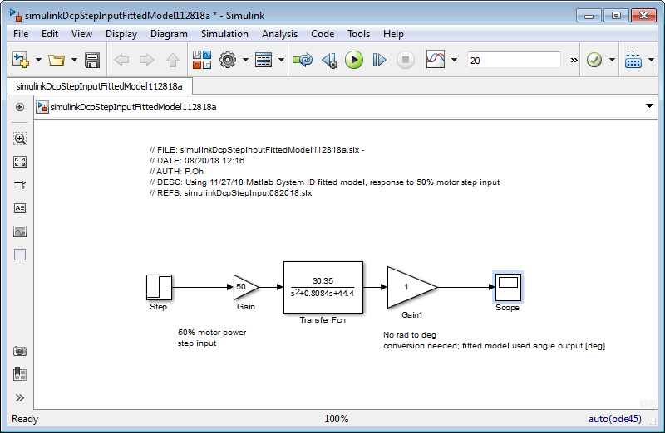
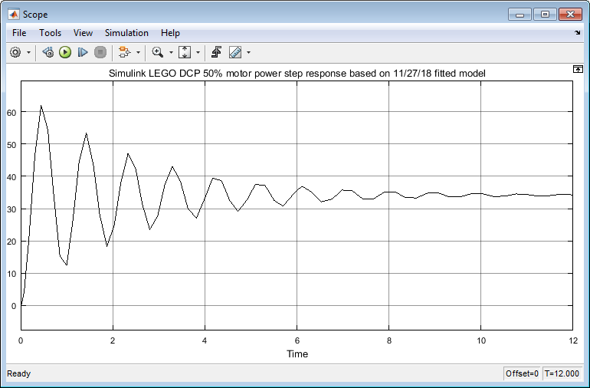
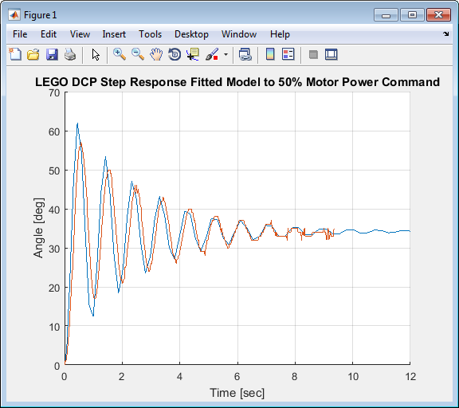
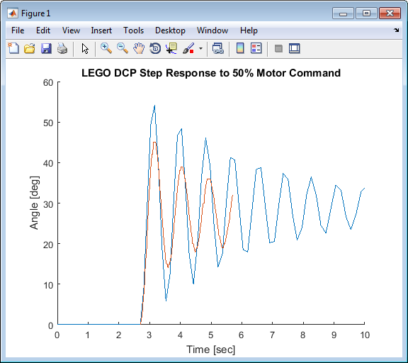
simulinkDcpStepInputFittedModel112818a.slx
Scope output for fitted DCP model
11/12/18 Evernote results i.e. hand-derived DCP model response.
Compared to figure on the left, this model doesn’t match as well
Overlay of CSV file (red) on simulated output

Slide 4
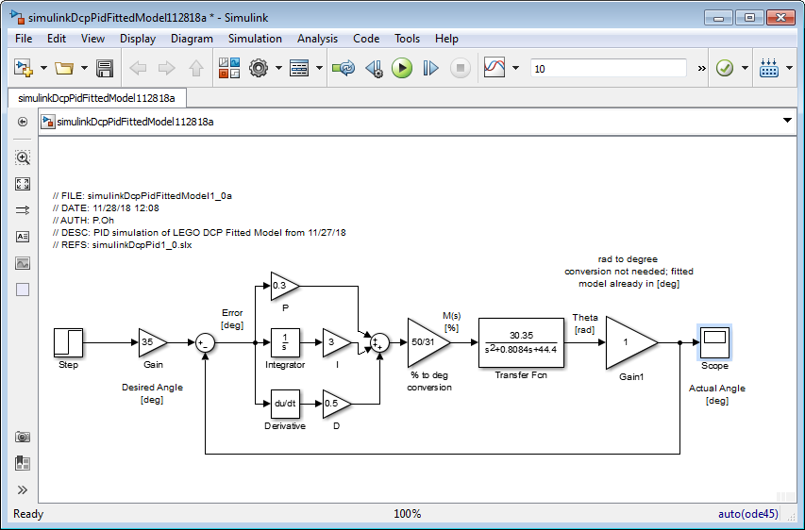
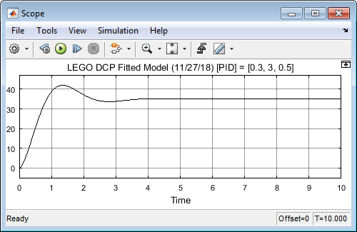
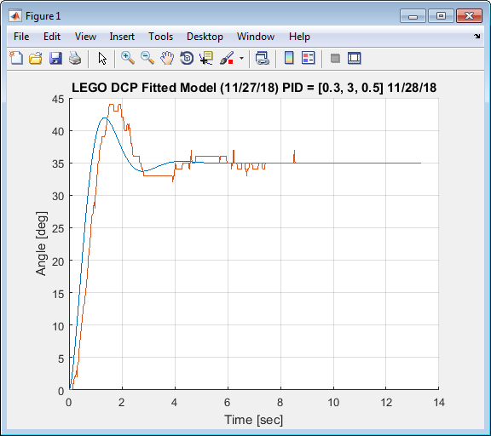
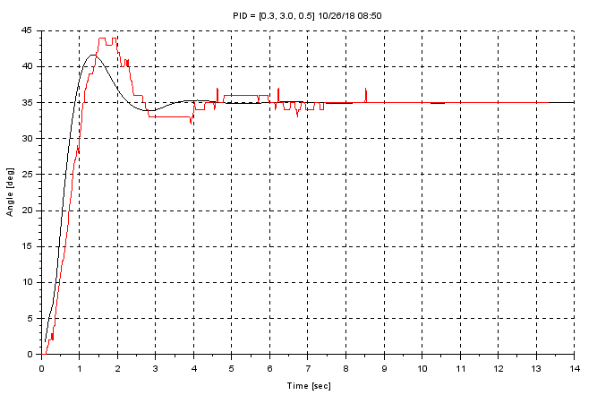
simulinkDcpPidFittedModel112818a.slx
Scope output for fitted DCP model with PID
10/26/18 Evernote results i.e. hand-derived DCP model response
Not too much difference…
Overlay of CSV file (red) on simulated output

Slide 5
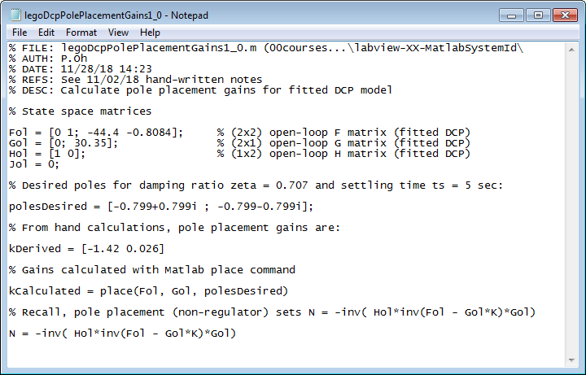
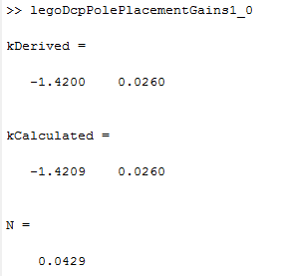
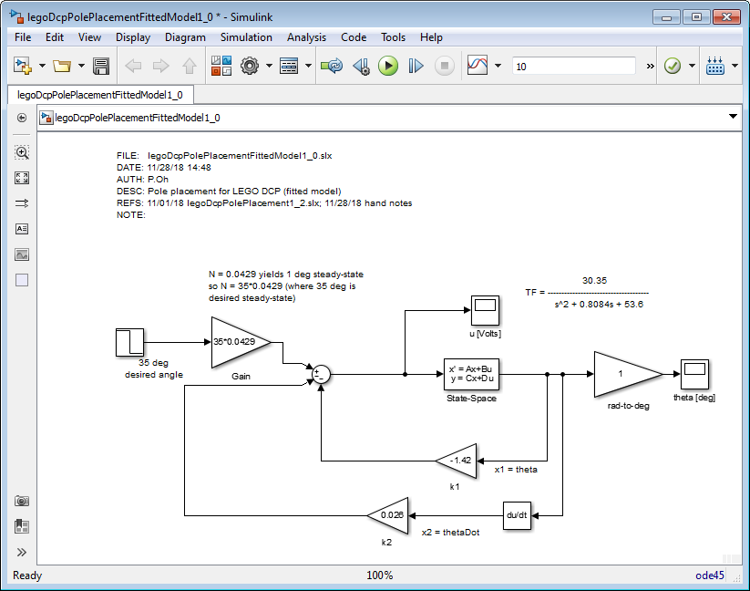
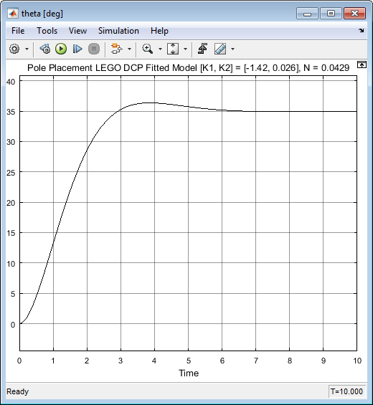
00courses\...\labview-XX-MatlabSystemId\legoDcpPolePlacementGains1_0.m
FILE: legoDcpPolePlacementFittedModel1_0.slx
Scope output for fitted DCP model with PID

