Slide 1
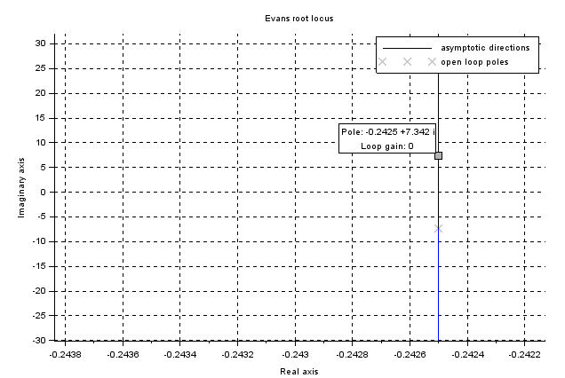
--> s=poly(0, "s");
--> p = 53.96 + 0.485*s + s^2
p =
2
53.96 +0.485s +s
--> x=roots(p)
x =
-0.2425 + 7.3417432i
-0.2425 - 7.3417432i
--> oltf = 31.27/p
oltf =
31.27
-------------------
2
53.96 + 0.485s + s
--> evans(oltf)
--> xgrid
--> datatipToggle()

