Slide 1
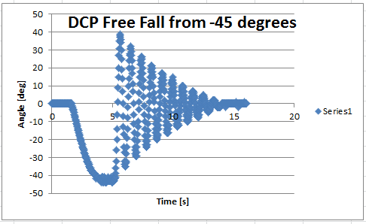
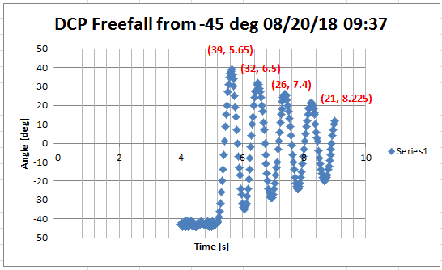
NXT Labview with DCP: Notes for System ID (started 08/20/18)
Exponentially Decaying Sinusoid defined by
and
n
n
Natural Frequency [rad/s]
(1)
Damping ratio
(2A)
Period [sec]
Angle [rad]
(2B)

Slide 2
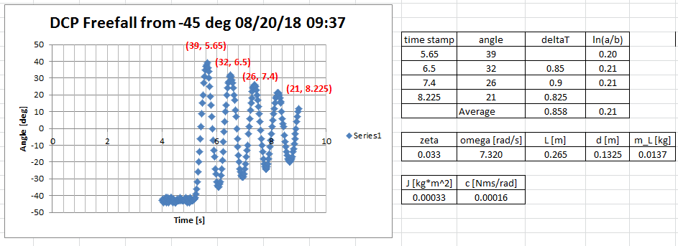
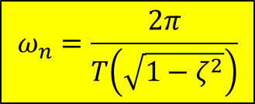
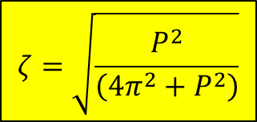


(1)
$$\ln{\frac{a}{b}=P} \text{then} \text{say} P^{2}\left(1−ζ^{2}\right)=ζ^{2}4π^{2}$$
(2A)
$ζ^{2}4π^{2}$+$P^{2}ζ^{2}=P^{2} \text{or} \text{say} ζ^{2}\left(4π^{2}+P^{2}\right)=P^{2}$
$$ζ=\sqrt{\frac{P^{2}}{\left(4π^{2}+P^{2}\right)}}$$
$$ω_{n}=\frac{2π}{T\left(\sqrt{1−ζ^{2}}\right)}$$
(2B)
QED, see 08/21/18 handwritten notes

Slide 3
Damped Compound Pendulum Equations of Motion
(3)
Linearized 2nd order differential equation assumes small angles
Bar length [m]
Pivot to CG distance [m]
Mass of pendulum [kg]
Moment of Inertia
Viscous damping coefficient

Slide 4
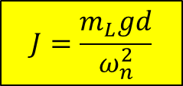
System Identification by Matching Coefficients
Compare (1) and (3)
(4A)
Yields:
$$J=\frac{m_{L}gd}{ω_{n}^{2}}$$
(4B)
08/21/18 verified equations http://ctms.engin.umich.edu/CTMS/index.php?aux=Activities_Pendulum
Bar length [m] = 26.5 cm = 0.265 m
Pivot to CG distance [m] = 0.265/2 = 0.1325 m
c units are expressed as Nms
Mass of pendulum [kg] = 13.7 g = 0.0137 kg
= 0.0033 kgm^2
J units are indeed kgm^2, but technically kgm^2/rad^2
Moment of Inertia
= 0.00016 Nms/rad
Viscous damping coefficient

Slide 5
Easier Math I: Laplace Domain
Voltage
applied to motor
Propeller spins, creating lift force
Lift on lever arm r creates torque
Pendulum rotates angle
[% power]
[Nm/%]

Slide 6

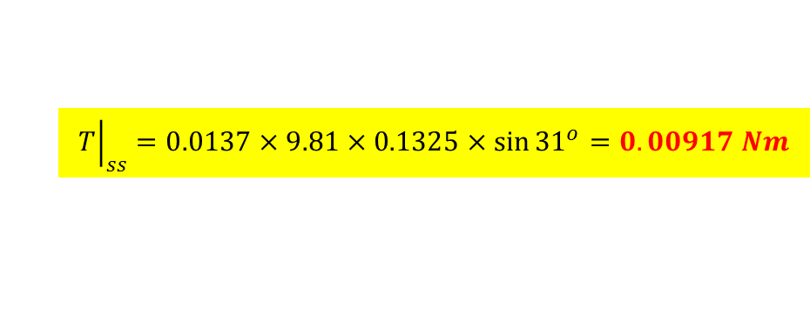
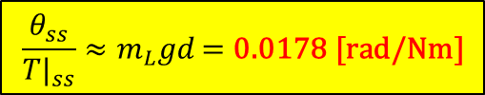
Calculating Constants
[% power]
[Nm/%]
Theory: can calculate lift force if have propeller pitch and radius dimensions, air density and motor angular velocity.
Experimentally, apply known voltage V and pendulum will eventually reach steady-state. Recall
$$\frac{θ_{ss}}{{T|}_{ss}}≈m_{L}gd\text{ = }\text{0.0178 [}\text{rad}\text{/}\text{Nm}\text{]}$$
At steady-state angular acceleration and velocity are zero. The torque at this known voltage is calculated by:
And hence
$${\left.T\right|}_{ss}=0.0137×9.81×0.1325×\sin{{31}^{o}=0.00917 Nm}$$
$K_{m}$=$\frac{0.00917}{50}=0.000183 Nm/\%$

Slide 7
Open-Loop Transfer Function
[% power]
[Nm/%]
OLTF:
Given
Nm/%
m
(3)
kgm
2
kg
Laplace domain OL Transfer function
Nms/rad

Slide 8
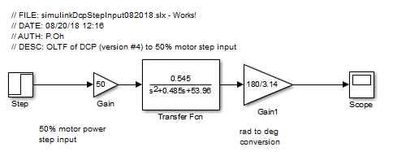
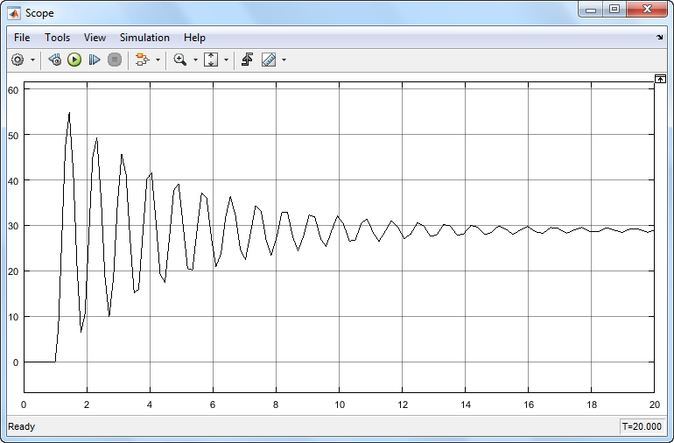
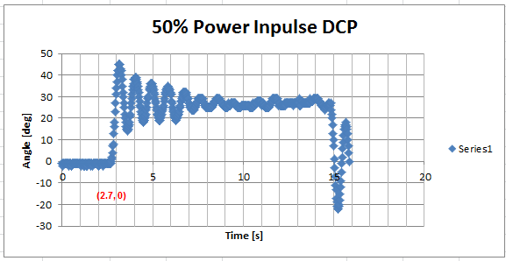
OLTF Simulations
08/21/18 hand notes explains why having this rad-to-deg gain is correct
08/20/18 Simulink Theory
simulinkDcpStepInput082018.slx
08/12/18 Labview Experimental
dcp081218-1445.xlsx
Thoughts:
Both theory and experiments show settling time is about 13 sec
Theory has higher overshoot (55 deg) vs. experiment (45 deg)
Perhaps because DCP mass is not uniform; heavier at end (due to motor)

Slide 9
