Slide 1
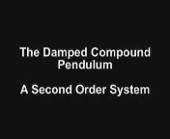

Course Objective
Simulation using “Working Model”

Slide 2
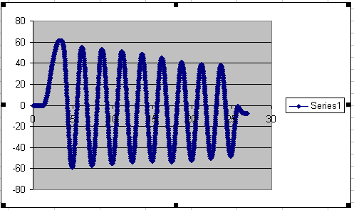
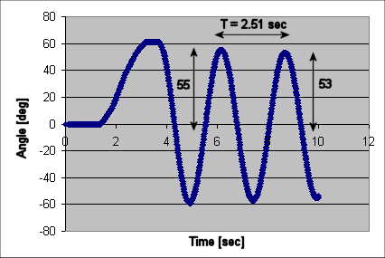
Exponentially Decaying Sinusoid defined by
and
n
n
Natural Frequency [rad/s]
(1)
Damping ratio
(2A)
Period [sec]
Angle [rad]
(2B)

Slide 3
Damped Compound Pendulum Equations of Motion
(3)
Linearized 2nd order differential equation assumes small angles
Bar length [m]
Pivot to CG distance [m]
Mass of pendulum [kg]
Moment of Inertia
Viscous damping coefficient

Slide 4
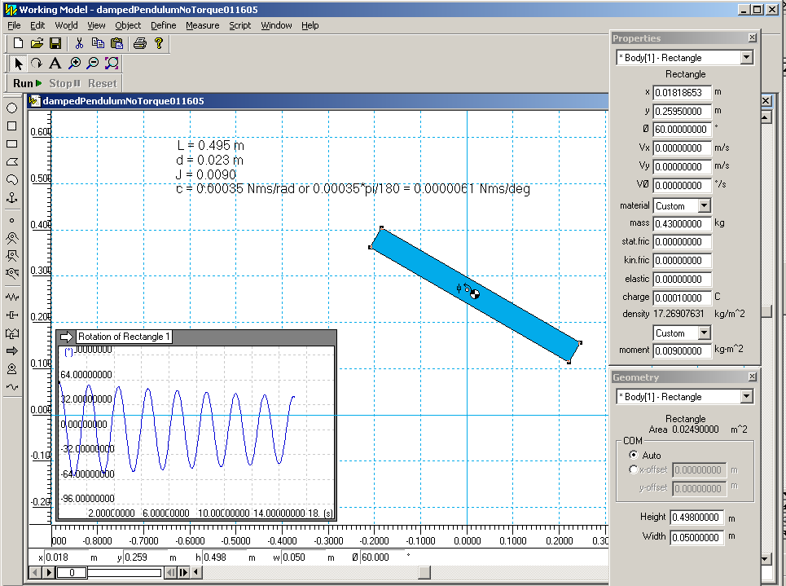
System Identification by Matching Coefficients
Compare (1) and (3)
(4A)
Yields:
(4B)
Now can create a model for simulation

Slide 5
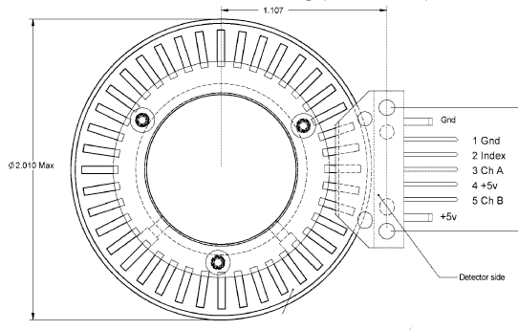
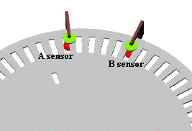
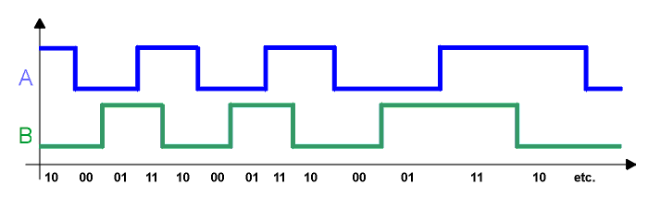
Optical Encoders and Quadrature
Incremental optical encoders generate two data signals that are electrically 90° out of phase with each other. The term quadrature refers to this 90° phase relationship.
CCW A-B
CW A-B
From
To
From
To
1-0
1-1
1-0
0-0
0-0
1-0
0-0
0-1
0-1
0-0
0-1
1-1
1-1
0-1
1-1
0-0

