Slide 1
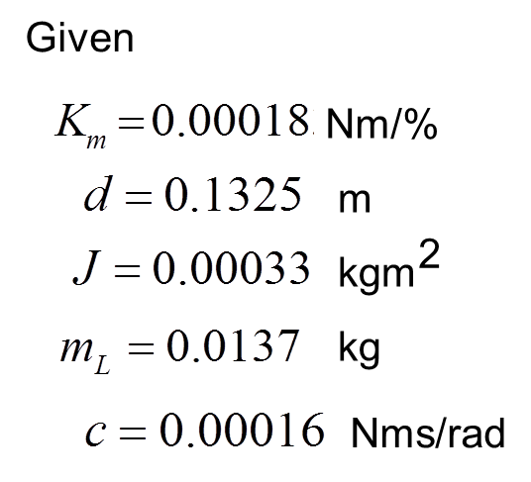
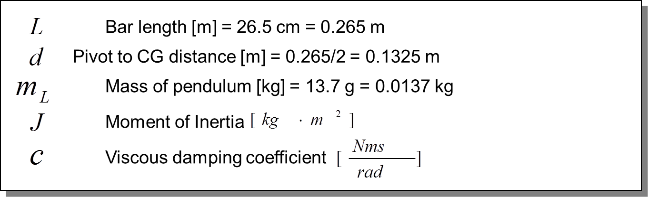










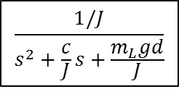









$$\frac{1/J}{s^{2}+\frac{c}{J}s+\frac{m_{L}gd}{J}}$$
$$\frac{0.00018}{0.00033}=0.545$$
$$Μ\left(s\right)$$
$$K_{m}$$
$$Τ\left(s\right)$$
$$Θ^{∗}\left(s\right)$$
$$Θ\left(s\right)$$
$$\frac{50}{31}$$
$$0.00018$$
$$\frac{1/0.00033}{s^{2}+0.485s+53.96}$$
$$\frac{180}{3.14}$$
[deg]
[%]
$$\left[\frac{Nm}{\%}\right]$$
[rad]
[deg]
$$\frac{0.00018}{0.00033}=0.545$$
$$\frac{0.00018∗1∗180}{0.00033∗3.14}=0.545\frac{180}{3.14}=31.27$$
$$Μ\left(s\right)$$
$$Θ^{∗}\left(s\right)$$
$$Μ\left(s\right)$$
$$Θ\left(s\right)$$
$$\frac{0.545}{s^{2}+0.485s+53.96}$$
$$\frac{31.27}{s^{2}+0.485s+53.96}$$
[%]
[rad]
[%]
[rad]

Slide 2






$$\frac{1/J}{s^{2}+\frac{c}{J}s+\frac{m_{L}gd}{J}}$$
$$\frac{0.00018}{0.00033}=0.545$$
$$Θ^{∗}\left(s\right)$$
$$Μ\left(s\right)$$
$$K_{m}$$
$$Τ\left(s\right)$$
$$Θ\left(s\right)$$
$$\frac{50}{31}$$
$$0.00018$$
$$\frac{1/0.00033}{s^{2}+0.485s+53.96}$$
[deg]
[%]
$$\left[\frac{Nm}{\%}\right]$$
[rad]
[deg]
$$\frac{K_{m}}{J}=\frac{0.00018}{0.00033}=0.545$$
$$\frac{0.00018∗1∗180}{0.00033∗3.14}=0.545\frac{180}{3.14}=31.27$$
$$Μ\left(s\right)$$
$$Θ\left(s\right)$$
$$Μ\left(s\right)$$
$$Θ\left(s\right)$$
$$\frac{0.545}{s^{2}+0.485s+53.96}$$
$$\frac{31.27}{s^{2}+0.485s+53.96}$$
[%]
[rad]
[%]
[rad]
$$\frac{1/J}{s^{2}+\frac{c}{J}s+\frac{m_{L}gd}{J}}$$
$$Θ^{∗}\left(s\right)$$

