Slide 1
Non-LEGO DCP

Slide 2
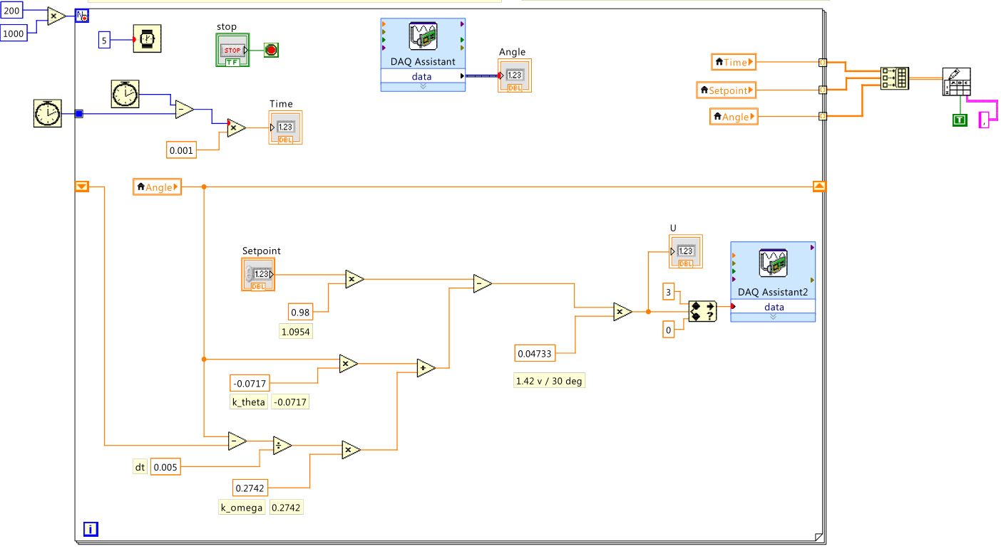
Pole-placement Demo and LabVIEW code
Operating code : nxtLabviewDcpPolePlacement2_0g_DrPark_08.vi
Data saving
Scale gain
Angle feedback gain
Set output limits
Conversion value
from deg to power in percent
Angular velocity calculated by a finite difference
Angular velocity feedback gain

Slide 3
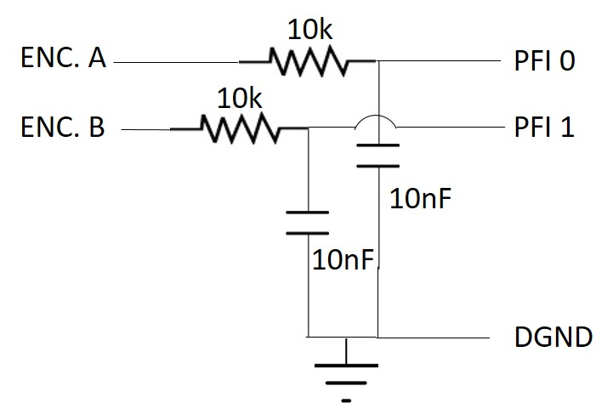
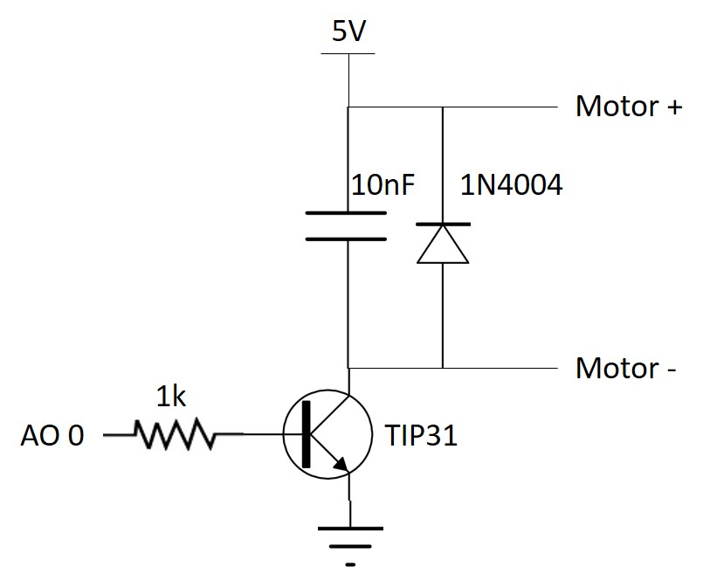
Circuits
Connectors
Low-pass filter for encoder
Motor driver

Slide 4
Reference
I did well organize Non-LEGO DCP on the following website: http://www.daslhub.org/unlv/wiki/doku.php?id=damped_compound_pendulum
Please, see the DASL wiki page.

Slide 5
NXT wheel/tire system

Slide 6
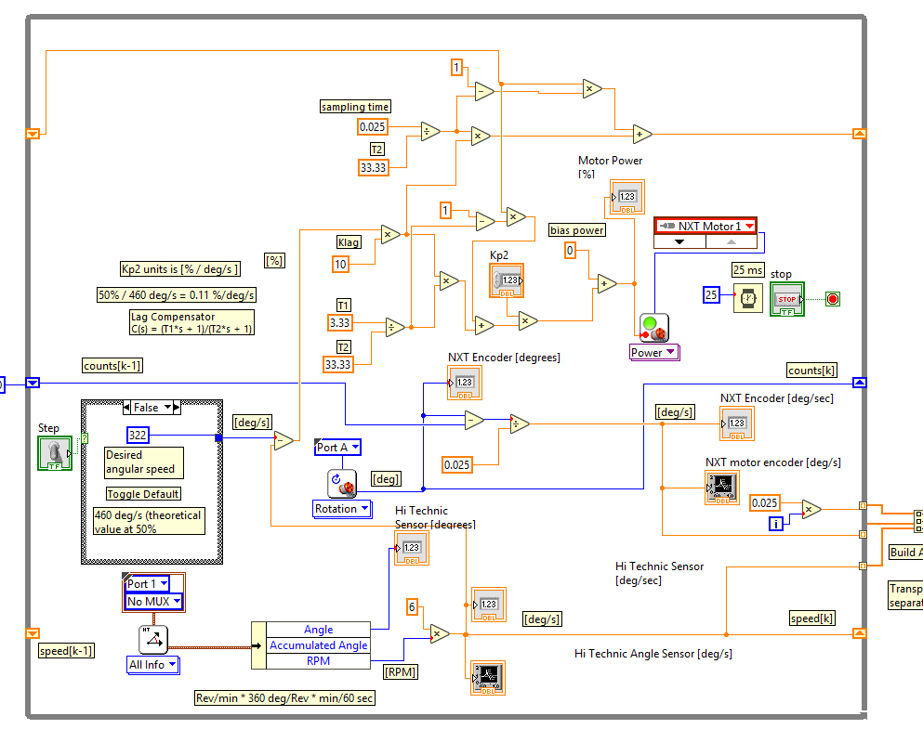
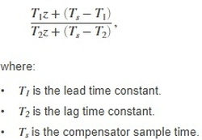
Lag compensator LabVIEW code
Operating code : nxtMotorStepResponse1_2d.vi
Continuous lag compensator
Lag compensator block
equivalent
Discrete lag compensator for implementation
equivalent

Slide 7
LEGO RIP

Slide 8
Reference
I did well organize LEGO RIP on the following website: http://www.daslhub.org/unlv/wiki/doku.php?id=lego_rip
Please, see the DASL wiki page.
Include two files: RIP_LQR_rev.m for Matlab RIP_SP_r3.nxc for NXT

