Slide 1
ME729 Advanced Robotics -
Singularity and Motion Trajectories
2/26/2018
Sangsin Park, Ph.D.

Slide 2
Singularity
Kinematic singularities
  The inverse mapping from Cartesian space to joint space is not sometimes defined.
  Those positions of the robot are referred to as singularities or degeneracies.
  At a singularity,
    Infinite inverse kinematic solutions may exist.
    Small Cartesian motions may require infinite joint velocities.
  Boundary Singularities (also known as workspace singularities)
    Usually caused by a full extension of a joint.
  Internal Singularities (also known as joint space singularities)
    Caused by an alignment of the robots axes in space.
  By analyzing the Jacobian matrix of a manipulator, we can find the singular positions of the robot.
Joint space
Cartesian space
Inverse kinematics

Slide 3





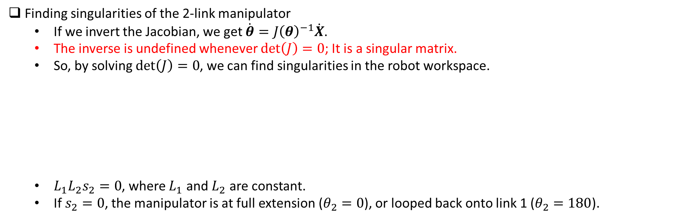



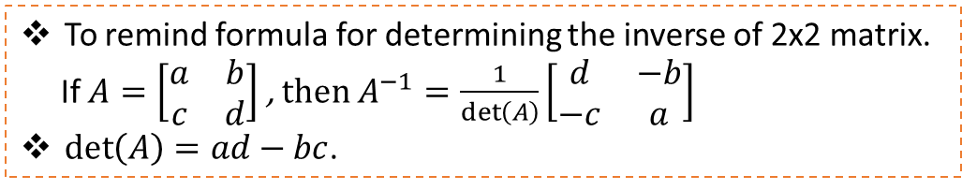

Singularity
Finding singularities of the 2-link manipulator
  If we invert the Jacobian, we get $\dot{θ}=J{\left(θ\right)}^{−1}\dot{X}$.
  The inverse is undefined whenever $\det\left(J\right)=0$; It is a singular matrix.
  So, by solving $\det\left(J\right)=0$, we can find singularities in the robot workspace.
  $L_{1}L_{2}s_{2}=0$, where $L_{1}$ and $L_{2}$ are constant.
  If $s_{2}=0$, the manipulator is at full extension ($θ_{2}=0$), or looped back onto link 1 ($θ_{2}=180$).
To remind formula for determining the inverse of 2x2 matrix.
If $A=\left[\begin{matrix}a & b \\ c & d\end{matrix}\right]$ , then $A^{−1}=\frac{1}{\det\left(A\right)}\left[\begin{matrix}d & −b \\ −c & a\end{matrix}\right]$
$\det\left(A\right)=ad−bc$.
$$\det\left(J\right)=L_{1}L_{2}s_{2}$$
$$y_{O}$$
$$y_{O}$$
$$O$$
$$x_{O}$$
$$O$$
$$x_{O}$$
$$θ_{2}=0$$
$$θ_{2}=180$$

Slide 4




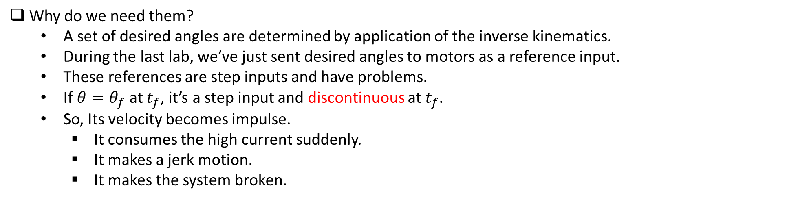






Motion Trajectories
Why do we need them?
  A set of desired angles are determined by application of the inverse kinematics.
  During the last lab, we’ve just sent desired angles to motors as a reference input.
  These references are step inputs and have problems.
  If $θ=θ_{f}$ at $t_{f}$, it’s a step input and discontinuous at $t_{f}$.
  So, Its velocity becomes impulse.
    It consumes the high current suddenly.
    It makes a jerk motion.
    It makes the system broken.
$$θ$$
$$\dot{θ}$$
$$θ_{f}$$
$$\dot{θ_{f}}$$
$$t$$
$$t$$
$$0$$
$$t_{f}$$
$$0$$
$$t_{f}$$
Step input
Impulse velocity

Slide 5





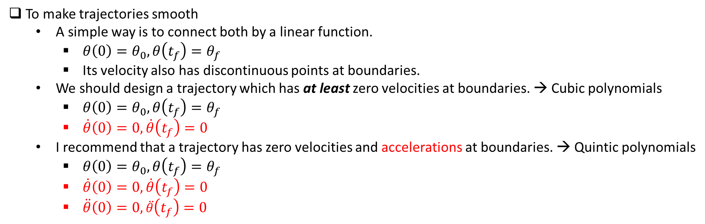







Motion Trajectories
To make trajectories smooth
  A simple way is to connect both by a linear function.
    $θ\left(0\right)=θ_{0},θ\left(t_{f}\right)=θ_{f}$
    Its velocity also has discontinuous points at boundaries.
  We should design a trajectory which has at least zero velocities at boundaries. → Cubic polynomials
    $θ\left(0\right)=θ_{0},θ\left(t_{f}\right)=θ_{f}$
    $\dot{θ}\left(0\right)=0,\dot{θ}\left(t_{f}\right)=0$
  I recommend that a trajectory has zero velocities and accelerations at boundaries. → Quintic polynomials
    $θ\left(0\right)=θ_{0},θ\left(t_{f}\right)=θ_{f}$
    $\dot{θ}\left(0\right)=0,\dot{θ}\left(t_{f}\right)=0$
    $\ddot{θ}\left(0\right)=0,\ddot{θ}\left(t_{f}\right)=0$
$$θ$$
$$θ$$
$$θ_{f}$$
$$θ_{f}$$
$$θ_{0}$$
$$θ_{0}$$
$$0$$
$$t_{f}$$
$$t$$
$$0$$
$$t_{f}$$
$$t$$

Slide 6



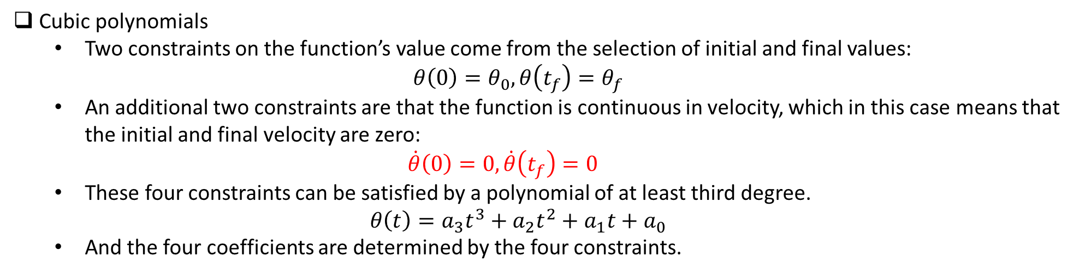





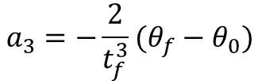
Motion Trajectories
Cubic polynomials
  Two constraints on the function’s value come from the selection of initial and final values:
  $θ\left(0\right)=θ_{0},θ\left(t_{f}\right)=θ_{f}$
  An additional two constraints are that the function is continuous in velocity, which in this case means that the initial and final velocity are zero:
  $\dot{θ}\left(0\right)=0,\dot{θ}\left(t_{f}\right)=0$
  These four constraints can be satisfied by a polynomial of at least third degree.
  $θ\left(t\right)=a_{3}t^{3}+a_{2}t^{2}+a_{1}t+a_{0}$
  And the four coefficients are determined by the four constraints.
$$a_{0}=θ_{0}$$
$$θ_{0}=a_{0}$$
$$a_{1}=0$$
$$θ_{f}=a_{3}t_{f}^{3}+a_{2}t_{f}^{2}+a_{1}t_{f}+a_{0}$$
Solving these equations for the $a_{i}$,
$$a_{2}=\frac{3}{t_{f}^{2}}(θ_{f}−θ_{0})$$
$$0=a_{1}$$
$$0=3a_{3}t_{f}^{2}+2a_{2}t_{f}+a_{1}$$
$$a_{3}=−\frac{2}{t_{f}^{3}}(θ_{f}−θ_{0})$$

Slide 7




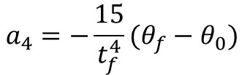
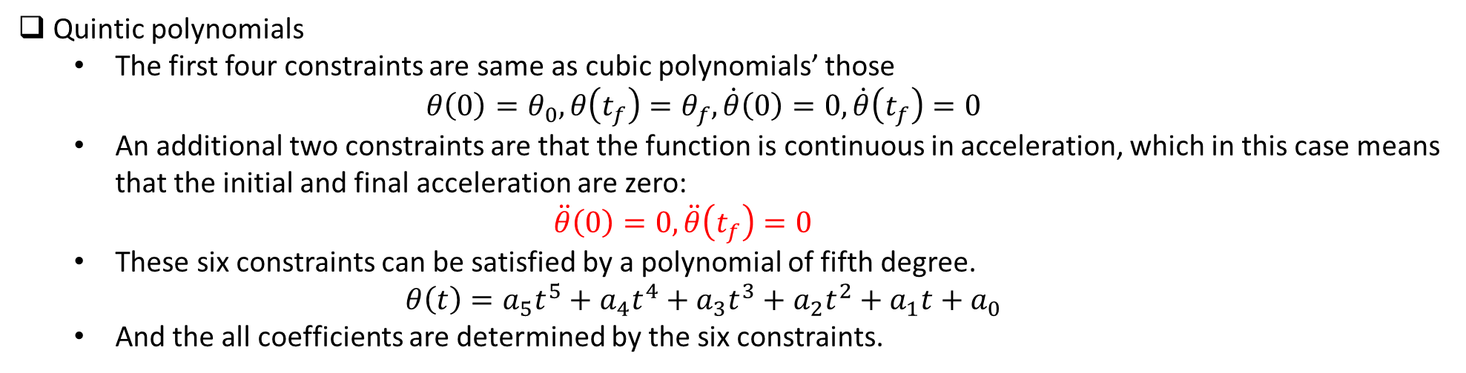
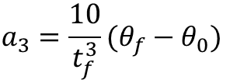




Motion Trajectories
Quintic polynomials
  The first four constraints are same as cubic polynomials’ those
  $θ\left(0\right)=θ_{0},θ\left(t_{f}\right)=θ_{f},\dot{θ}\left(0\right)=0,\dot{θ}\left(t_{f}\right)=0$
  An additional two constraints are that the function is continuous in acceleration, which in this case means that the initial and final acceleration are zero:
  $\ddot{θ}\left(0\right)=0,\ddot{θ}\left(t_{f}\right)=0$
  These six constraints can be satisfied by a polynomial of fifth degree.
  $θ\left(t\right)=a_{5}t^{5}+a_{4}t^{4}+a_{3}t^{3}+a_{2}t^{2}+a_{1}t+a_{0}$
  And the all coefficients are determined by the six constraints.
$a_{0}=θ_{0}$, $a_{1}=0$, $a_{2}=0$
$$θ_{0}=a_{0}$$
$$θ_{f}=a_{5}t_{f}^{5}+a_{4}t_{f}^{4}+a_{3}t_{f}^{3}+a_{2}t_{f}^{2}+a_{1}t_{f}+a_{0}$$
$$a_{3}=\frac{10}{t_{f}^{3}}(θ_{f}−θ_{0})$$
$$0=a_{1}$$
Solving these equations for the $a_{i}$,
$$0=5a_{5}t_{f}^{4}+4a_{4}t_{f}^{3}+3a_{3}t_{f}^{2}+2a_{2}t_{f}+a_{1}$$
$$a_{4}=−\frac{15}{t_{f}^{4}}(θ_{f}−θ_{0})$$
$$0=a_{2}$$
$$a_{5}=\frac{6}{t_{f}^{5}}(θ_{f}−θ_{0})$$
$$0=20a_{5}t_{f}^{3}+12a_{4}t_{f}^{2}+6a_{3}t_{f}+2a_{2}$$

Slide 8










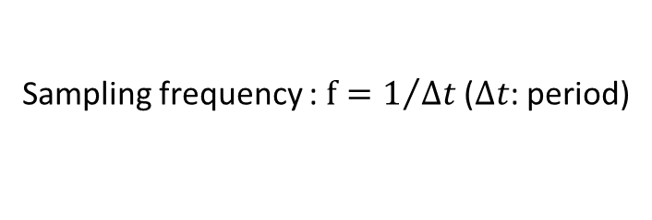
Motion Trajectories
The way to implement motion trajectories
  We need to discretize continuous trajectories with a sampling frequency.
  $t_{i}=Δt∗i$ and $θ_{i}=θ\left(t_{i}\right)$, where $i=0, ⋯,n$.
  And then, we set the sampled points to reference input sequentially.
  So, we need a timer to discretize and update reference input in real-time.
$$θ$$
$$θ$$
$$θ_{f}$$
$$θ_{f}$$
Sampling frequency : $f=1/{Δt}$ ($Δt$: period)
$$θ_{0}$$
$$θ_{0}$$
$$t$$
$$0$$
$$t_{f}$$
$$t$$
$$0$$
$$t_{f}$$
$$Δt$$

