Slide 1
ME729 Advanced Robotics -
Inverse Kinematics
2/12/2018
Sangsin Park, Ph.D.

Slide 2
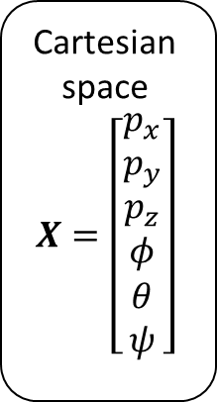
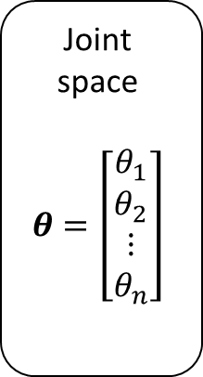
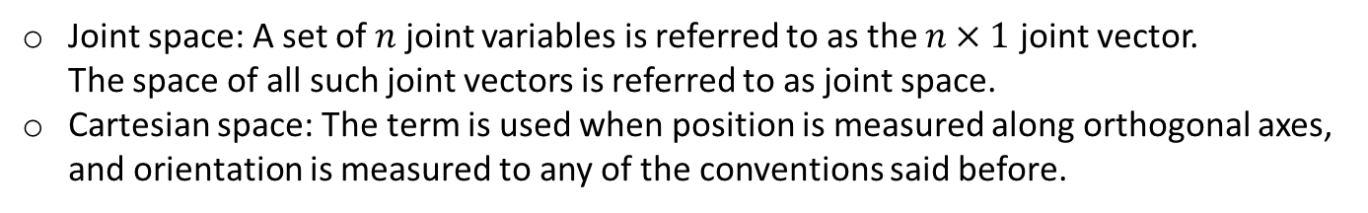
Inverse Kinematics
Mappings between kinematic descriptions
Forward kinematics
Joint space
$$θ=\left[\begin{aligned}θ_{1} \\ θ_{2} \\ ⋮ \\ θ_{n}\end{aligned}\right]$$
Cartesian space
$$X=\left[\begin{aligned}p_{x} \\ p_{y} \\ p_{z} \\ φ \\ θ \\ ψ\end{aligned}\right]$$
Inverse kinematics
Joint space: A set of $n$ joint variables is referred to as the $n×1$ joint vector.
The space of all such joint vectors is referred to as joint space.
Cartesian space: The term is used when position is measured along orthogonal axes,
and orientation is measured to any of the conventions said before.

Slide 3





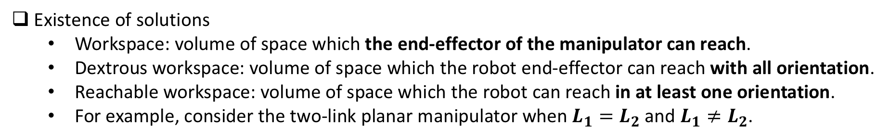







Inverse Kinematics
Existence of solutions
  Workspace: volume of space which the end-effector of the manipulator can reach.
  Dextrous workspace: volume of space which the robot end-effector can reach with all orientation.
  Reachable workspace: volume of space which the robot can reach in at least one orientation.
  For example, consider the two-link planar manipulator when $L_{1}=L_{2}$ and $L_{1}≠L_{2}$.
$$L_{2}$$
$$L_{2}$$
$$y_{O}$$
$$L_{1}$$
reachable workspace
$$y_{O}$$
$$L_{1}$$
$$O$$
$$x_{O}$$
$$O$$
$$x_{O}$$
dextrous workspace, the origin
NO dextrous workspace
$$L_{1}=L_{2}$$
$$L_{1}≠L_{2}$$

Slide 4



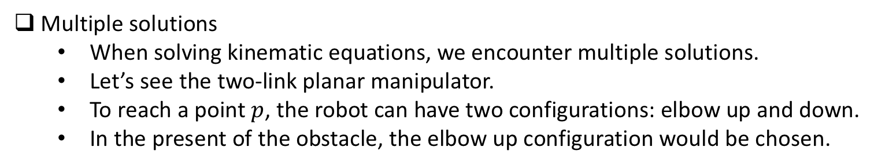





Inverse Kinematics
Multiple solutions
  When solving kinematic equations, we encounter multiple solutions.
  Let’s see the two-link planar manipulator.
  To reach a point $p$, the robot can have two configurations: elbow up and down.
  In the present of the obstacle, the elbow up configuration would be chosen.
elbow-up
$$p$$
$$p$$
$$y_{O}$$
$$y_{O}$$
Obstacle
$$x_{O}$$
elbow-down
$$x_{O}$$
$$O$$
$$O$$

Slide 5
Inverse Kinematics
Method of solution
  Closed form methods: based on analytic expressions.
  Numerical methods: based on iterative procedures.
  We consider two methods: algebraic and Jacobi method.
Solving kinematic equations
Closed form methods
Numerical methods
Algebraic method
Geometric method
Jacobi method

Slide 6
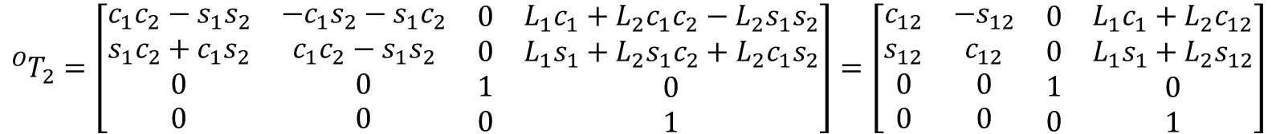


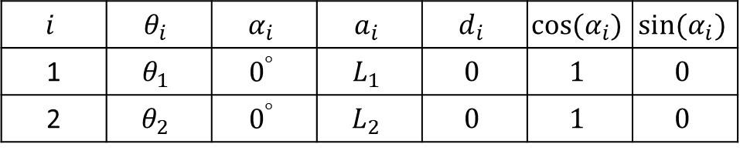








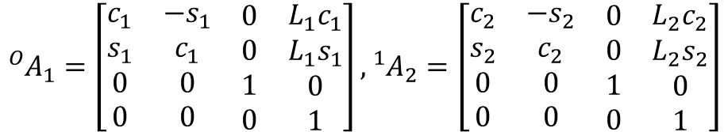


Kinematic Equations
The two-link planar manipulator
1) DH parameters table
$$y_{2}$$
$$x_{2}$$
$$i$$ | $$θ_{i}$$ | $$α_{i}$$ | $$a_{i}$$ | $$d_{i}$$ | $$cos⁡(α_{i})$$ | $$sin⁡(α_{i})$$
1 | $$θ_{1}$$ | $$0^{°}$$ | $$L_{1}$$ | $$0$$ | $$1$$ | $$0$$
2 | $$θ_{2}$$ | $$0^{°}$$ | $$L_{2}$$ | $$0$$ | $$1$$ | $$0$$
Link 2
$$θ_{2}$$
$$y_{1}$$
$$L_{2}$$
Link 1
$$x_{1}$$
2) Link transformation matrices
$$L_{1}$$
$$y_{O}$$
$${}_{ }^{O}{A_{1}}=\left[\begin{matrix}\begin{aligned}c_{1} \\ s_{1} \\ 0 \\ 0\end{aligned} & \begin{aligned}−s_{1} \\ c_{1} \\ 0 \\ 0\end{aligned} & \begin{matrix}\begin{aligned}0 \\ 0 \\ 1 \\ 0\end{aligned} & \begin{aligned}L_{1}c_{1} \\ L_{1}s_{1} \\ 0 \\ 1\end{aligned}\end{matrix}\end{matrix}\right],{}_{ }^{1}{A_{2}}=\left[\begin{matrix}\begin{aligned}c_{2} \\ s_{2} \\ 0 \\ 0\end{aligned} & \begin{aligned}−s_{2} \\ c_{2} \\ 0 \\ 0\end{aligned} & \begin{matrix}\begin{aligned}0 \\ 0 \\ 1 \\ 0\end{aligned} & \begin{aligned}L_{2}c_{2} \\ L_{2}s_{2} \\ 0 \\ 1\end{aligned}\end{matrix}\end{matrix}\right]$$
Joint 2
$$θ_{1}$$
$$z_{O}$$
$$x_{O}$$
$$O$$
*$\cos\left(θ_{i}\right)=c_{i} ,\sin\left(θ_{i}\right)=s_{i},\cos\left(θ_{i}+θ_{j}\right)=c_{ij} ,\sin\left(θ_{i}+θ_{j}\right)=s_{ij}$
Joint 1
3) The single transformation matrix that relates frame 2 from frame O
$${}_{ }^{O}{T_{2}}=\left[\begin{matrix}\begin{aligned}c_{1}c_{2}−s_{1}s_{2} \\ s_{1}c_{2}+c_{1}s_{2} \\ 0 \\ 0\end{aligned} & \begin{aligned}−c_{1}s_{2}−s_{1}c_{2} \\ c_{1}c_{2}−s_{1}s_{2} \\ 0 \\ 0\end{aligned} & \begin{matrix}\begin{aligned}0 \\ 0 \\ 1 \\ 0\end{aligned} & \begin{aligned}L_{1}c_{1}+L_{2}c_{1}c_{2}−L_{2}s_{1}s_{2} \\ L_{1}s_{1}+L_{2}s_{1}c_{2}+L_{2}c_{1}s_{2} \\ 0 \\ 1\end{aligned}\end{matrix}\end{matrix}\right]=\left[\begin{matrix}\begin{aligned}c_{12} \\ s_{12} \\ 0 \\ 0\end{aligned} & \begin{aligned}−s_{12} \\ c_{12} \\ 0 \\ 0\end{aligned} & \begin{matrix}\begin{aligned}0 \\ 0 \\ 1 \\ 0\end{aligned} & \begin{aligned}L_{1}c_{1}+L_{2}c_{12} \\ L_{1}s_{1}+L_{2}s_{12} \\ 0 \\ 1\end{aligned}\end{matrix}\end{matrix}\right]$$
Notes:
Let me give you one example.
It is very familiar to us.
Yes. This is a solution of homework 2, problem 4.
Here is a reference frame.
Assign coordinate frames on each link.
A x axis is placed on a longitudinal axis of each link.
Cos theta i and sin theta i are abbreviated to c i and s i.
Also, c ij and s ij are the abbreviation for cos theta i plus theta j and sin theta i plus theta j.

Slide 7

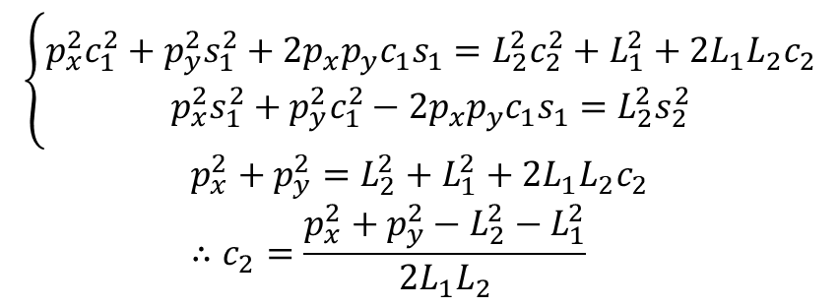
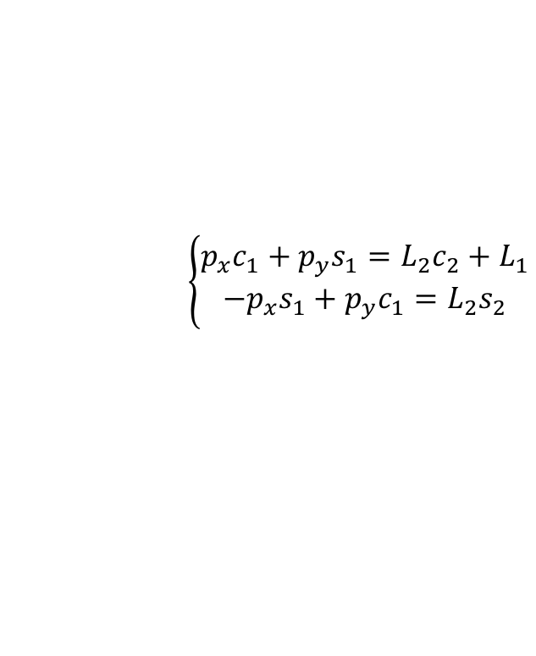
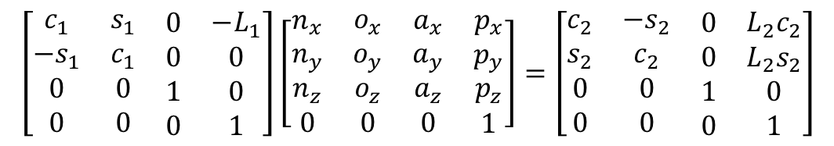
Algebraic Method
From kinematic equations, ${{}_{ }^{O}{A_{1}}}^{−1}{}_{ }^{O}{T_{2}}={}_{ }^{1}{A_{2}}$
$$\left[\begin{matrix}\begin{aligned}c_{1} \\ {−s}_{1} \\ 0 \\ 0\end{aligned} & \begin{aligned}s_{1} \\ c_{1} \\ 0 \\ 0\end{aligned} & \begin{matrix}\begin{aligned}0 \\ 0 \\ 1 \\ 0\end{aligned} & \begin{aligned}{−L}_{1} \\ 0 \\ 0 \\ 1\end{aligned}\end{matrix}\end{matrix}\right]\left[\begin{matrix}\begin{aligned}n_{x} \\ n_{y} \\ n_{z} \\ 0\end{aligned} & \begin{matrix}\begin{aligned}o_{x} \\ o_{y} \\ o_{z} \\ 0\end{aligned} & \begin{matrix}\begin{aligned}a_{x} \\ a_{y} \\ a_{z} \\ 0\end{aligned} & \begin{aligned}p_{x} \\ p_{y} \\ p_{z} \\ 1\end{aligned}\end{matrix}\end{matrix}\end{matrix}\right]=\left[\begin{matrix}\begin{aligned}c_{2} \\ s_{2} \\ 0 \\ 0\end{aligned} & \begin{aligned}−s_{2} \\ c_{2} \\ 0 \\ 0\end{aligned} & \begin{matrix}\begin{aligned}0 \\ 0 \\ 1 \\ 0\end{aligned} & \begin{aligned}L_{2}c_{2} \\ L_{2}s_{2} \\ 0 \\ 1\end{aligned}\end{matrix}\end{matrix}\right]$$
$$\left\{\begin{aligned}p_{x}c_{1}+p_{y}s_{1}=L_{2}c_{2}+L_{1} \\ {−p}_{x}s_{1}+p_{y}c_{1}=L_{2}s_{2}\end{aligned}\right.$$
Square both equations and add them.
$$\left\{\begin{aligned}p_{x}^{2}c_{1}^{2}+p_{y}^{2}s_{1}^{2}+2p_{x}p_{y}c_{1}s_{1}=L_{2}^{2}c_{2}^{2}+L_{1}^{2}+2L_{1}L_{2}c_{2} \\ p_{x}^{2}s_{1}^{2}+p_{y}^{2}c_{1}^{2}−2p_{x}p_{y}c_{1}s_{1}=L_{2}^{2}s_{2}^{2}\end{aligned}\right.$$
$$p_{x}^{2}+p_{y}^{2}=L_{2}^{2}+L_{1}^{2}+2L_{1}L_{2}c_{2} \\ ∴c_{2}=\frac{p_{x}^{2}+p_{y}^{2}−L_{2}^{2}−L_{1}^{2}}{2L_{1}L_{2}}$$

Slide 8
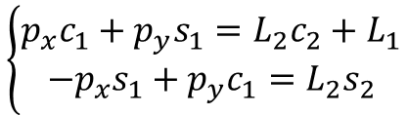
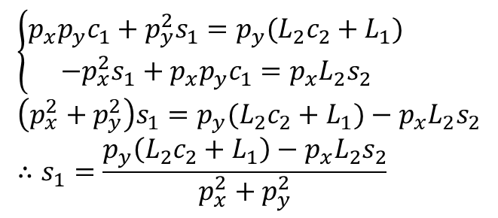


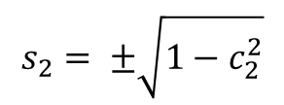

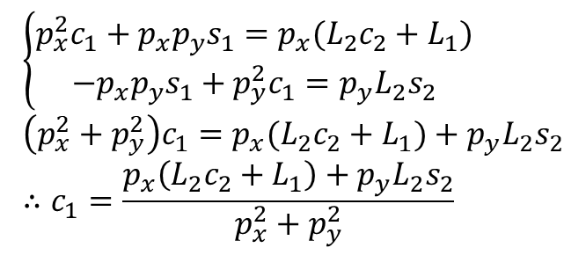
Algebraic Method
We write an expression for $s_{2}$ as
$$s_{2}= ±\sqrt{1−c_{2}^{2}}$$
$$∴θ_{2}=atan2(s_{2},c_{2})$$
The choice of $s_{2}$ signs corresponds to the multiple solution in which we can choose the ‘elbow-down’ or the ‘elbow-up’ solution.
$$\left\{\begin{aligned}p_{x}c_{1}+p_{y}s_{1}=L_{2}c_{2}+L_{1} \\ {−p}_{x}s_{1}+p_{y}c_{1}=L_{2}s_{2}\end{aligned}\right.$$
Remind these equations,
Expressions for $s_{1}$ and $c_{1}$ are obtained by solving the equations.
$$\left\{\begin{aligned}p_{x}p_{y}c_{1}+p_{y}^{2}s_{1}={p_{y}(L}_{2}c_{2}+L_{1}) \\ {−p}_{x}^{2}s_{1}+{p_{x}p}_{y}c_{1}={p_{x}L}_{2}s_{2}\end{aligned}\right. \\ \left(p_{x}^{2}+p_{y}^{2}\right)s_{1}={p_{y}(L}_{2}c_{2}+L_{1})−{p_{x}L}_{2}s_{2} \\ ∴s_{1}=\frac{p_{y}\left(L_{2}c_{2}+L_{1}\right)−p_{x}L_{2}s_{2}}{p_{x}^{2}+p_{y}^{2}}$$
$$\left\{\begin{aligned}p_{x}^{2}c_{1}+p_{x}p_{y}s_{1}={p_{x}(L}_{2}c_{2}+L_{1}) \\ −p_{x}p_{y}s_{1}+p_{y}^{2}c_{1}={p_{y}L}_{2}s_{2}\end{aligned}\right. \\ \left(p_{x}^{2}+p_{y}^{2}\right)c_{1}={p_{x}(L}_{2}c_{2}+L_{1})+{p_{y}L}_{2}s_{2} \\ ∴c_{1}=\frac{p_{x}\left(L_{2}c_{2}+L_{1}\right)+p_{y}L_{2}s_{2}}{p_{x}^{2}+p_{y}^{2}}$$
$$∴θ_{1}=atan2(s_{1},c_{1})$$

Slide 9

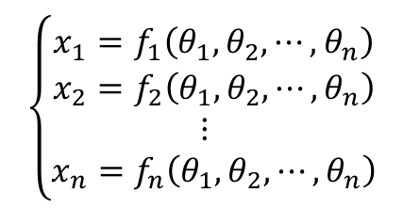
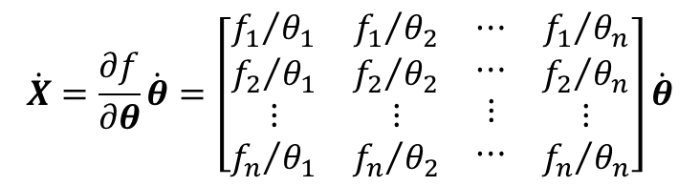


Jacobi Method
Derive the Jacobian
From kinematic equations,
$$\left\{\begin{aligned}x_{1}=f_{1}\left(θ_{1}, θ_{2}, ⋯,θ_{n}\right) \\ x_{2}=f_{2}\left(θ_{1}, θ_{2}, ⋯,θ_{n}\right) \\ ⋮ \\ x_{n}=f_{n}\left(θ_{1}, θ_{2}, ⋯,θ_{n}\right)\end{aligned}\right.$$
vector notation
$X=f(θ)$,
where $X$ is a Cartesian space vector and $θ$ is a joint space vector.
Differentiate the kinematic equations.
$$\dot{X}=\frac{∂f}{∂θ}\dot{θ}=\left[\begin{matrix}\begin{aligned}{f_{1}}/{θ_{1}} \\ {f_{2}}/{θ_{1}} \\ ⋮ \\ {f_{n}}/{θ_{1}}\end{aligned} & \begin{aligned}{f_{1}}/{θ_{2}} \\ {f_{2}}/{θ_{2}} \\ ⋮ \\ {f_{n}}/{θ_{2}}\end{aligned} & \begin{matrix}\begin{aligned}⋯ \\ ⋯ \\ ⋮ \\ ⋯\end{aligned} & \begin{aligned}{f_{1}}/{θ_{n}} \\ {f_{2}}/{θ_{n}} \\ ⋮ \\ {f_{n}}/{θ_{n}}\end{aligned}\end{matrix}\end{matrix}\right]\dot{θ}$$
Define the matrix of partial derivatives as the Jacobian, $J\left(θ\right)$.
$$∴\dot{X}=J\left(θ\right)\dot{θ}$$
If $J\left(θ\right)$ is invertible, we can calculate joint velocities given Cartesian velocities.
$$\dot{θ}=J{\left(θ\right)}^{−1}\dot{X}$$
Notes:
the partial derivative of f with respect to theta.

Slide 10
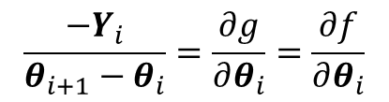







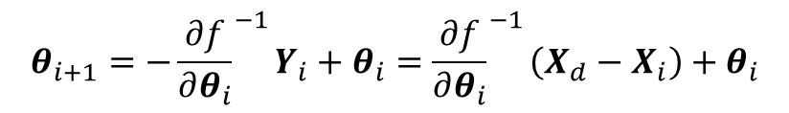


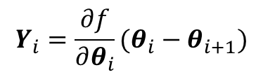

Jacobi Method
A way to find a solution of inverse kinematics
When the desired Cartesian space, $X_{d}$, the kinematic equation are rewritten as
$$X−X_{d}=f\left(θ\right)−X_{d}$$
Let $X−X_{d}=Y$ and $f\left(θ\right)−X_{d}=g\left(θ\right).$Then $Y=g\left(θ\right).$
By Newton-Rhapson method, we can find the solution (i.e. the joint angles) satisfied with $X_{d}$.
$$\frac{−Y_{i}}{θ_{i+1}−θ_{i}}=\frac{∂g}{∂θ_{i}}=\frac{∂f}{∂θ_{i}}$$
$$Y$$
$$Y_{i}$$
$$Y_{i}=\frac{∂f}{∂θ_{i}}(θ_{i}−θ_{i+1})$$
$$Y=g(θ)$$
$$\frac{∂g}{∂θ_{i}}$$
$$θ_{i+1}=−{\frac{∂f}{∂θ_{i}}}^{−1}Y_{i}+θ_{i}={\frac{∂f}{∂θ_{i}}}^{−1}\left(X_{d}−X_{i}\right)+θ_{i}$$
$$0$$
$$θ$$
$$θ_{i+1}$$
$$θ_{i}$$
$$∴θ_{i+1}={J(θ_{i})}^{−1}\left(X_{d}−X_{i}\right)+θ_{i}$$

Slide 11



Jacobi Method
A way to find a solution of inverse kinematics
When the desired Cartesian space, $X_{d}$, the kinematic equation are rewritten as
$$X−X_{d}=f\left(θ\right)−X_{d}$$
Let $X−X_{d}=Y$ and $f\left(θ\right)−X_{d}=g\left(θ\right).$Then $Y=g\left(θ\right).$
By Newton-Rhapson method, we can find the solution (i.e. the joint angles) satisfied with $X_{d}$.
$$\frac{−Y_{i}}{θ_{i+1}−θ_{i}}=\frac{∂g}{∂θ_{i}}=\frac{∂f}{∂θ_{i}}$$
$$Y$$
To remember easily, we rewrite the joint rates equation, $\dot{θ}=J{\left(θ\right)}^{−1}\dot{X}$ as
$$Y_{i}$$
$$Y_{i}=\frac{∂f}{∂θ_{i}}(θ_{i}−θ_{i+1})$$
$$\frac{Δθ}{Δt}=J{\left(θ\right)}^{−1}\frac{Δθ}{Δt}$$
$$Δθ=J{\left(θ\right)}^{−1}ΔX$$
$$Y=g(θ)$$
$$\frac{∂g}{∂θ_{i}}$$
$$θ_{i+1}=−{\frac{∂f}{∂θ_{i}}}^{−1}Y_{i}+θ_{i}={\frac{∂f}{∂θ_{i}}}^{−1}\left(X_{d}−X_{i}\right)+θ_{i}$$
$$θ_{i+1}−θ_{i}=J{\left(θ_{i}\right)}^{−1}(X_{d}−X_{i})$$
$$0$$
$$θ$$
$$θ_{i+1}$$
$$θ_{i}$$
$$∴θ_{i+1}={J(θ_{i})}^{−1}\left(X_{d}−X_{i}\right)+θ_{i}$$

Slide 12
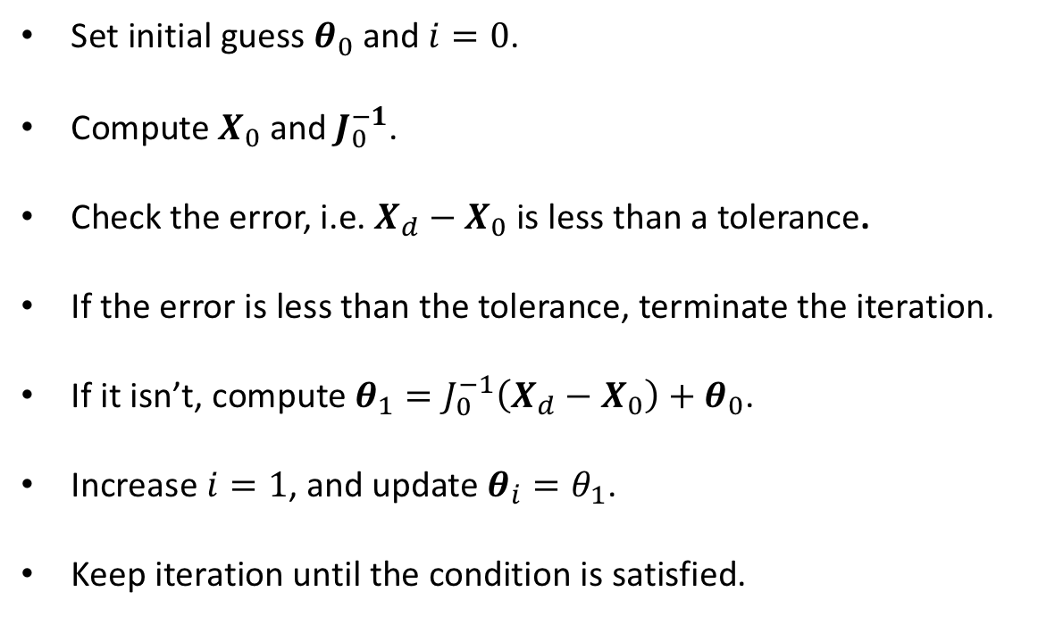
Jacobi Method
Iteration flow
Set initial guess $θ_{0}$ and $i=0$.
Compute $X_{0}$ and $J_{0}^{−1}$.
Check the error, i.e. $X_{d}−X_{0}$ is less than a tolerance.
If the error is less than the tolerance, terminate the iteration.
If it isn’t, compute $θ_{1}=J_{0}^{−1}\left(X_{d}−X_{0}\right)+θ_{0}$.
Increase $i=1$, and update $θ_{i}=θ_{1}$.
Keep iteration until the condition is satisfied.

