Slide 1
ME729 Advanced Robotics -
Forward Kinematics
2/5/2018
Sangsin Park, Ph.D.

Slide 2









Representation of Orientation
Three common methods to represent orientation
  There are a base frame and a moving frame A.
  We want to know how many rotations is the frame A made w.r.t. the base frame.
$$z_{A}$$
X-Y-Z fixed angles rotation or Roll-Pitch-Yaw rotation.
The rotation is made w.r.t. the reference frame.
$$y_{A}$$
$$z_{O}$$
Z-Y-X Euler angles rotation.
The rotation is made w.r.t. the moving frame.
$$O_{A}$$
$$p$$
body A
Z-Y-Z Euler angles rotation.
The rotation is made w.r.t. the moving frame.
$$x_{A}$$
$$y_{O}$$
$$O$$
$$x_{O}$$

Slide 3












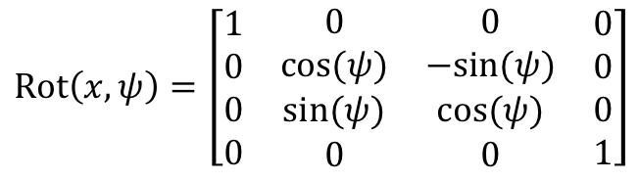














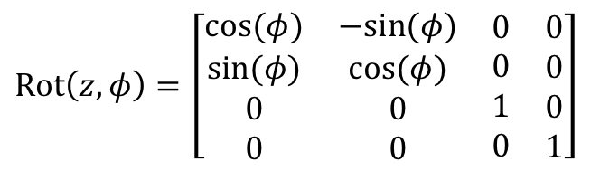








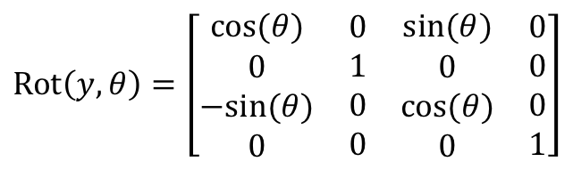
Representation of Orientation
X-Y-Z fixed angles (Roll-Pitch-Yaw) rotation
$$z′$$
$$z$$
$$z′$$
$$z$$
$$y^{′′′}$$
$$z$$
$$z′$$
$$z$$
$$z"$$
$$z^{′′′}$$
$$φ$$
$φ$, roll
$$y′$$
$$z"$$
$$y′$$
$$y′$$
$$y$$
$$y$$
$$y$$
$$y$$
$ψ$, yaw
$$θ$$
$$y"$$
$$y"$$
$θ$, pitch
$$ψ$$
$$x$$
$$x$$
$$x′$$
$$x$$
$$x′$$
$$x$$
$$x′$$
$$x^{′′′}$$
$$x"$$
$$x"$$
$$\text{Rot}\left(x,ψ\right)=\left[\begin{matrix}\begin{aligned}1 \\ 0 \\ 0 \\ 0\end{aligned} & \begin{matrix}\begin{aligned}0 \\ cos⁡(ψ) \\ sin⁡(ψ) \\ 0\end{aligned} & \begin{matrix}\begin{aligned}0 \\ −sin⁡(ψ) \\ cos⁡(ψ) \\ 0\end{aligned} & \begin{aligned}0 \\ 0 \\ 0 \\ 1\end{aligned}\end{matrix}\end{matrix}\end{matrix}\right]$$
$$\text{Rot}\left(y,θ\right)=\left[\begin{matrix}\begin{aligned}cos⁡(θ) \\ 0 \\ −sin⁡(θ) \\ 0\end{aligned} & \begin{matrix}\begin{aligned}0 \\ 1 \\ 0 \\ 0\end{aligned} & \begin{matrix}\begin{aligned}sin⁡(θ) \\ 0 \\ cos⁡(θ) \\ 0\end{aligned} & \begin{aligned}0 \\ 0 \\ 0 \\ 1\end{aligned}\end{matrix}\end{matrix}\end{matrix}\right]$$
$$\text{Rot}\left(z,φ\right)=\left[\begin{matrix}\begin{aligned}cos⁡(φ) \\ sin⁡(φ) \\ 0 \\ 0\end{aligned} & \begin{matrix}\begin{aligned}−sin⁡(φ) \\ cos⁡(φ) \\ 0 \\ 0\end{aligned} & \begin{matrix}\begin{aligned}0 \\ 0 \\ 1 \\ 0\end{aligned} & \begin{aligned}0 \\ 0 \\ 0 \\ 1\end{aligned}\end{matrix}\end{matrix}\end{matrix}\right]$$
$$∴{\text{Euler}}_{xyz}\left(φ,θ,ψ\right) or \text{RPY}\left(φ,θ,ψ\right)=\text{Rot}\left(z,φ\right)\text{Rot}\left(y,θ\right)\text{Rot} \left(x,ψ\right)=\left[\begin{matrix}\begin{aligned}n_{x} \\ n_{y} \\ n_{z}\end{aligned} & \begin{aligned}o_{x} \\ o_{y} \\ o_{z}\end{aligned} & \begin{aligned}a_{x} \\ a_{y} \\ a_{z}\end{aligned}\end{matrix}\right]$$
$$θ=atan2\left(−n_{z} , \sqrt{n_{x}^{2}+n_{y}^{2}} \right), φ=atan2\left(\frac{n_{y}}{\cos\left(θ\right)},\frac{n_{x}}{\cos\left(θ\right)}\right), ψ=atan2\left(\frac{o_{z}}{\cos\left(θ\right)},\frac{a_{z}}{\cos\left(θ\right)}\right)$$

Slide 4
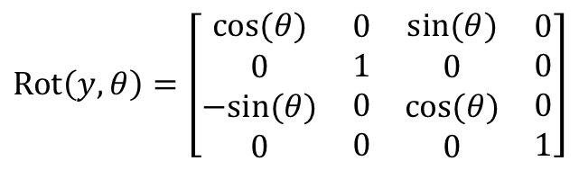






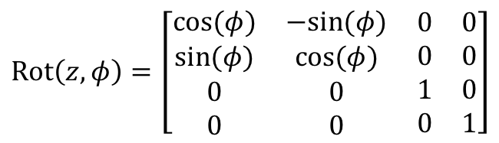
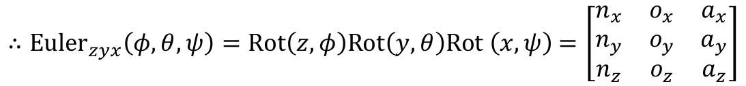










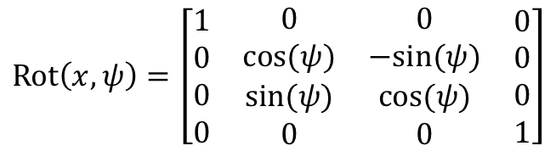




Representation of Orientation
Z-Y-X Euler angles rotation
$$z$$
$$z^{′}′$$
$$z$$
$$z$$
$$z$$
$$z^{′}$$
$$z^{′′}$$
$$z^{′}$$
$$z^{′}$$
$$z^{′}′′$$
$$y^{′}′′$$
$$φ$$
$$y^{′}$$
$$θ$$
$$y^{′}′$$
$$y^{′}$$
$$y^{′}′$$
$$y^{′}$$
$$y$$
$$y$$
$$y$$
$$y$$
$$ψ$$
$$x$$
$$x$$
$$x$$
$$x^{′}′$$
$$x$$
$$x^{′}′$$
$$x^{′′′}$$
$$x^{′}$$
$$x^{′}$$
$$x^{′}$$
$$\text{Rot}\left(z,φ\right)=\left[\begin{matrix}\begin{aligned}cos⁡(φ) \\ sin⁡(φ) \\ 0 \\ 0\end{aligned} & \begin{matrix}\begin{aligned}−sin⁡(φ) \\ cos⁡(φ) \\ 0 \\ 0\end{aligned} & \begin{matrix}\begin{aligned}0 \\ 0 \\ 1 \\ 0\end{aligned} & \begin{aligned}0 \\ 0 \\ 0 \\ 1\end{aligned}\end{matrix}\end{matrix}\end{matrix}\right]$$
$$\text{Rot}\left(y,θ\right)=\left[\begin{matrix}\begin{aligned}cos⁡(θ) \\ 0 \\ −sin⁡(θ) \\ 0\end{aligned} & \begin{matrix}\begin{aligned}0 \\ 1 \\ 0 \\ 0\end{aligned} & \begin{matrix}\begin{aligned}sin⁡(θ) \\ 0 \\ cos⁡(θ) \\ 0\end{aligned} & \begin{aligned}0 \\ 0 \\ 0 \\ 1\end{aligned}\end{matrix}\end{matrix}\end{matrix}\right]$$
$$\text{Rot}\left(x,ψ\right)=\left[\begin{matrix}\begin{aligned}1 \\ 0 \\ 0 \\ 0\end{aligned} & \begin{matrix}\begin{aligned}0 \\ cos⁡(ψ) \\ sin⁡(ψ) \\ 0\end{aligned} & \begin{matrix}\begin{aligned}0 \\ −sin⁡(ψ) \\ cos⁡(ψ) \\ 0\end{aligned} & \begin{aligned}0 \\ 0 \\ 0 \\ 1\end{aligned}\end{matrix}\end{matrix}\end{matrix}\right]$$
$∴{\text{Euler}}_{zyx}\left(φ,θ,ψ\right)=\text{Rot}\left(z,φ\right)\text{Rot}\left(y,θ\right)\text{Rot} \left(x,ψ\right)$ $=\left[\begin{matrix}\begin{aligned}n_{x} \\ n_{y} \\ n_{z}\end{aligned} & \begin{aligned}o_{x} \\ o_{y} \\ o_{z}\end{aligned} & \begin{aligned}a_{x} \\ a_{y} \\ a_{z}\end{aligned}\end{matrix}\right]$
$$θ=atan2\left(−n_{z} , \sqrt{n_{x}^{2}+n_{y}^{2}} \right), φ=atan2\left(\frac{n_{y}}{\cos\left(θ\right)},\frac{n_{x}}{\cos\left(θ\right)}\right), ψ=atan2\left(\frac{o_{z}}{\cos\left(θ\right)},\frac{a_{z}}{\cos\left(θ\right)}\right)$$

Slide 5
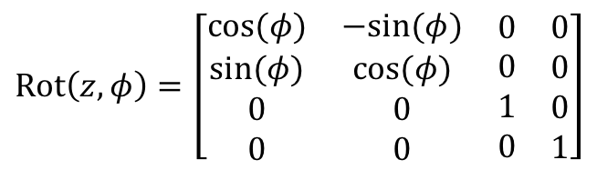



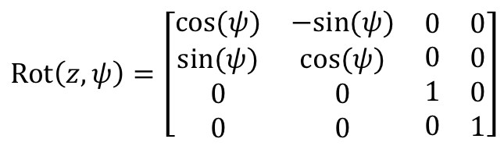


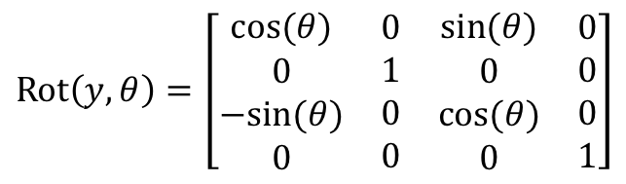














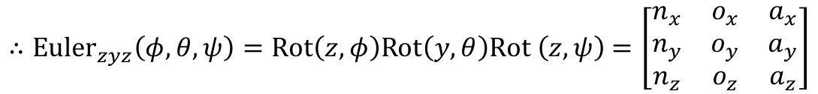




Representation of Orientation
Z-Y-Z Euler angles rotation
$$z$$
$$z^{′}$$
$$z$$
$$z^{′}$$
$$z$$
$$z$$
$$z^{′}$$
$$z^{′′}$$
$$z^{′′′}$$
$$y^{′′′}$$
$$z^{′′}$$
$$φ$$
$$y^{′}$$
$$ψ$$
$$θ$$
$$y^{′}$$
$$y^{′′}$$
$$y^{′}$$
$$y^{′′}$$
$$y$$
$$y$$
$$y$$
$$y$$
$$x$$
$$x$$
$$x^{′}$$
$$x$$
$$x$$
$$x^{′′′}$$
$$x^{′}$$
$$x^{′′}$$
$$x^{′}$$
$$x^{′′}$$
$$\text{Rot}\left(z,φ\right)=\left[\begin{matrix}\begin{aligned}cos⁡(φ) \\ sin⁡(φ) \\ 0 \\ 0\end{aligned} & \begin{matrix}\begin{aligned}−sin⁡(φ) \\ cos⁡(φ) \\ 0 \\ 0\end{aligned} & \begin{matrix}\begin{aligned}0 \\ 0 \\ 1 \\ 0\end{aligned} & \begin{aligned}0 \\ 0 \\ 0 \\ 1\end{aligned}\end{matrix}\end{matrix}\end{matrix}\right]$$
$$\text{Rot}\left(y,θ\right)=\left[\begin{matrix}\begin{aligned}cos⁡(θ) \\ 0 \\ −sin⁡(θ) \\ 0\end{aligned} & \begin{matrix}\begin{aligned}0 \\ 1 \\ 0 \\ 0\end{aligned} & \begin{matrix}\begin{aligned}sin⁡(θ) \\ 0 \\ cos⁡(θ) \\ 0\end{aligned} & \begin{aligned}0 \\ 0 \\ 0 \\ 1\end{aligned}\end{matrix}\end{matrix}\end{matrix}\right]$$
$$\text{Rot}\left(z,ψ\right)=\left[\begin{matrix}\begin{aligned}cos⁡(ψ) \\ sin⁡(ψ) \\ 0 \\ 0\end{aligned} & \begin{matrix}\begin{aligned}−sin⁡(ψ) \\ cos⁡(ψ) \\ 0 \\ 0\end{aligned} & \begin{matrix}\begin{aligned}0 \\ 0 \\ 1 \\ 0\end{aligned} & \begin{aligned}0 \\ 0 \\ 0 \\ 1\end{aligned}\end{matrix}\end{matrix}\end{matrix}\right]$$
$∴{\text{Euler}}_{zyz}\left(φ,θ,ψ\right)=\text{Rot}\left(z,φ\right)\text{Rot}\left(y,θ\right)\text{Rot} \left(z,ψ\right)$ $=\left[\begin{matrix}\begin{aligned}n_{x} \\ n_{y} \\ n_{z}\end{aligned} & \begin{aligned}o_{x} \\ o_{y} \\ o_{z}\end{aligned} & \begin{aligned}a_{x} \\ a_{y} \\ a_{z}\end{aligned}\end{matrix}\right]$
$$θ=atan2\left(\sqrt{n_{z}^{2}+o_{z}^{2}} ,a_{z}\right), φ=atan2\left(\frac{a_{y}}{\sin\left(θ\right)},\frac{a_{x}}{\sin\left(θ\right)}\right), ψ=atan2\left(\frac{o_{z}}{\sin\left(θ\right)},−\frac{n_{z}}{\sin\left(θ\right)}\right)$$

Slide 6

















































Forward Kinematics
We will affix a coordinate frame to each link of the manipulator.
Using homogeneous transformations, we can describe the relative position and orientation between these frames.
The homogeneous transformation describing the relation between one link and the next has been called an A matrix.
These products of A matrices have been called T matrices.
Kinematics of robotics is to derive the relationships between the reference frame and the end-effector’s frame.
1
2
3
1
$$x_{E}$$
2
$$x_{E}$$
3
$$z_{E}$$
$$z_{E}$$
$$x_{E}$$
$$z_{n−2}$$
$$z_{n−1}$$
$$E$$
$$z_{n−2}$$
$$z_{n−1}$$
$$E$$
$$z_{E}$$
$$z_{O}$$
$$z_{O}$$
$$z_{1}$$
$$z_{2}$$
$$y_{E}$$
$$z_{O}$$
$$z_{1}$$
$$z_{2}$$
$$y_{E}$$
$$E$$
$$⋯$$
$$⋯$$
$$y_{E}$$
$$x_{n−2}$$
$$x_{n−1}$$
$$x_{n−2}$$
$$x_{n−1}$$
$$⋯$$
$$x_{1}$$
$$x_{2}$$
$$x_{1}$$
$$x_{2}$$
$$⋯$$
$$y_{O}$$
$${{}_{ }^{n−1}A}_{E}$$
$$O$$
$$y_{O}$$
$$y_{O}$$
$$O$$
$$O$$
$${{}_{ }^{1}A}_{2}$$
$${{}_{ }^{n−2}A}_{n−1}$$
$${{}_{ }^{O}A}_{1}$$
$$x_{O}$$
$$x_{O}$$
An n degree of freedom manipulator
$$x_{O}$$
$$T_{E}={{}_{ }^{O}A}_{1}{{}_{ }^{1}A}_{2} ⋯ {{}_{ }^{n−2}A}_{n−1}{{}_{ }^{n−1}A}_{E}$$
$$T_{E}={{}_{ }^{O}A}_{1}{{}_{ }^{1}A}_{2} ⋯ {{}_{ }^{n−2}A}_{n−1}{{}_{ }^{n−1}A}_{E}$$
$$∴{T_{E}={}_{ }^{O}A}_{E}$$

Slide 7

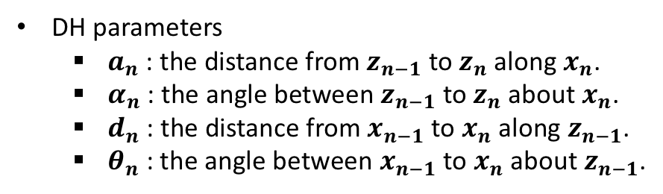










Standard Denavit-Hartenberg Notation
How to affix the coordinate frame
The origin of the coordinate frame of link n is set to be at the intersection of the common normal between the axes of joints n and n+1 and the axis of joint n+1.
The z axis for link n will be aligned with the axis of joint n+1.
The x axis for link n will be directed along the normal between the axes of joints n and n+1.
Joint n
$$θ_{n}$$
Joint n+1
Link n
$$θ_{n+1}$$
Joint n-1
…
$$θ_{n−1}$$
Link n-1
DH parameters
  $a_{n}$ : the distance from $z_{n−1}$ to $z_{n}$ along $x_{n}$.
  $α_{n}$ : the angle between $z_{n−1}$ to $z_{n}$ about $x_{n}$.
  $d_{n}$ : the distance from $x_{n−1}$ to $x_{n}$ along $z_{n−1}$.
  $θ_{n}$ : the angle between $x_{n−1}$ to $x_{n}$ about $z_{n−1}$.
$$α_{n}$$
$$z_{n}$$
$$a_{n}$$
…
$$x_{n}$$
$$z_{n−1}$$
$$d_{n}$$
$$x_{n−1}$$
$$θ_{n}$$

Slide 8
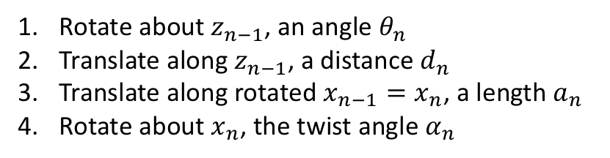
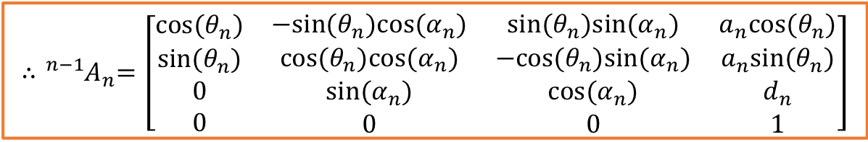
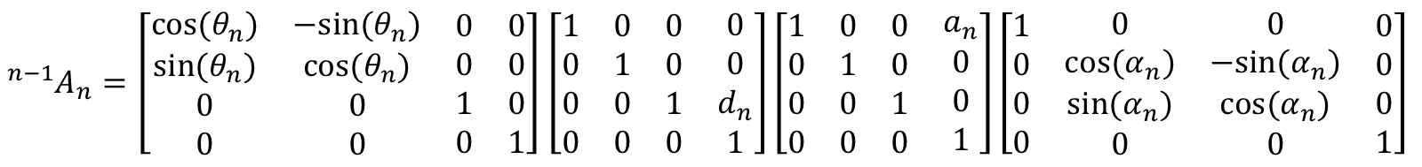
Standard Denavit-Hartenberg Notation
How to derive an A matrix
  We can establish an A matrix between successive frame n-1, n by the following rotations and translations.
Rotate about $z_{n−1}$, an angle $θ_{n}$
Translate along $z_{n−1}$, a distance $d_{n}$
Translate along rotated $x_{n−1}=x_{n}$, a length $a_{n}$
Rotate about $x_{n}$, the twist angle $α_{n}$
$${{}_{ }^{n−1}A}_{n}=Rot(z,θ_{n})Trans\left(0,0,d_{n}\right)Trans\left(a_{n},0,0\right)Rot(x,α_{n})$$
Relative transformation
${{}_{ }^{n−1}A}_{n}=\left[\begin{matrix}\begin{aligned}cos⁡(θ_{n}) \\ sin⁡(θ_{n}) \\ 0 \\ 0\end{aligned} & \begin{matrix}\begin{aligned}−sin⁡(θ_{n}) \\ cos⁡(θ_{n}) \\ 0 \\ 0\end{aligned} & \begin{matrix}\begin{aligned}0 \\ 0 \\ 1 \\ 0\end{aligned} & \begin{aligned}0 \\ 0 \\ 0 \\ 1\end{aligned}\end{matrix}\end{matrix}\end{matrix}\right]$ $\left[\begin{matrix}\begin{aligned}1 \\ 0 \\ 0 \\ 0\end{aligned} & \begin{matrix}\begin{aligned}0 \\ 1 \\ 0 \\ 0\end{aligned} & \begin{matrix}\begin{aligned}0 \\ 0 \\ 1 \\ 0\end{aligned} & \begin{aligned}0 \\ 0 \\ d_{n} \\ 1\end{aligned}\end{matrix}\end{matrix}\end{matrix}\right]\left[\begin{matrix}\begin{aligned}1 \\ 0 \\ 0 \\ 0\end{aligned} & \begin{matrix}\begin{aligned}0 \\ 1 \\ 0 \\ 0\end{aligned} & \begin{matrix}\begin{aligned}0 \\ 0 \\ 1 \\ 0\end{aligned} & \begin{aligned}a_{n} \\ 0 \\ 0 \\ 1\end{aligned}\end{matrix}\end{matrix}\end{matrix}\right]\left[\begin{matrix}\begin{aligned}1 \\ 0 \\ 0 \\ 0\end{aligned} & \begin{matrix}\begin{aligned}0 \\ cos⁡(α_{n}) \\ sin⁡(α_{n}) \\ 0\end{aligned} & \begin{matrix}\begin{aligned}0 \\ −sin⁡(α_{n}) \\ cos⁡(α_{n}) \\ 0\end{aligned} & \begin{aligned}0 \\ 0 \\ 0 \\ 1\end{aligned}\end{matrix}\end{matrix}\end{matrix}\right]$
$${∴{}_{ }^{n−1}A}_{n}=\left[\begin{matrix}\begin{aligned}cos⁡(θ_{n}) \\ sin⁡(θ_{n}) \\ 0 \\ 0\end{aligned} & \begin{matrix}\begin{aligned}−sin⁡(θ_{n})cos⁡(α_{n}) \\ cos⁡(θ_{n})cos⁡(α_{n}) \\ sin⁡(α_{n}) \\ 0\end{aligned} & \begin{matrix}\begin{aligned}sin⁡(θ_{n})sin⁡(α_{n}) \\ −cos⁡(θ_{n})sin⁡(α_{n}) \\ cos⁡(α_{n}) \\ 0\end{aligned} & \begin{aligned}a_{n}cos⁡(θ_{n}) \\ a_{n}sin⁡(θ_{n}) \\ d_{n} \\ 1\end{aligned}\end{matrix}\end{matrix}\end{matrix}\right]$$

Slide 9








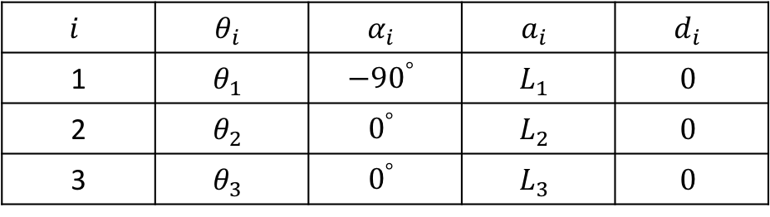













Standard Denavit-Hartenberg Notation
DH parameters table for a 3-DOF manipulator
$$z_{O}$$
$$L_{1}$$
$$L_{2}$$
$$L_{3}$$
$$i$$ | $$θ_{i}$$ | $$α_{i}$$ | $$a_{i}$$ | $$d_{i}$$
1 | $$θ_{1}$$ | $${−90}^{°}$$ | $$L_{1}$$ | $$0$$
2 | $$θ_{2}$$ | $$0^{°}$$ | $$L_{2}$$ | $$0$$
3 | $$θ_{3}$$ | $$0^{°}$$ | $$L_{3}$$ | $$0$$
$$θ_{1}$$
$$y_{O}$$
$$θ_{2}$$
$$θ_{3}$$
$$z_{1}$$
$$z_{2}$$
$$z_{3}$$
$$O$$
$$x_{O}$$
$$x_{1}$$
$$x_{2}$$
$$x_{3}$$
$$y_{3}$$
?
?
?
$${}_{ }^{O}{A_{1}}=\left[\begin{matrix}\begin{aligned}c_{1} \\ s_{1} \\ 0 \\ 0\end{aligned} & \begin{aligned}0 \\ 0 \\ −1 \\ 0\end{aligned} & \begin{matrix}\begin{aligned}−s_{1} \\ c_{1} \\ 0 \\ 0\end{aligned} & \begin{aligned}L_{1}c_{1} \\ L_{1}s_{1} \\ 0 \\ 1\end{aligned}\end{matrix}\end{matrix}\right]$$
$${}_{ }^{1}{A_{2}}=\left[\begin{matrix}\begin{aligned}c_{2} \\ s_{2} \\ 0 \\ 0\end{aligned} & \begin{aligned}−s_{2} \\ c_{2} \\ 0 \\ 0\end{aligned} & \begin{matrix}\begin{aligned}0 \\ 0 \\ 1 \\ 0\end{aligned} & \begin{aligned}L_{2}c_{2} \\ L_{2}s_{2} \\ 0 \\ 1\end{aligned}\end{matrix}\end{matrix}\right]$$
$${}_{ }^{2}{A_{3}}=\left[\begin{matrix}\begin{aligned}c_{3} \\ s_{3} \\ 0 \\ 0\end{aligned} & \begin{aligned}−s_{3} \\ c_{3} \\ 0 \\ 0\end{aligned} & \begin{matrix}\begin{aligned}0 \\ 0 \\ 1 \\ 0\end{aligned} & \begin{aligned}L_{3}c_{3} \\ L_{3}s_{3} \\ 0 \\ 1\end{aligned}\end{matrix}\end{matrix}\right]$$
$∴{}_{ }^{O}{T_{3}}={}_{ }^{O}{A_{1}}$ ${}_{ }^{1}{A_{2}}$ ${}_{ }^{2}{A_{3}}$

Slide 10
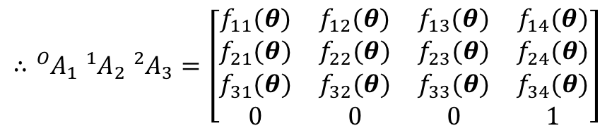

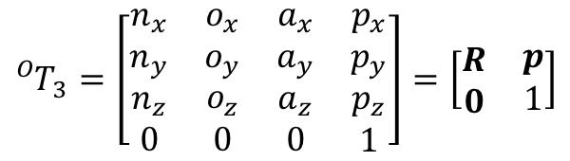


Standard Denavit-Hartenberg Notation
Forward kinematics for a 3-DOF manipulator
  Set the left-hand side of ${}_{ }^{O}{T_{3}}={}_{ }^{O}{A_{1}}$ ${}_{ }^{1}{A_{2}}$ ${}_{ }^{2}{A_{3}}$ as the following.
  The result of products of A matrices (i.e. the right-hand side of ${}_{ }^{O}{T_{3}}={}_{ }^{O}{A_{1}}$ ${}_{ }^{1}{A_{2}}$ ${}_{ }^{2}{A_{3}}$)
  Therefore, the position and orientation of the manipulator is represented by the position vector and the rotation matrix.
$${}_{ }^{O}{T_{3}}=\left[\begin{matrix}\begin{aligned}n_{x} \\ n_{y} \\ n_{z} \\ 0\end{aligned} & \begin{matrix}\begin{aligned}o_{x} \\ o_{y} \\ o_{z} \\ 0\end{aligned} & \begin{matrix}\begin{aligned}a_{x} \\ a_{y} \\ a_{z} \\ 0\end{aligned} & \begin{aligned}p_{x} \\ p_{y} \\ p_{z} \\ 1\end{aligned}\end{matrix}\end{matrix}\end{matrix}\right]=\left[\begin{matrix}\begin{aligned}R \\ 0\end{aligned} & \begin{aligned}p \\ 1\end{aligned}\end{matrix}\right]$$
$$∴{}_{ }^{O}{A_{1}} {}_{ }^{1}{A_{2}} {}_{ }^{2}{A_{3}}=\left[\begin{matrix}\begin{aligned}f_{11}(θ) \\ f_{21}(θ) \\ f_{31}(θ) \\ 0\end{aligned} & \begin{matrix}\begin{aligned}f_{12}(θ) \\ f_{22}(θ) \\ f_{32}(θ) \\ 0\end{aligned} & \begin{matrix}\begin{aligned}f_{13}(θ) \\ f_{23}(θ) \\ f_{33}(θ) \\ 0\end{aligned} & \begin{aligned}f_{14}(θ) \\ f_{24}(θ) \\ f_{34}(θ) \\ 1\end{aligned}\end{matrix}\end{matrix}\end{matrix}\right]$$
The rotation matrix = $R$
The position vector = $p$

Slide 11

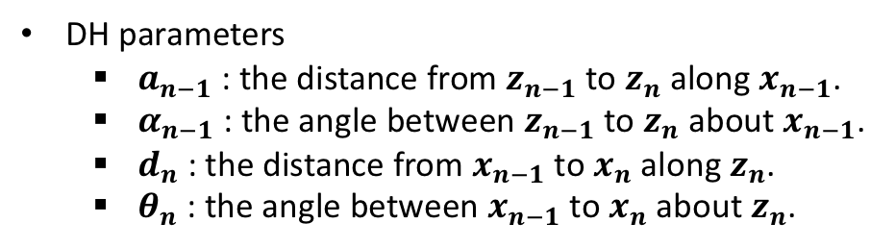










Modified Denavit-Hartenberg Notation
How to affix the coordinate frame
The origin of the coordinate frame of link n is set to be at the intersection of the common normal between the axes of joints n-1 and n and the axis of joint n.
The z axis for link n will be aligned with the axis of joint n.
The x axis for link n will be directed along the normal between the axes of joints n-1 and n.
Joint n
$$θ_{n}$$
Joint n+1
Link n
$$θ_{n+1}$$
Joint n-1
…
$$θ_{n−1}$$
Link n-1
DH parameters
  $a_{n−1}$ : the distance from $z_{n−1}$ to $z_{n}$ along $x_{n−1}$.
  $α_{n−1}$ : the angle between $z_{n−1}$ to $z_{n}$ about $x_{n−1}$.
  $d_{n}$ : the distance from $x_{n−1}$ to $x_{n}$ along $z_{n}$.
  $θ_{n}$ : the angle between $x_{n−1}$ to $x_{n}$ about $z_{n}$.
$$z_{n}$$
…
$$x_{n}$$
$$α_{n−1}$$
$$d_{n}$$
$$z_{n−1}$$
$$x_{n−1}$$
$$θ_{n}$$
$$a_{n−1}$$

Slide 12
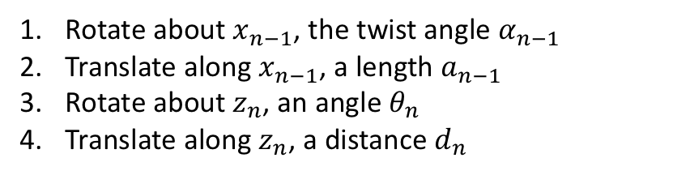
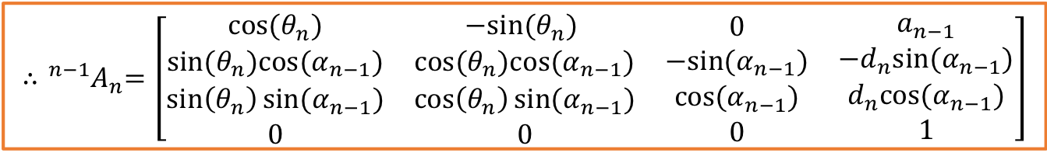
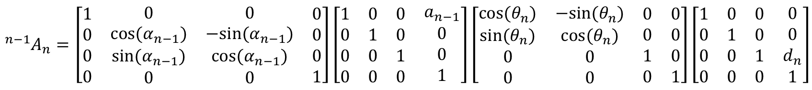
Modified Denavit-Hartenberg Notation
How to derive an A matrix
  We can establish an A matrix between successive frame n-1, n by the following rotations and translations.
Rotate about $x_{n−1}$, the twist angle $α_{n−1}$
Translate along $x_{n−1}$, a length $a_{n−1}$
Rotate about $z_{n}$, an angle $θ_{n}$
Translate along $z_{n}$, a distance $d_{n}$
$${{}_{ }^{n−1}A}_{n}=Rot(x,α_{n−1}) Trans\left(a_{n−1},0,0\right)Rot(z,θ_{n})Trans\left(0,0,d_{n}\right)$$
Relative transformation
$${{}_{ }^{n−1}A}_{n}=\left[\begin{matrix}\begin{aligned}1 \\ 0 \\ 0 \\ 0\end{aligned} & \begin{matrix}\begin{aligned}0 \\ cos⁡(α_{n−1}) \\ sin⁡(α_{n−1}) \\ 0\end{aligned} & \begin{matrix}\begin{aligned}0 \\ −sin⁡(α_{n−1}) \\ cos⁡(α_{n−1}) \\ 0\end{aligned} & \begin{aligned}0 \\ 0 \\ 0 \\ 1\end{aligned}\end{matrix}\end{matrix}\end{matrix}\right]\left[\begin{matrix}\begin{aligned}1 \\ 0 \\ 0 \\ 0\end{aligned} & \begin{matrix}\begin{aligned}0 \\ 1 \\ 0 \\ 0\end{aligned} & \begin{matrix}\begin{aligned}0 \\ 0 \\ 1 \\ 0\end{aligned} & \begin{aligned}a_{n−1} \\ 0 \\ 0 \\ 1\end{aligned}\end{matrix}\end{matrix}\end{matrix}\right]\left[\begin{matrix}\begin{aligned}cos⁡(θ_{n}) \\ sin⁡(θ_{n}) \\ 0 \\ 0\end{aligned} & \begin{matrix}\begin{aligned}−sin⁡(θ_{n}) \\ cos⁡(θ_{n}) \\ 0 \\ 0\end{aligned} & \begin{matrix}\begin{aligned}0 \\ 0 \\ 1 \\ 0\end{aligned} & \begin{aligned}0 \\ 0 \\ 0 \\ 1\end{aligned}\end{matrix}\end{matrix}\end{matrix}\right]\left[\begin{matrix}\begin{aligned}1 \\ 0 \\ 0 \\ 0\end{aligned} & \begin{matrix}\begin{aligned}0 \\ 1 \\ 0 \\ 0\end{aligned} & \begin{matrix}\begin{aligned}0 \\ 0 \\ 1 \\ 0\end{aligned} & \begin{aligned}0 \\ 0 \\ d_{n} \\ 1\end{aligned}\end{matrix}\end{matrix}\end{matrix}\right]$$
$${∴{}_{ }^{n−1}A}_{n}=\left[\begin{matrix}\begin{aligned}cos⁡(θ_{n}) \\ sin⁡(θ_{n})cos⁡(α_{n−1}) \\ \sin\left(θ_{n}\right)sin⁡(α_{n−1}) \\ 0\end{aligned} & \begin{matrix}\begin{aligned}−sin⁡(θ_{n}) \\ cos⁡(θ_{n})cos⁡(α_{n−1}) \\ \cos\left(θ_{n}\right)sin⁡(α_{n−1}) \\ 0\end{aligned} & \begin{matrix}\begin{aligned}0 \\ −sin⁡(α_{n−1}) \\ cos⁡(α_{n−1}) \\ 0\end{aligned} & \begin{aligned}a_{n−1} \\ −d_{n}sin⁡(α_{n−1}) \\ d_{n}cos⁡(α_{n−1}) \\ 1\end{aligned}\end{matrix}\end{matrix}\end{matrix}\right]$$

Slide 13










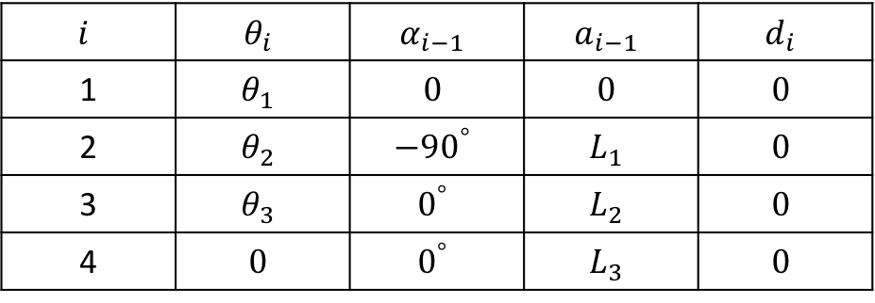














Modified Denavit-Hartenberg Notation
DH parameters table for a 3-DOF manipulator
$$i$$ | $$θ_{i}$$ | $$α_{i−1}$$ | $$a_{i−1}$$ | $$d_{i}$$
1 | $$θ_{1}$$ | $$0$$ | $$0$$ | $$0$$
2 | $$θ_{2}$$ | $${−90}^{°}$$ | $$L_{1}$$ | $$0$$
3 | $$θ_{3}$$ | $$0^{°}$$ | $$L_{2}$$ | $$0$$
4 | $$0$$ | $$0^{°}$$ | $$L_{3}$$ | $$0$$
$$z_{O}$$
$$z_{1}$$
$$L_{1}$$
$$L_{2}$$
$$L_{3}$$
$$θ_{1}$$
$$y_{O}$$
$$θ_{2}$$
$$θ_{3}$$
$$x_{1}$$
$$z_{2}$$
$$z_{3}$$
$$z_{4}$$
$$O$$
$$x_{O}$$
$$x_{2}$$
$$x_{3}$$
$$x_{4}$$
$$y_{4}$$
?
?
?
?
$${}_{ }^{O}{A_{1}}=\left[\begin{matrix}\begin{aligned}c_{1} \\ s_{1} \\ 0 \\ 0\end{aligned} & \begin{aligned}−s_{1} \\ c_{1} \\ 0 \\ 0\end{aligned} & \begin{matrix}\begin{aligned}0 \\ 0 \\ 1 \\ 0\end{aligned} & \begin{aligned}0 \\ 0 \\ 0 \\ 1\end{aligned}\end{matrix}\end{matrix}\right]$$
$${}_{ }^{1}{A_{2}}=\left[\begin{matrix}\begin{aligned}c_{2} \\ 0 \\ −s_{2} \\ 0\end{aligned} & \begin{aligned}−s_{2} \\ 0 \\ −c_{2} \\ 0\end{aligned} & \begin{matrix}\begin{aligned}0 \\ 1 \\ 0 \\ 0\end{aligned} & \begin{aligned}L_{1} \\ 0 \\ 0 \\ 1\end{aligned}\end{matrix}\end{matrix}\right]$$
$${}_{ }^{2}{A_{3}}=\left[\begin{matrix}\begin{aligned}c_{3} \\ s_{3} \\ 0 \\ 0\end{aligned} & \begin{aligned}−s_{3} \\ c_{3} \\ 0 \\ 0\end{aligned} & \begin{matrix}\begin{aligned}0 \\ 0 \\ 1 \\ 0\end{aligned} & \begin{aligned}L_{2} \\ 0 \\ 0 \\ 1\end{aligned}\end{matrix}\end{matrix}\right]$$
$${}_{ }^{3}{A_{4}}=\left[\begin{matrix}\begin{aligned}1 \\ 0 \\ 0 \\ 0\end{aligned} & \begin{aligned}0 \\ 1 \\ 0 \\ 0\end{aligned} & \begin{matrix}\begin{aligned}0 \\ 0 \\ 1 \\ 0\end{aligned} & \begin{aligned}L_{3} \\ 0 \\ 0 \\ 1\end{aligned}\end{matrix}\end{matrix}\right]$$
$∴{}_{ }^{O}{T_{4}}={}_{ }^{O}{A_{1}}$ ${}_{ }^{1}{A_{2}}$ ${}_{ }^{2}{A_{3}}{}_{ }^{3}{A_{4}}$

Slide 14

Appx. - Denavit-Hartenberg Notation
Video clip to help understand Denavit-Hartenberg (DH) notation
  https://youtu.be/rA9tm0gTln8 : A ‘r’ parameter in the video is same as an ‘a’ parameter in this note.

